Slide 1
Coronavirus Disease 2019: Ocular Manifestations
Harpal S. Sandhu, MD, FRCSC
Retina Northwest
Clinical Professor
Casey Eye Institute
Department of Ophthalmology
Oregon Health and Science University
Adjunct Professor of Bioengineering
University of Louisville

Slide 2
Goals
Review the range of ocular findings associated with COVID-19
Discuss mechanisms of disease and strength of the relationship of each finding with COVID-19
Briefly cover ocular diseases temporally associated with the COVID-19 vaccines

Slide 3
Ocular Manifestations by Anatomy
Ocular Surface
Anterior Segment
Posterior Segment
Neuro-ophthalmic
  Optic nerve and visual pathway
  Cranial nerves

Slide 4
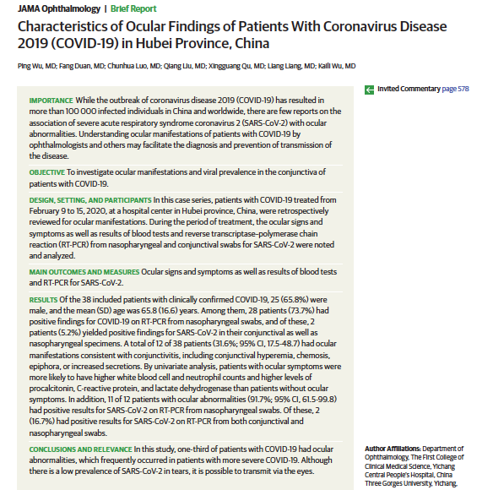
Ocular Surface
Of 38 COVID+ patients, 1/3 had signs of ocular surface involvement: conjunctival hyperemia, chemosis, tearing, increased secretions
But only 5% were + from the conjunctiva for SARS-CoV-2
In a systematic review of 20 case series (2228 patients), 3% of those undergoing conj PCR were +, and 1% of patients had an eye complaint as presenting symptom
Conjunctivitis tends to occur early in the course of infection, though it can occur midway. Multiple reports now of keratoconjunctivitis with SEIs
Reports of +Virus on the conj in patients without conj injection or eye complaints
Overall, frequent non-specific ocular surface involvement, but true conjunctivitis less common

Slide 5
Conjunctivitis + Anterior Uveitis
Single case of 30yo woman in Northern Italy who presented with 2 weeks of +FBS and tearing OU + chills and fever followed by a decrease in vision
Exam: acute follicular conjunctivitis, +AC flare, and anterior capsule ”inflammatory precipitates”

Slide 6
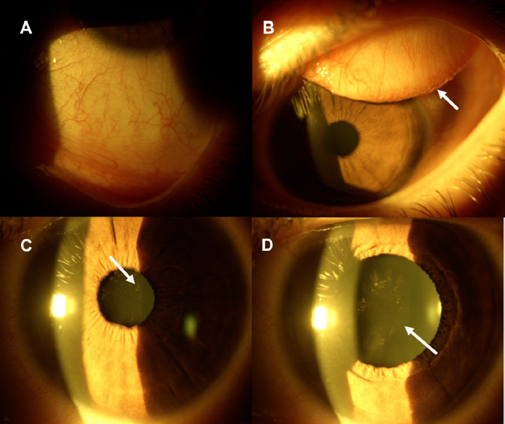
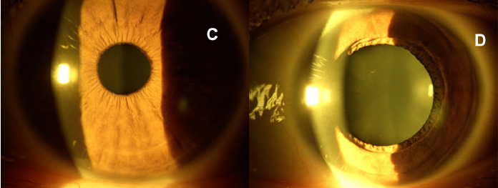
Weaknesses of this association
  No PCR performed on the aqueous humor
  No AC cell or KP
  Few cases
If ant capsule lesions = inflamm cells, was this intracameral virus or a sterile immune response?
4 weeks of topical chloramphenicol 0.5% + betamethasone 0.2%

Slide 7
Anterior Uveitis in MISC
MISC = multisystem inflammatory syndromes in children, caused by COVID-19
Similar but not identical to Kawasaki’s disease, which classically can have eye involvement
There have now been several cases reported of anterior uveitis in MISC
Given the similarities between Kawasaki’s and MISC, and common eye involvement in Kawasaki’s, it seems probable that this is truly caused by the virus

Slide 8
Posterior Segment
Findings fall into two broad categories:
Vascular diseases
  Retinal vein occlusions
  Acute macular neuroretinopathy (AMN)- or Paracentral acute middle maculopathy (PAMM)-like findings
  Non-specific microvascular findings
Autoimmune diseases
  Posterior or panuveitis syndromes soon around the time of COVID infection

Slide 9
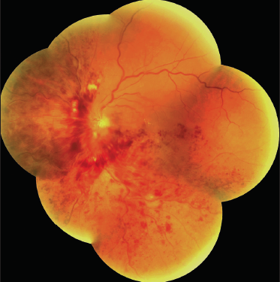
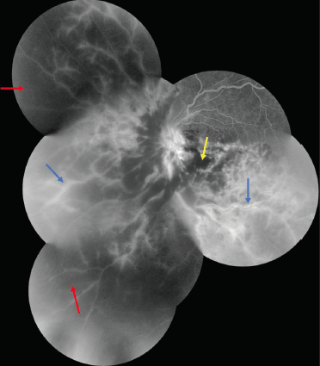
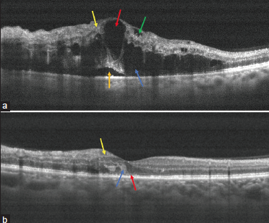
Retinal Vein Occlusion
A small number reports of RVOs in young, otherwise healthy patients with COVID
Treated with ranibizumab
+
Prednisone PO
Authors argued that this represented an occlusive retinal vasculitis
Possible but optic disc leakge, vascular staining are all c/w a typical RVO
Venous occlusions are well established complication of COVID due to hypercoagulability and endothelial dysfunction

Slide 10
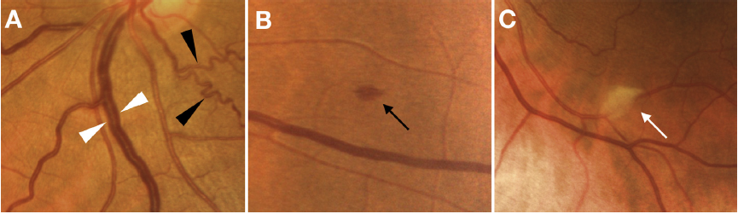
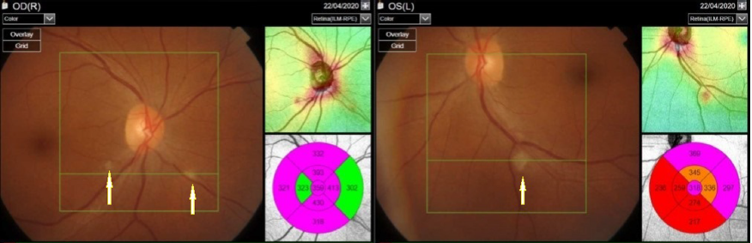
Non-specific Retinopathy
Milan study: DFEs and photos in 54 patients with COVID in the last month (not requiring ICU) vs 133 controls
  7.5% with cotton wool spots
  9% with retinal hemorrhages
  13% with tortuous vessels
  28% with dilated veins
Two Comments
Mild, not visually significant
Symptomatic COVID patients are not the same as unexposed patients!
  Significantly higher rates of HTN and diabetes in symptomatic patients
  Are we just seeing hypertensive retinopathy/DR? To what extent is this something more?

Slide 11
Acute Macular Neuroretinopathy and Paracentral Acute Middle Maculopathy
Scattered case reports of acute macular neuroretinopathy (AMN) or paracentral acute middle maculopathy (PAMM) in patients after COVID infection
These are essentially very small branch arteriolar occlusions causing small scotomas
Risk factors include female gender, oral contraceptive pills, vasoconstrictors (ephedrine, pseudoephedrine), low blood pressure, pre-eclampsia, sickle cell disease

Slide 12
Case Report: AMN and PAMM
53-year-old with a history of traumatic glaucoma OD (NLP OD) and splenectomy after car accident complains of decreased vision OS 8 days after having contact with a COVID-19+ friend
VA 20/60 OS

Slide 13
OCT shows lesions similar to both PAMM and AMN
1 week later, develops chest pain with inspiration -> CT scan shows pneumonia c/w COVID
3 weeks later, recovered from COVID and VA 20/30
At last follow up, still some ellipsoid abnormalities on OCT

Slide 14
Posterior Uveitis
Several cases of uveitis involving the posterior segment around of the time of COVID-19

Slide 15
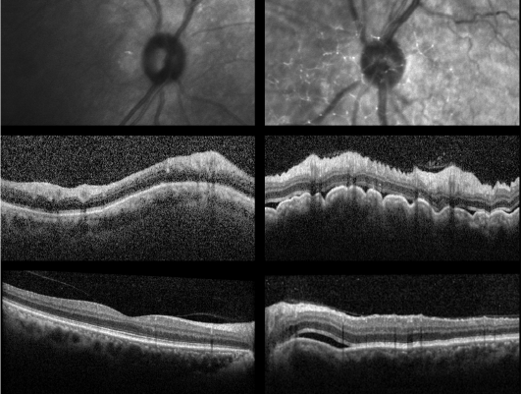
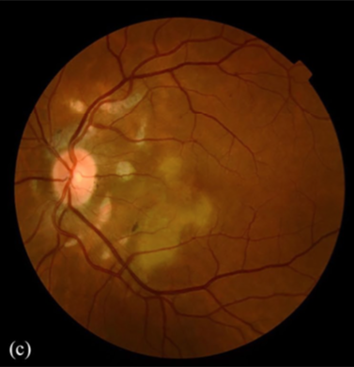
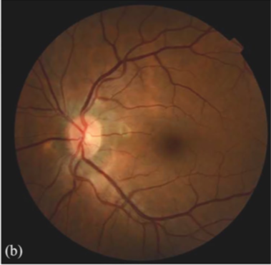
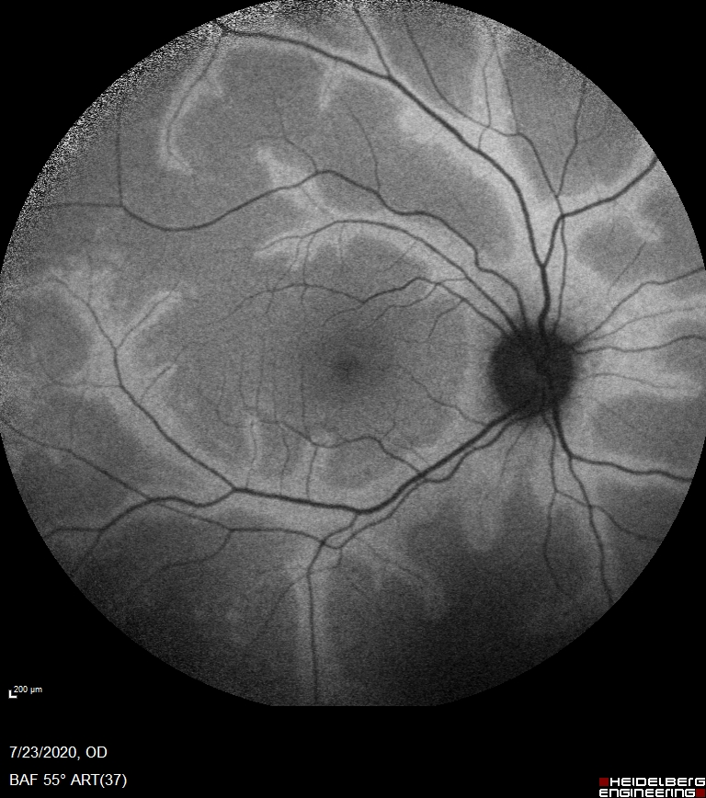
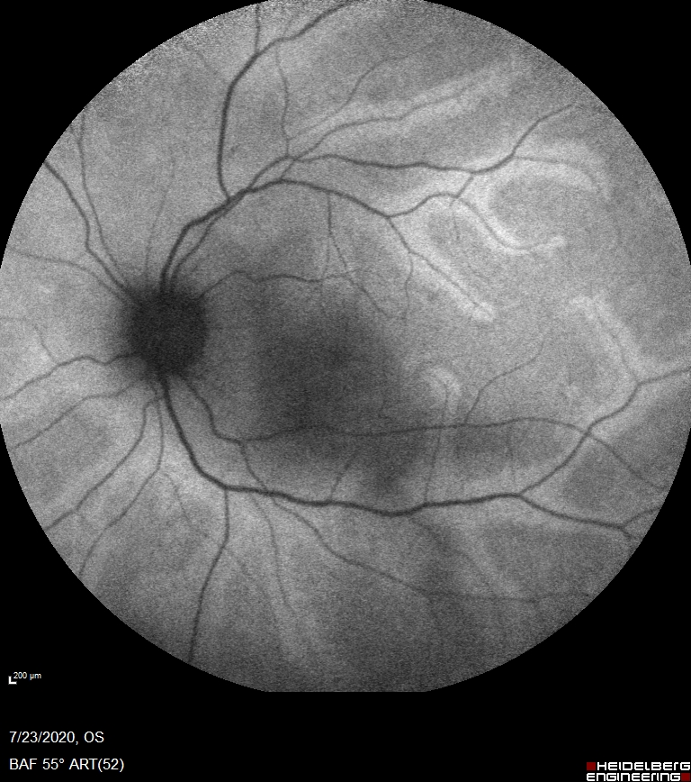
60 yo F c/o conjunctivitis OS
VA drops to 20/200 OS, 3+ AC cell, +vit cell, started on prednisone 60 mg
10 days
New dyspnea, cough, COVID+
10 days
2 weeks
AC tap for PCR, negative
36 yo F with old peripapillary lesions OS in 2016
2020
1 month
Dx serpiginous, started on prednisone + methotrexate, improves
Mild COVID infection
New floaters and mild decrease in VA OU
Dx: Frosted branch angiitis
16 yo F with mild COVID infection
1 month
3 months

Slide 16
What’s Wrong with These Cases?
No +COVID recovered from intraocular samples
Patient developed COVID after being on high-dose systemic steroids
This is a true pandemic. >10% of the US has now been infected. Is every medical finding we see within a few months of COVID+ related to infection? Whatever happened to “true, true, unrelated”?

Slide 17
Optic Neuritis
A few reports of patients developing optic neuritis s/p COVID infection
  At least 3 reports of developing anti-myelin oligodendrocyte glycoprotein (MOG) antibody-related disease, a rare form of optic neuritis
  At least 1 patient developed ”idiopathic” ON while hospitalized for COVID
More questions than answers for this set of diseases
  Could just be chance association
  Other COVID patients have developed auto-antibodies to other self-antigens in the wake of infection: anti-nuclear antibodies, anti-phospholipid antibodies
  If a causal relationship, is this direct viral infection of neural tissue or an autoimmune response? Animal models of CoV show a neural tropism
Management in cases of acute COVID-19 infection: consider dexamethasone treatment rather than methylprednisolone (based on RECOVERY Trial)

Slide 18
Other Visual Pathway Disease
Cerebral venous sinus thrombosis
  COVID-related hypercoagulability -> thromboembolic disease -> venous sinus thrombosis -> intracranial hypertension -> papilledema and a pseudotumor cerebri-like presentation
Posterior Reversible Encephalopathy Syndrome (PRES)
Acute ischemic stroke -> homonymous visual field defects

Slide 19
Cranial Neuropathies
CMF-variant Guillain Barre Syndrome
  GBS very rare but well established complication of influenza and the influenza vaccine
  Autoimmune inflammation of the peripheral nerves resulting in loss of motor function, CMF-variant involves primarily the head
Ocular myasthenia gravis

Slide 20
 | Probability | Mechanism
Ocular Surface
Conjunctivitis | Definite | Direct infection
Keratoconjunctivitis | Definite | Direct infection
Anterior Segment
Anterior Uveitis (+ conjunctivitis) | Probable | Autoimmune, ?infectious
Posterior Segment
RVO | Highly probable | Vascular
Non-specific retinopathy/microangiopathy | Possible | Vascular
Acute macular neuroretinopathy | Probable | Vascular
Vasculitis | Possible | Autoimmune
Unilateral VKH-like | Possible | Autoimmune, ?infectious
Serpiginous (?recurrence) | Possible | Autoimmune
Neuro-Ophthalmic
CMF-variant GBS | Probable | Autoimmune
Optic neuritis | Possible | Autoimmune, ?infectious
MOG optic neuritis | Possible | Autoimmune
Myasthenia gravis | Possible | Autoimmune
PRES | Possible | Vascular
Venous sinous thrombosis-> ICH | Highly Probable | Vascular
Ischemic stroke -> homonymous defects | Definite | Vascular
Other
Exposure keratopathy in ICU |  | Iatrogenic
Orbital compartment syndrome from proning |  | Iatrogenic
Endogenous endophthalmitis | Possible | Secondary infection
3 Mechanisms of Disease
Direct infection
Vascular
Autoimmune

Slide 21
Adverse Effects of the COVID Vaccines
Adverse effects (AEs) of the COVID vaccines (Pfizer, Moderna, AstraZeneca, Johnson and Johnson) are of concern to the whole population
  Common AEs expected: local site reactions, 1-2 days of flu-like symptoms
Of greater concern are rare but serious adverse events (SAEs)
  Anaphylaxis
  Guillan-Barre Syndrome
  Vaccine-induced thrombotic thrombocytopenia (VITT) -> cerebral venous sinus thrombosis

Slide 22
Ocular Adverse Effects
Multiple cases of uveitis and retinal vascular disease have been noted with close temporal association to all four vaccines (i.e., within two weeks of a dose)
American Uveitis Society and IUSG are in the process of collecting all these cases

Slide 23
Vaccine-induced Ocular Disease
  Anterior uveitis (new onset)
  Panuveitis (new onset)
  Retinal vasculitis (new onset)
  Herpes zoster ophthalmicus with or without zoster uveitis (new onset)
  Flares of pre-existing non-infectious uveitis
  Reactivation of toxoplasmic retinochoroiditis
  Reactivation of herpes simplex uveitis and/or keratitis
  Unilateral and bilateral central retinal vein occlusion
  CN III palsy
  Cerebral venous sinus thrombosis
  And one more . . .

Slide 24
Case Study
Day 0: Healthy 45-year-old woman with VA 20/20 OU receives first dose of Pfizer vaccine
Day 3, AM: Sudden acute vision loss OU
Day 3, PM: Diagnosed with central retinal artery occlusion OU
Days 4-6: Admitted to the hospital
  receives methylprednisolone 1000 mg IV daily x 3
  Serum, inflammatory markers normal; platelets, coagulation factors, and hypercoagulable work up all negative
Present condition: VA 20/200 OU

Slide 25
Are These Cases Causally Related to the Vaccine?
Common things are common – uveitis flares in patients with chronic uveitis, retinal vein occlusions, new iritis. Is every eye problem within a few weeks of a vaccine dose truly caused by the vaccine?
  160 million Americans have received at least one vaccine dose -> surely many of these cases are coincidental
On the other hand, some of these cases are profoundly abnormal (e.g. bilateral, simultaneous CRAO in a young, healthy patient)
To meet the standard of causality, 4 criteria must be met:
  Close temporal connection
  Lack of alternative explanation
  Biological plausibility
  Recurrence with re-challenge

Slide 26
“ASIA”, a Possible Mechanism of Vaccine-induced Ocular Disease
Autoimmune/inflammatory Syndromes Induced by Adjuvants (ASIA)
All vaccines contain “adjuvants”, molecules that are designed to prime the innate immune system, which helps to rev up the antibody-making arm of the immune system
In all 4 vaccines, the RNA that is either delivered or produced is the danger-signal that activates the immune system
Adjuvants alone were not thought to cause inflammatory/autoimmune disease, but it may be that in some genetically susceptible, they can ***controversial***

Slide 27
Thank You!

