Slide 1
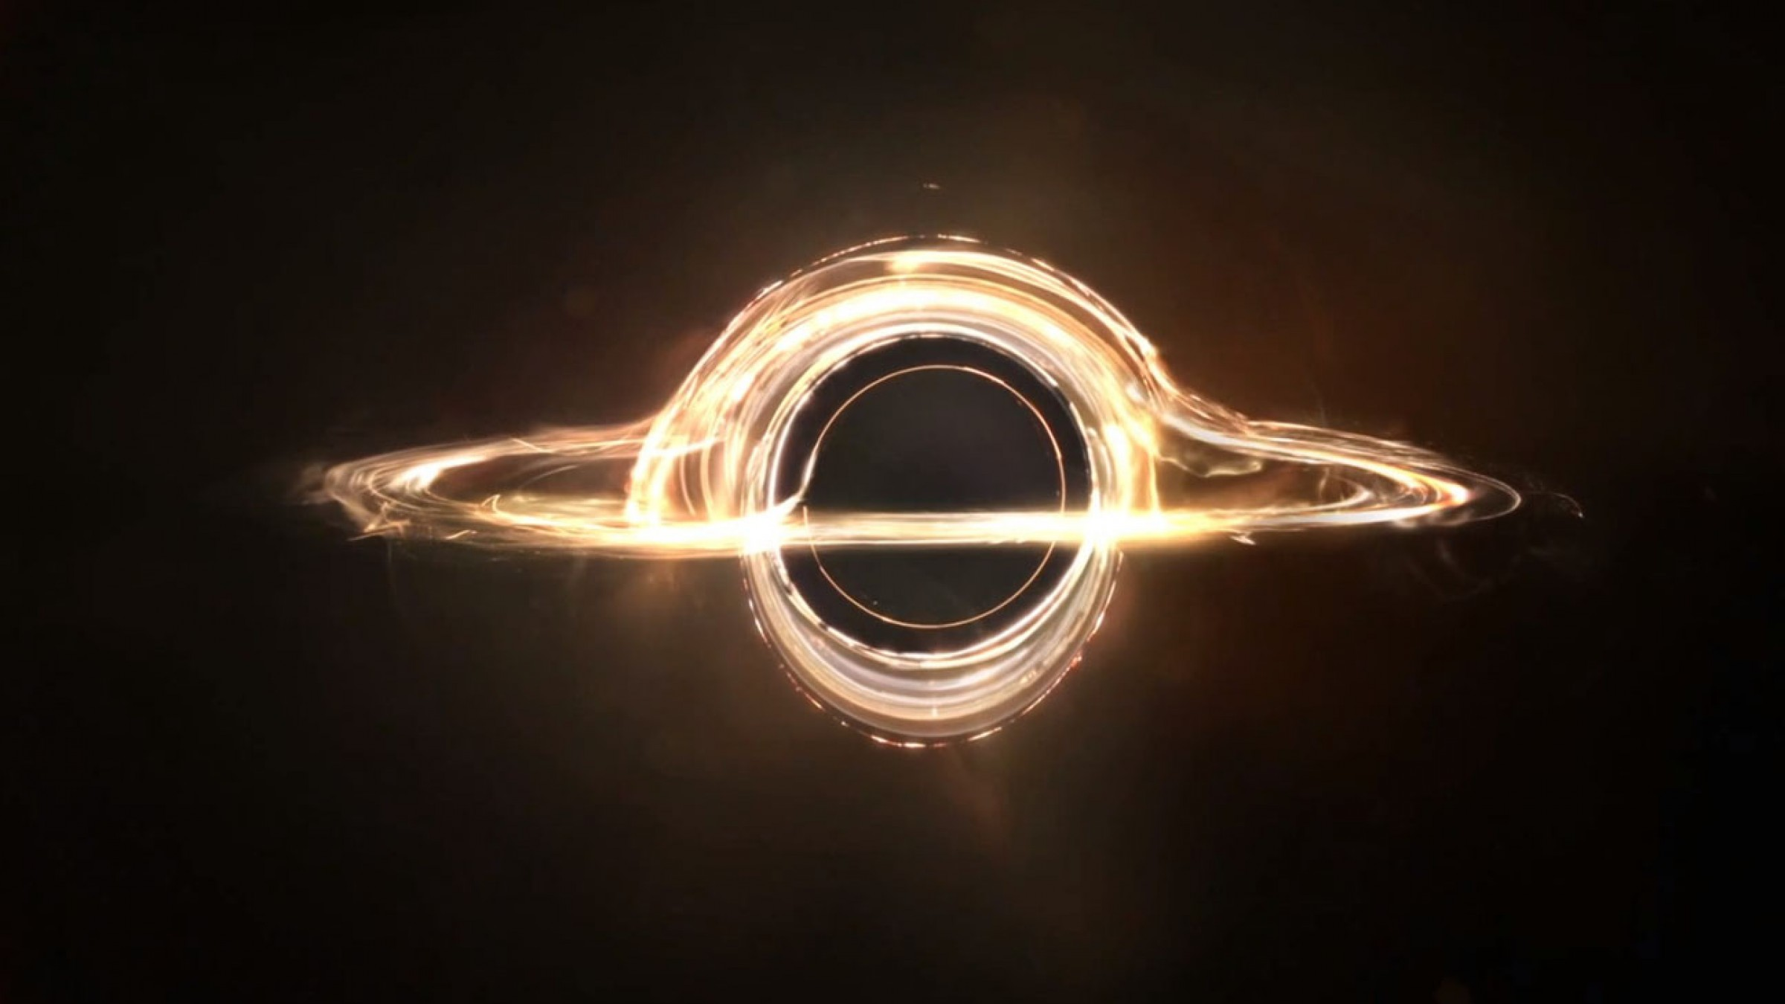
Black Holes
and how do we know that they really exist
Dr. Dirk Grupe
Department of Physics, Earth Science, and
Space Systems Engineering
Space Science Center
d.grupe@moreheadstate.edu

Slide 2
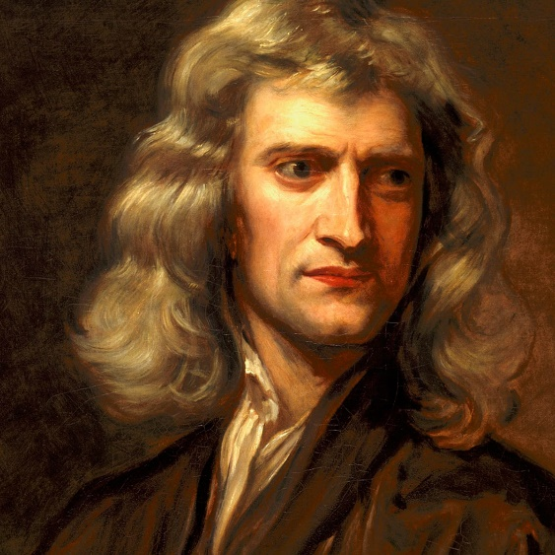
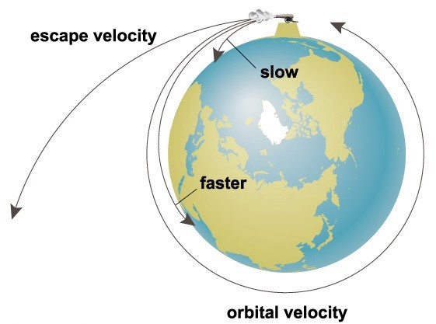
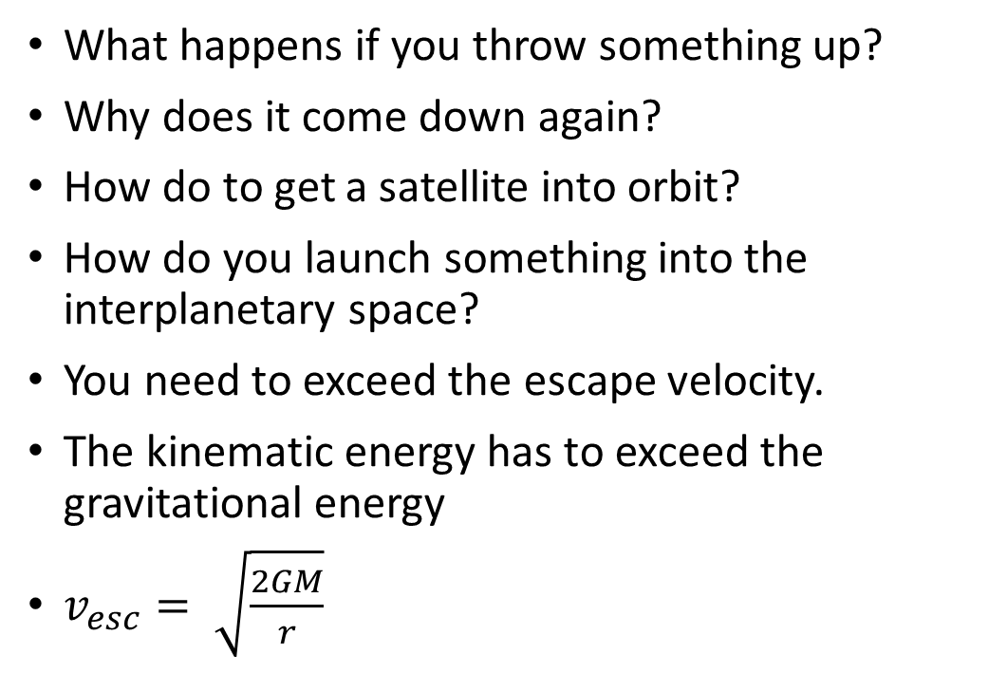
Newton’s Laws of Motion
What happens if you throw something up?
Why does it come down again?
How do to get a satellite into orbit?
How do you launch something into the interplanetary space?
You need to exceed the escape velocity.
The kinematic energy has to exceed the gravitational energy
$v_{esc}= \sqrt{\frac{2GM}{r}}$

Slide 3
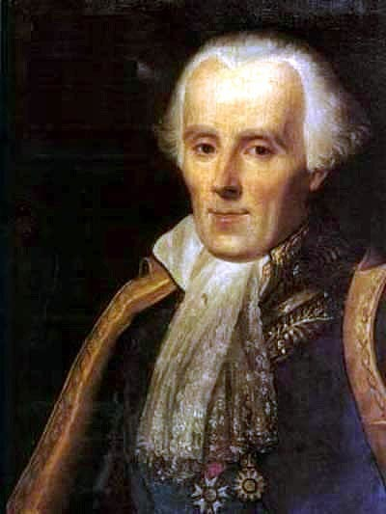
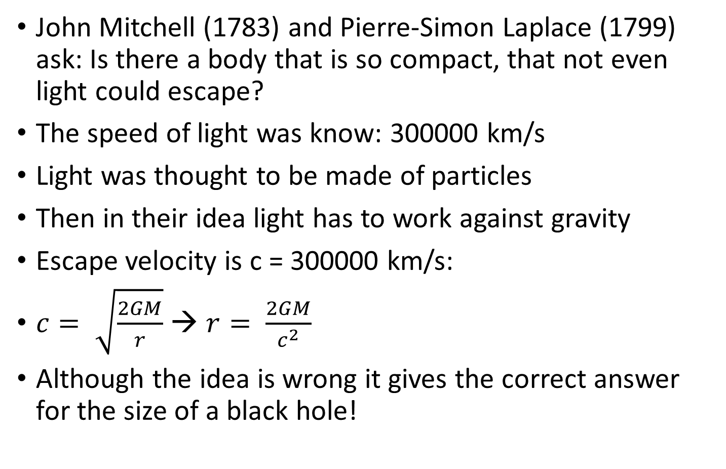
Dark Star
John Mitchell (1783) and Pierre-Simon Laplace (1799) ask: Is there a body that is so compact, that not even light could escape?
The speed of light was know: 300000 km/s
Light was thought to be made of particles
Then in their idea light has to work against gravity
Escape velocity is c = 300000 km/s:
$c= \sqrt{\frac{2GM}{r}}$ → $r= \frac{2GM}{c^{2}}$
Although the idea is wrong it gives the correct answer for the size of a black hole!

Slide 4
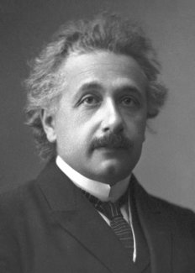
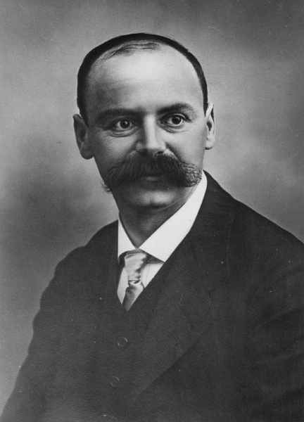
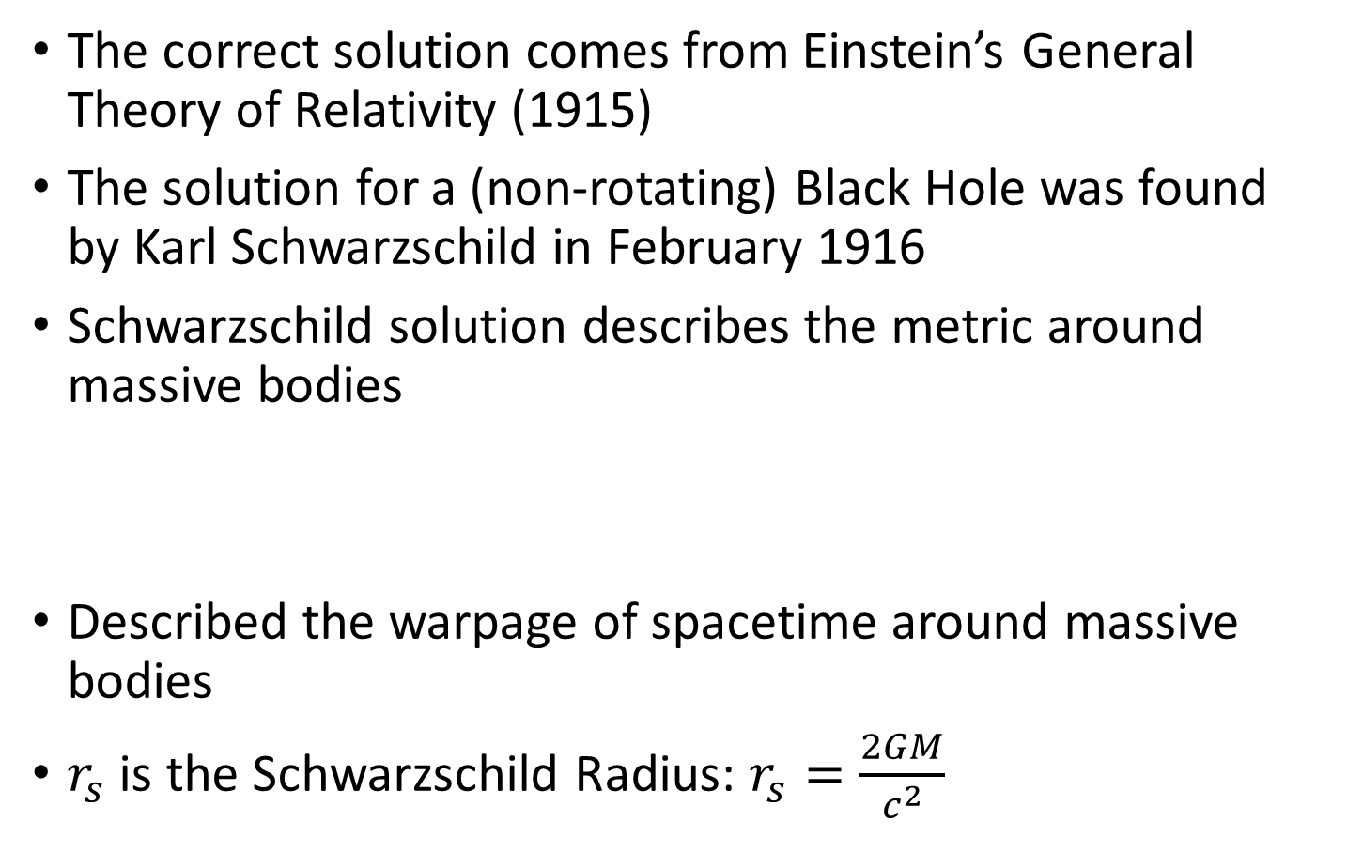
A Black Hole is not a Dark Star!
The correct solution comes from Einstein’s General Theory of Relativity (1915)
The solution for a (non-rotating) Black Hole was found by Karl Schwarzschild in February 1916
Schwarzschild solution describes the metric around massive bodies
Described the warpage of spacetime around massive bodies
$r_{s}$ is the Schwarzschild Radius: $r_{s}=\frac{2GM}{c^{2}}$

Slide 5
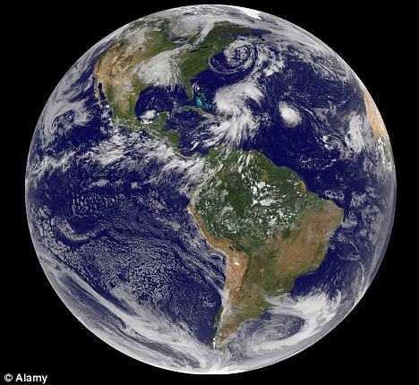

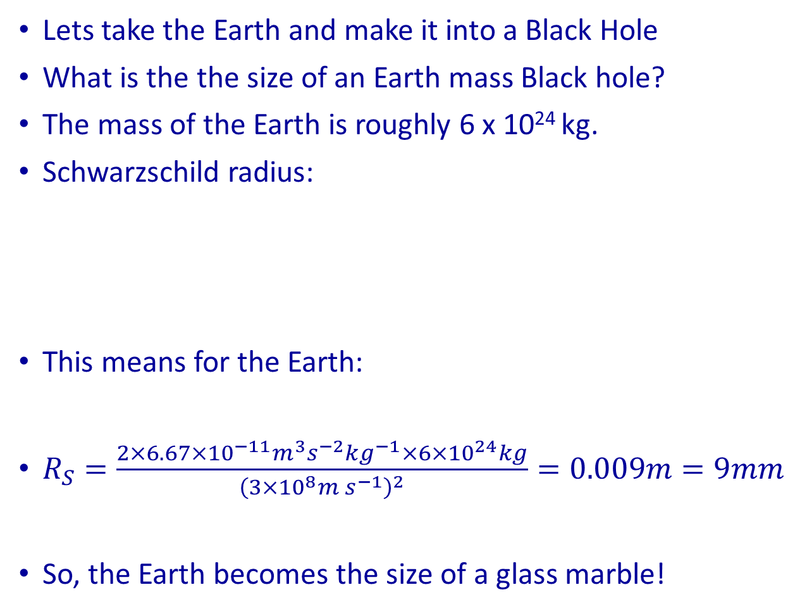
Example how to calculate a Schwarzschild radius
Lets take the Earth and make it into a Black Hole
What is the the size of an Earth mass Black hole?
The mass of the Earth is roughly 6 x 10²⁴ kg.
Schwarzschild radius:
This means for the Earth:
$R_{S}=\frac{2×6.67×{10}^{−11}m^{3}s^{−2}kg^{−1}×6×{10}^{24}kg}{{\left(3×{10}^{8}m s^{−1}\right)}^{2}}=0.009m=9mm$
So, the Earth becomes the size of a glass marble!

Slide 6
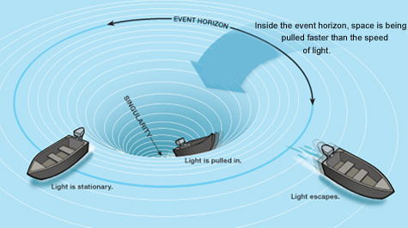
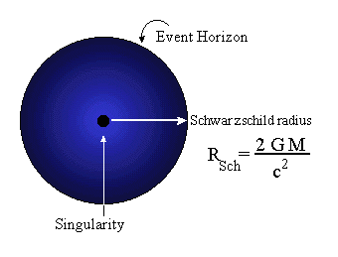
The `No Hair' Theorem of Black Holes, or how `black' is it really?
The No Hair Theorem postulates that a black hole can be described by only three classical observable parameters:
The mass of the black hole M_{BH}
The angular momentum/spin
The electric charge
All other information will be lost within the Event Horizon

Slide 7
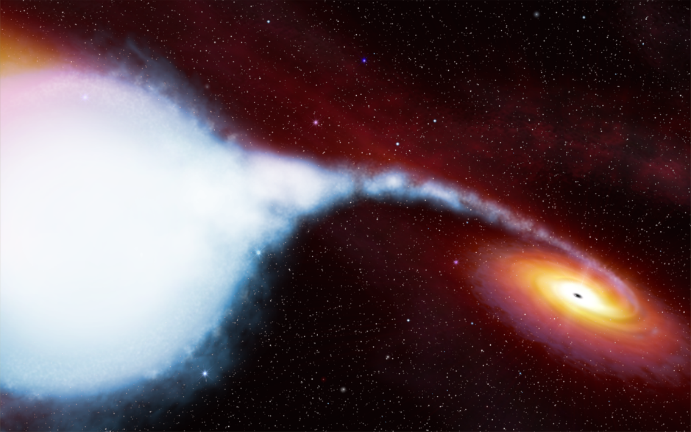
How do we know Black Holes really exist?
Einstein was never convinced that Black Holes could really exist
First discovery in 1964 in X-rays: Cygnus X-1
Binary with solar mass Black Hole
By 1980s, is there a super-massive Black Hole in every galaxy?
Evolution of galaxies goes together with the evolution of the central black hole
Also our Milky Way has a massive Black Hole in its Center

Slide 8
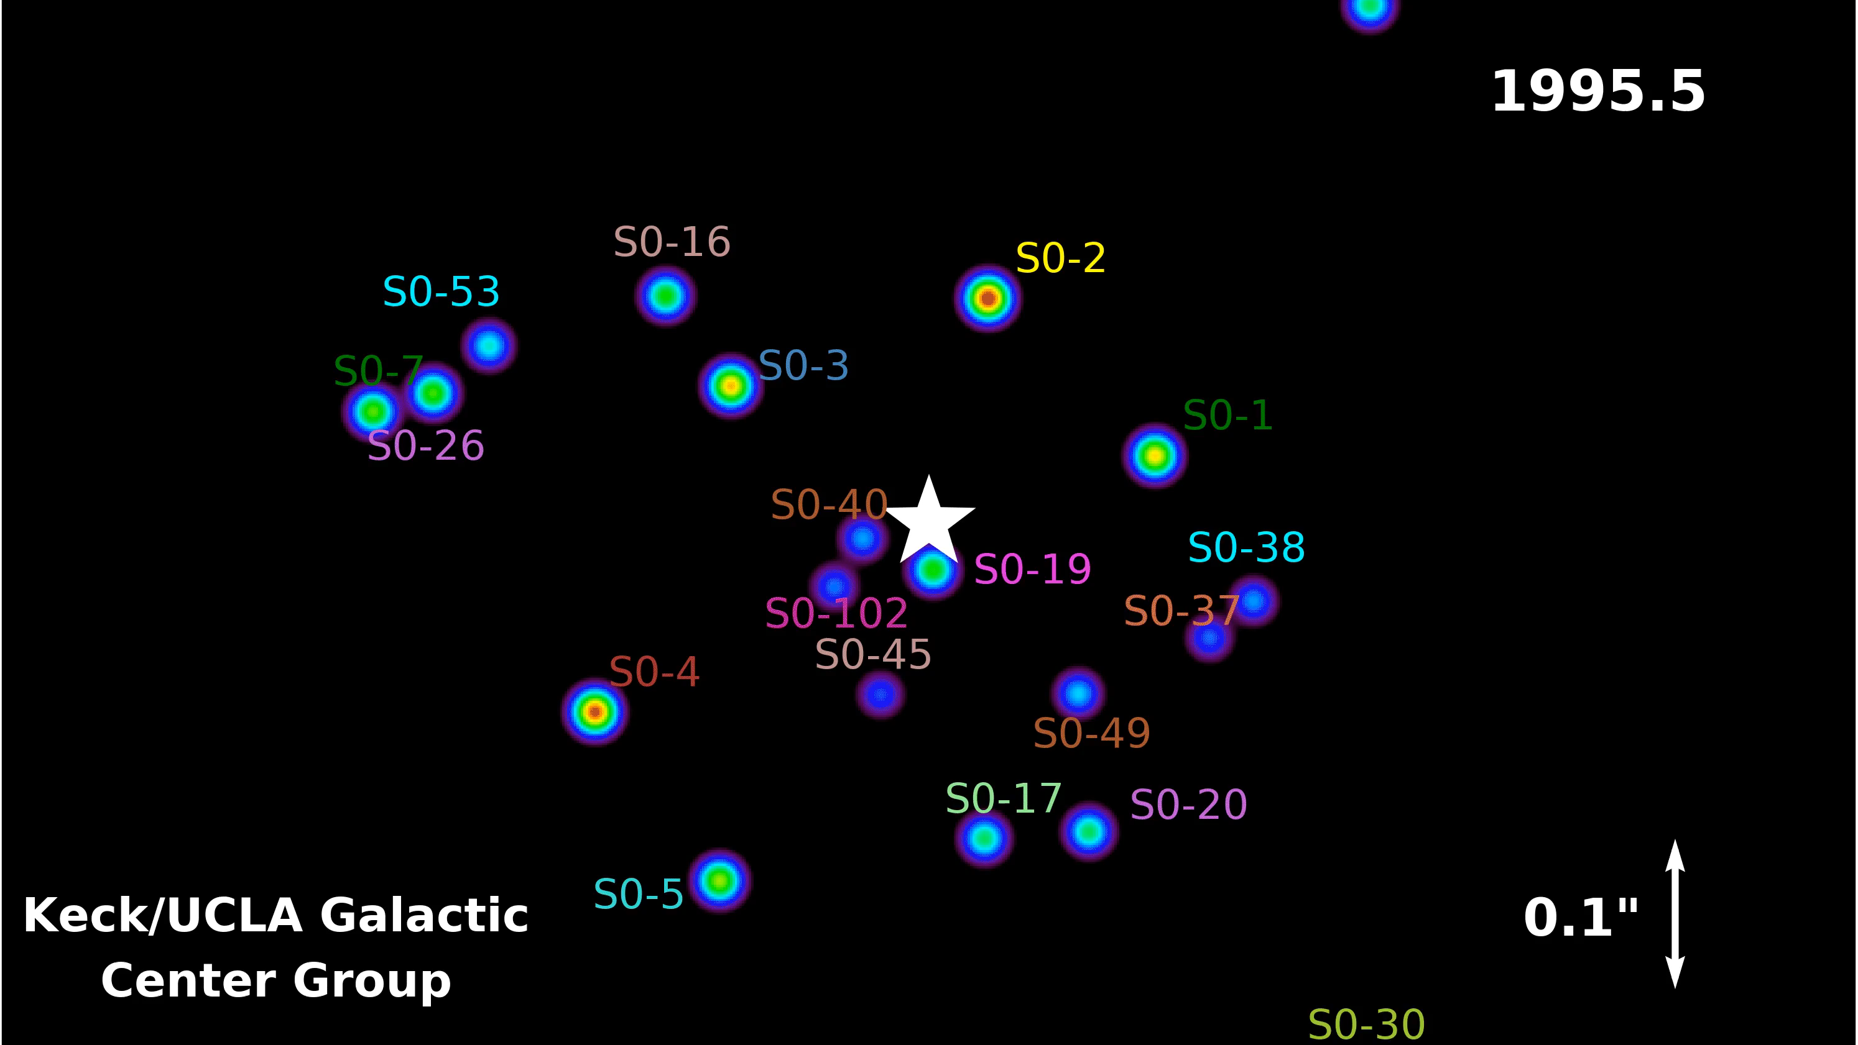


Measure the motion of stars around the central black hole
http://http://www.astro.ucla.edu/~ghezgroup/gc/animations.html

Slide 9
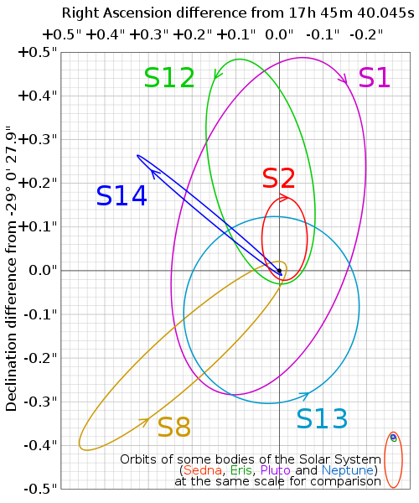
Calculate the mass of the Galaxy's central black hole for stellar motions
Example is star S2
R = 1.8 10¹³ m
Period = 15.2 years
= 4.775 10⁸ s
➔ v = 3.6 10⁶ m s⁻¹
➔ M ~ 3.5 10³⁶ kg or 2 10⁶ M_{sun}
Not too far of, the current real value is about 4 10⁶ M_{sun}

Slide 10
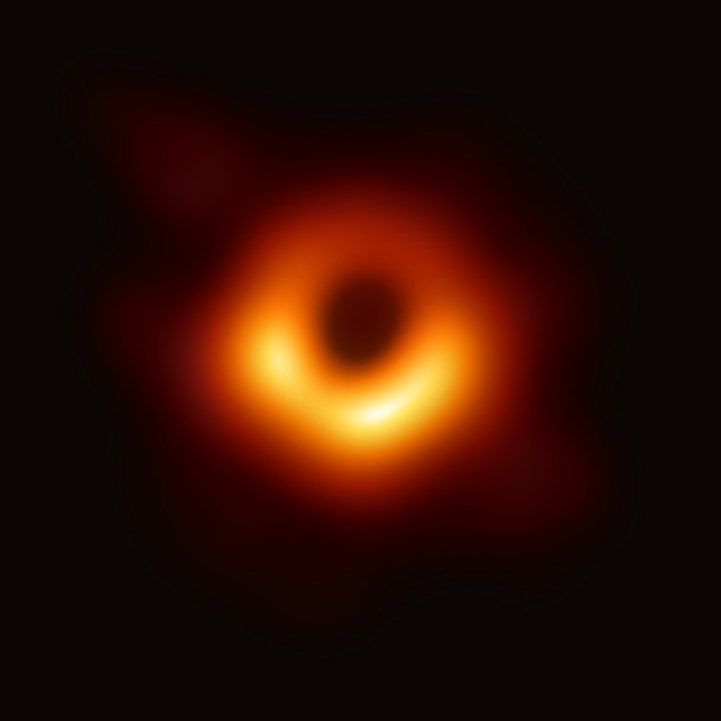
Black Hole Event Horizon
One of the greatest scientific discoveries in 2019 was the first image of a Black Hole
This picture was a world-wide effort that involved multiple sub-mm telescopes all around the world
What this picture shows is the event horizon around the 5x10⁹ solar mass black hole in the center of the nearby galaxy M87
Now we really know: Black Holes exist!

Slide 11
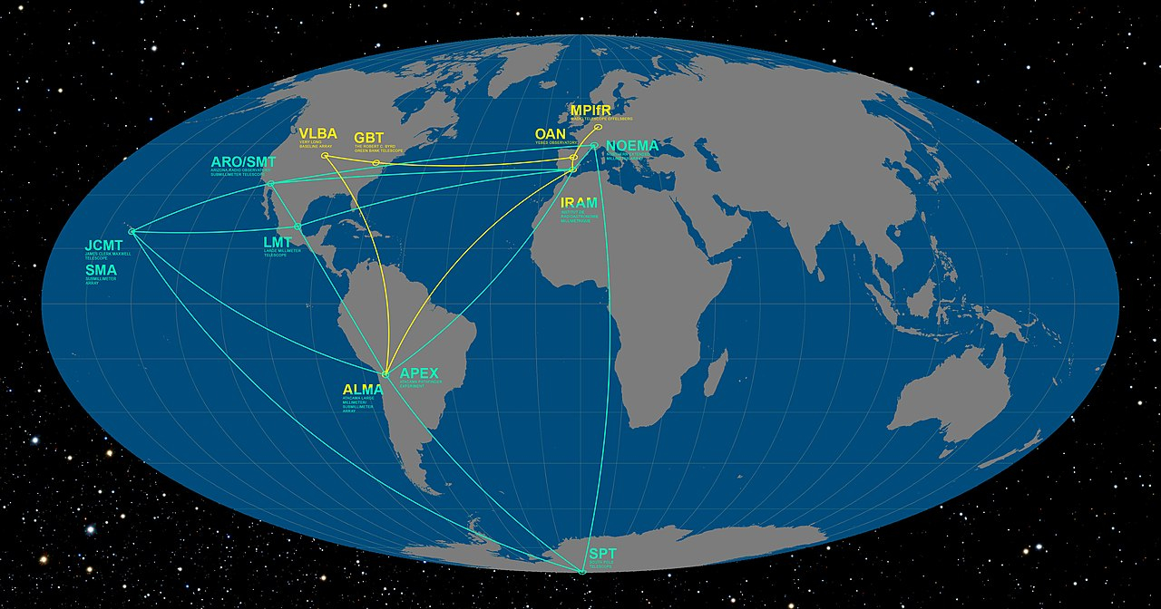
Event Horizon Telescope EHT

Slide 12
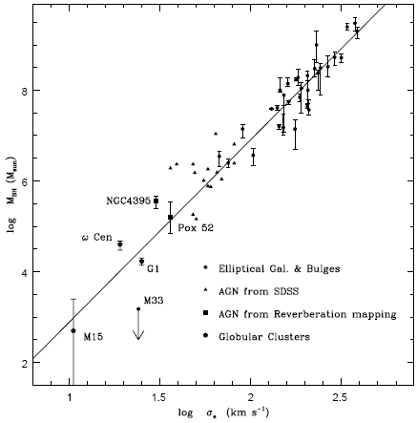
Where are intermediate mass Black Holes?
We have stellar mass black hole from Supernova explosions and Gamma-Ray Bursts
We also know about super-massive black holes of more than 10⁵ M_{sun} in AGN
Any black hole growth should produce intermediate BHs
Nayola et al. 2008, ApJ 801
log M_{BH}
log σ

Slide 13
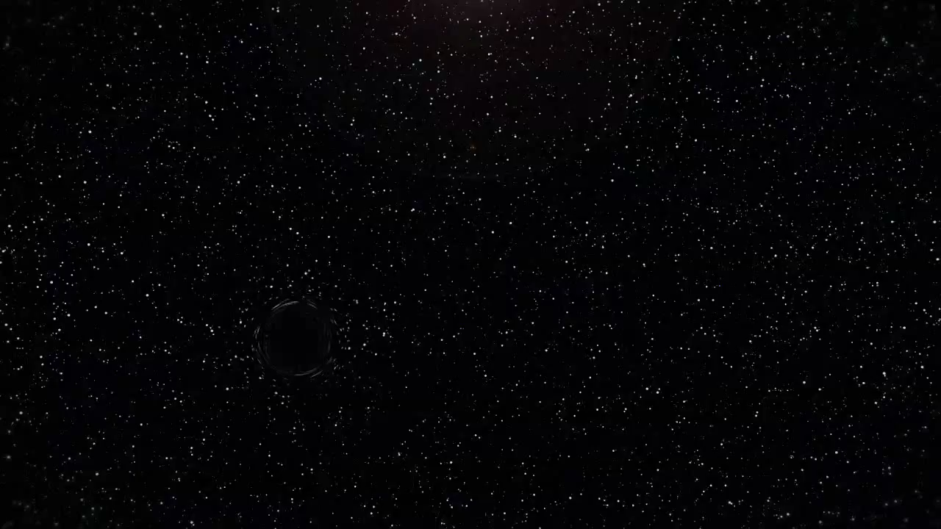
Tidal disruption of a star by a black hole
Animation from NASA for Swift J1644+57
http://www.youtube.com/watch?v=azLDH9ZPbVs

Slide 14


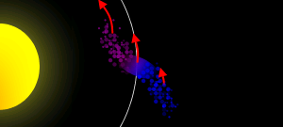
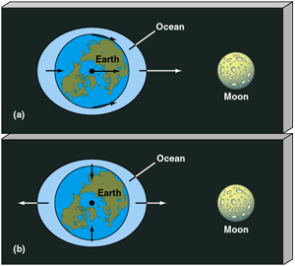
What happens when the star gets disrupted
Tidal disruption was suggested by Martin Rees (1988, Nature 333)
What rips the star apart is the tidal force that distorts the star
Radius at which the star/objects is disrupted is the tidal radius or Roche radius
At the Roche radius the tidal force and the gravitational force are in equillibrium.

Slide 15
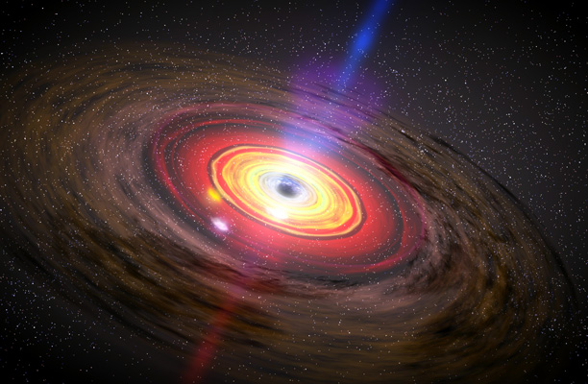
In a normal Active Galactic Nuclei we transfer
Matter to a Black Hole through an accretion disk

Slide 16
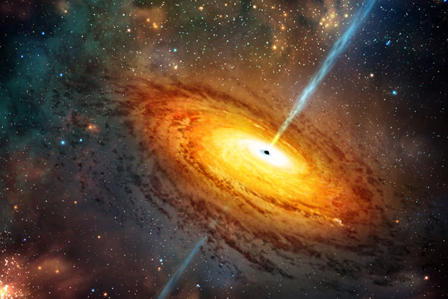
AGN or Quasars can exceed the luminosity of its host galaxy by factors of 1000!

Slide 17
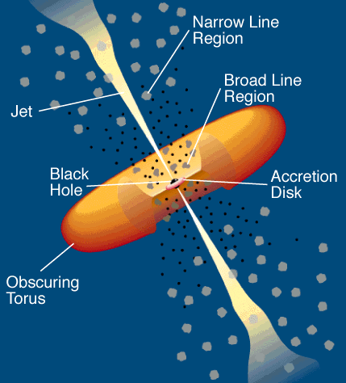
Continuum emission of AGN is emitted from an Accretion disk around central Black Hole
Narrow forbidden and permitted emission lines
Broad permitted emission lines
Continuum emission
Urry & Padovani, 1995
Notes:
Blank slide for drafting title slide.

Slide 18
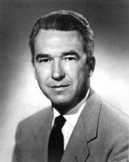
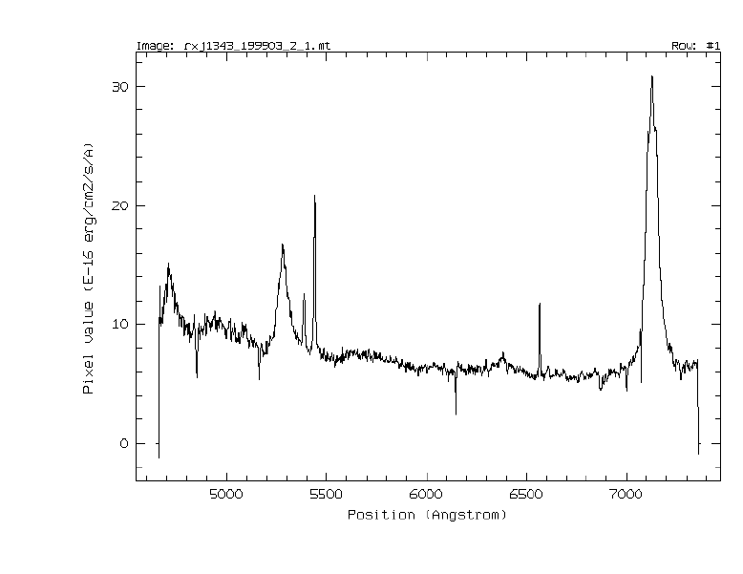
Seyferts definition of an AGN
Karl Seyfert noticed the following properties of AGN:
Compact nucleus
Strong emission lines
Hydrogen lines are broader than the other lines
Notes:
Blank slide for drafting title slide.

Slide 19
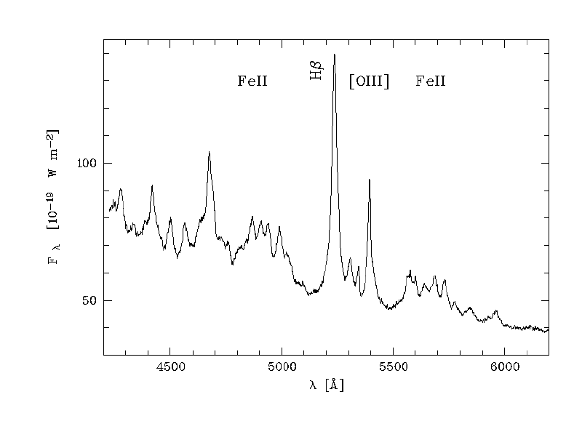
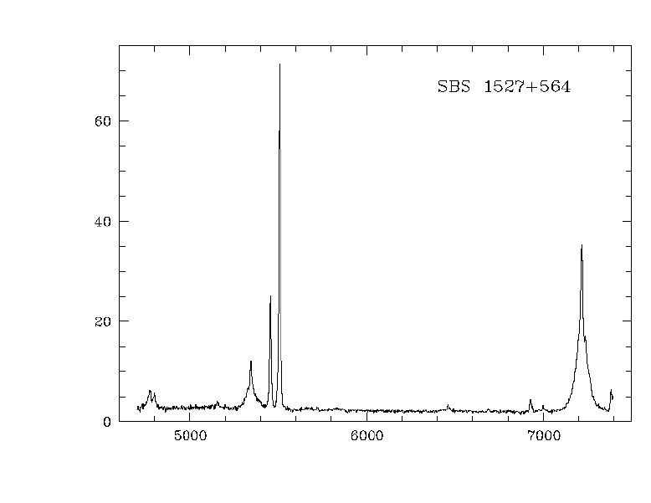
Comparison spectra between NLS1 and BLS1
NLS1 Mkn 478
BLS1 SBS 1527+564
[OIII]
Hβ
Strong FeII
Weak [OIII]
Weak FeII
Strong [OIII]

Slide 20
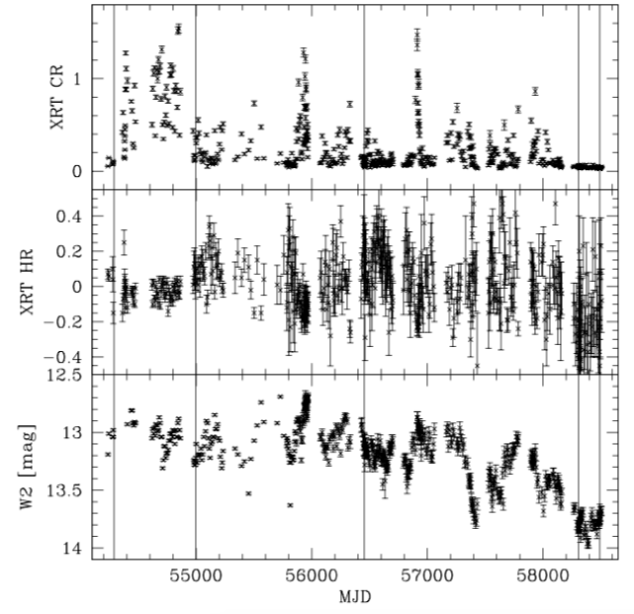
And sometimes this variability can be extreme, especially in NLS1s
← Factors of 30 in X-rays
← More than 1.5 mag in the UV
Mkn 335
Swift monitoring campaign
2007-2019 (Grupe et al., 2012)

Slide 21

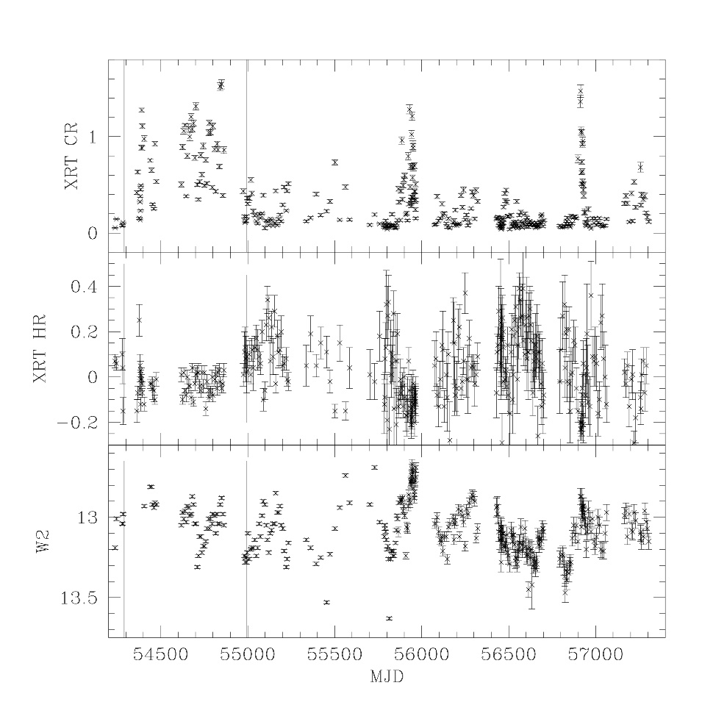
NLS1s are AGN in an Early stage
NLS1s are young AGN (toddlers)
NLS1s are messy eaters, throw tantrums
Strong outflows from the accretion disk
Fast growing Black Holes

