Slide 1
Political Climate Change: Opportunities and Challenges for the Scientific Community
Yvette R. Seger, PhD
Director of Science Policy, FASEB

Slide 2
Understatement of the Year
Growing Workforce
Sexual
Harassment
Limited Number of
Academic Jobs
“The scientific community has faced a few challenges over the past decade.”
COVID-19
Challenges to
Peer Review
Flat Federal Budgets
Sequestration
Systemic Racism

Slide 3
Bright Spots
COVID-19 Vaccines
Regular NIH Budget
Increases Since FY 2016
Bipartisan Support
Visibility of Science

Slide 4
2021?

Slide 5
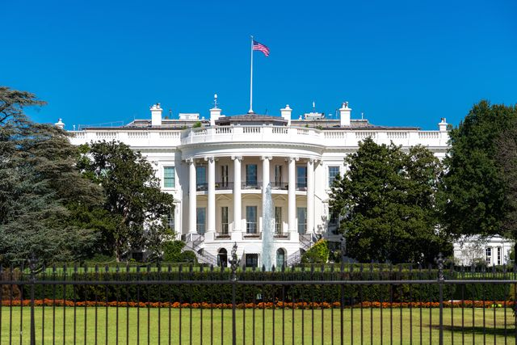
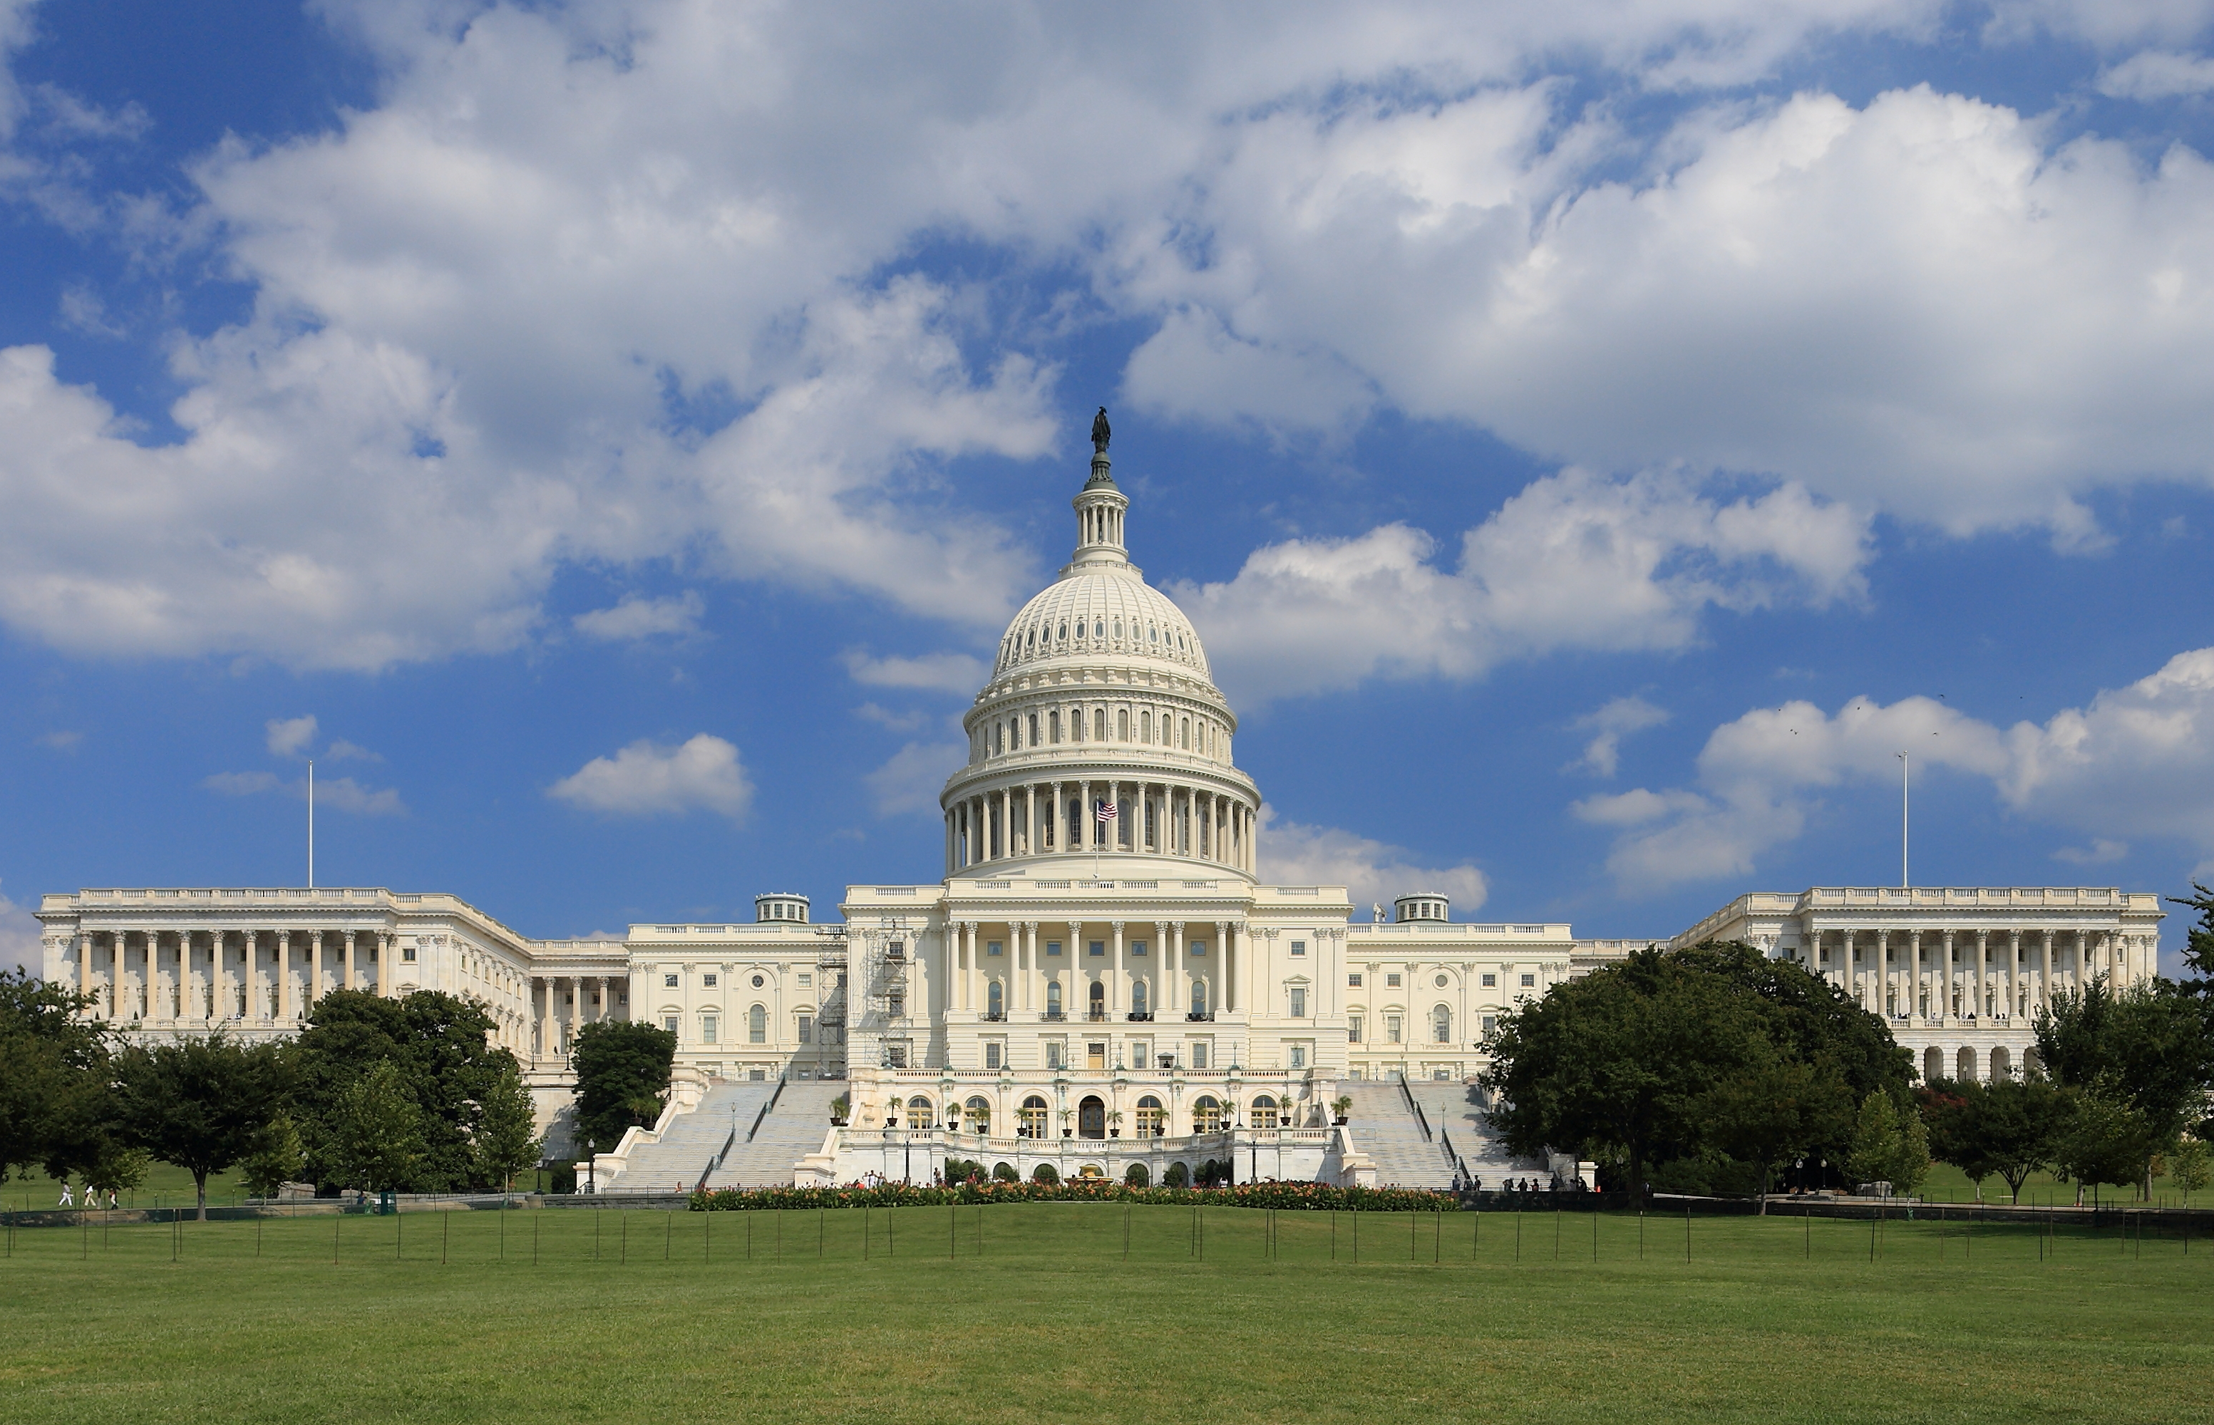
Current Political Environment
Joseph R. Biden, Jr.
&
Kamala Harris
House: 219 Democrats
211 Republicans
5 Vacancies
Senate: 48 Democrats
50 Republicans
2 Independent

Slide 6
Opportunities
Role of science in combatting COVID-19 pandemic
More frequent reporting of science in general press
Community outreach tools for preventing viral spread and reducing vaccine hesitancy
Science elevated within the Biden-Harris Administration
Bipartisan activity within key Congressional committees
Virtual environment broadens engagement opportunities

Slide 7
Challenges
Public impatience with the scientific process
Partisan application of science at state/local level
Public perception of science/scientists
Competing priorities within the Congressional majority
You may disagree with your elected official(s)
Virtual environment is exhausting

Slide 8
What can YOU do?
Advocacy is not limited to those seeking to make the jump to a policy career!

Slide 9
What Can You Do?
What is the core problem you want to address?
Federal funding for science?
Need for clearer career pathways for PhDs?
Support for specific legislation?
Advocacy is dependent upon message discipline!
Who can help resolve these core problems?
Institutional leadership?
Grassroots community?
Elected officials

Slide 10
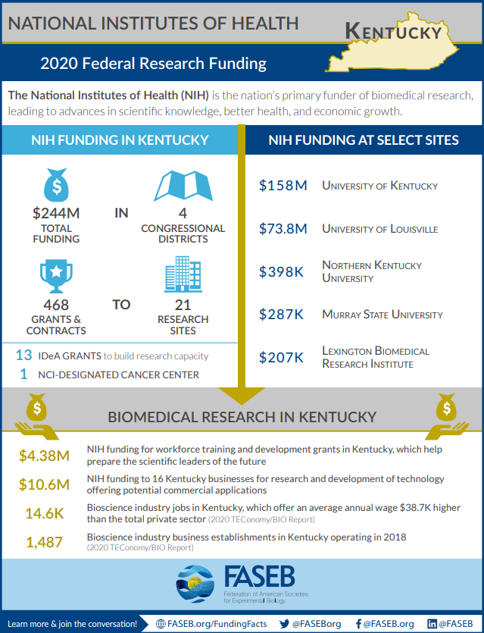
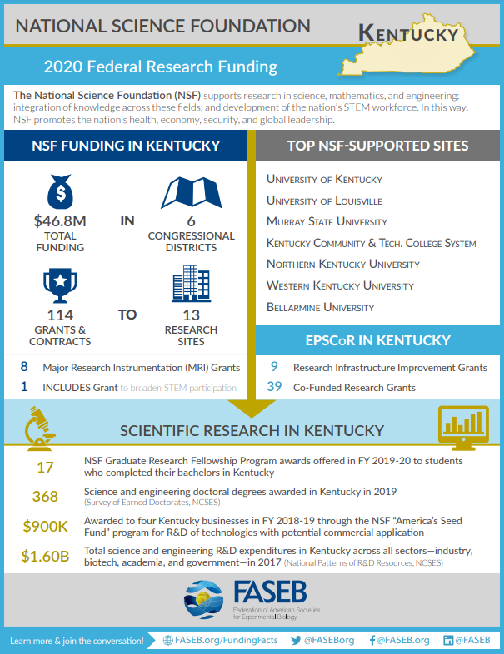
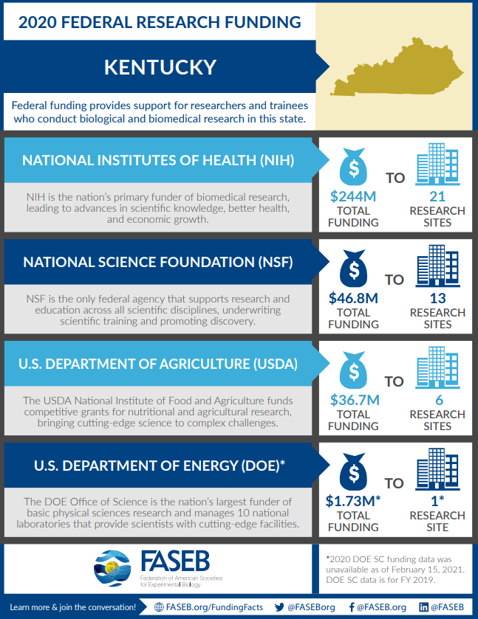
Engage!
But I’ve never done this before!
Many advocacy tool-kits and resources are available
FASEB Advocacy Tool-Kit
Many professional societies host advocacy events specific for early-career researchers

Slide 11
Keep in mind…
The most effective advocacy starts at home
Community/institutional events
Congressional Town Halls
Letters to the Editor/Blogs
Persistency is key!

Slide 12
Thank You!
Contact Me:
yseger@faseb.org

