Slide 1
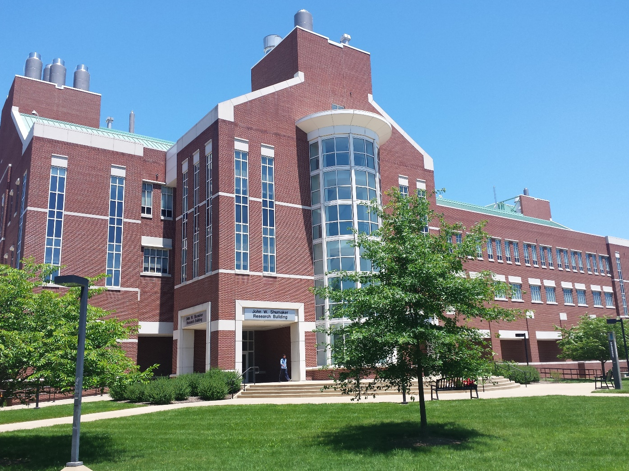

Shumaker Research Building
https://louisville.edu/micronano/

Slide 2
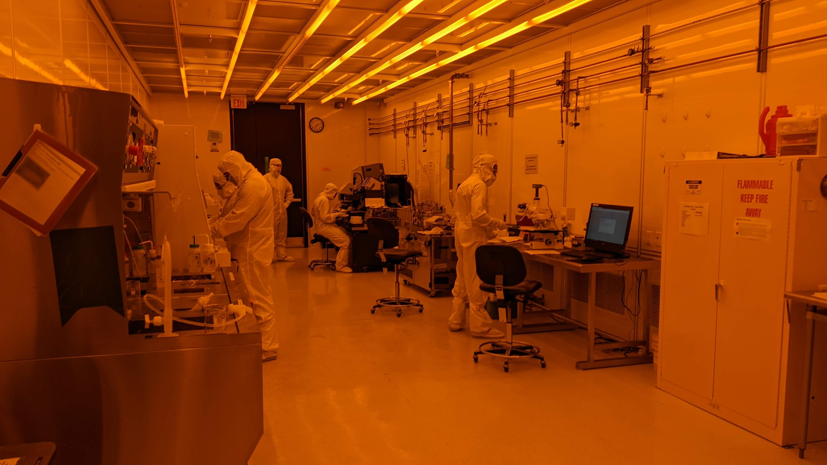
Micro/Nano Technology Center $30 M 10,000 ft² Cleanroom

Slide 3
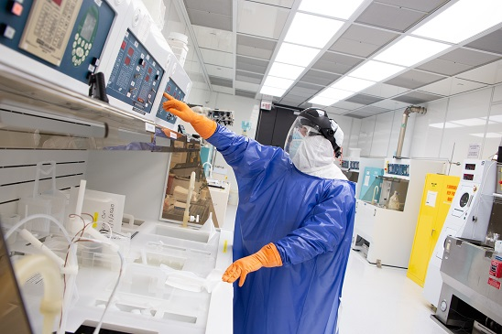
Micro/Nano Technology Center $30 M 10,000 ft² Cleanroom

Slide 4
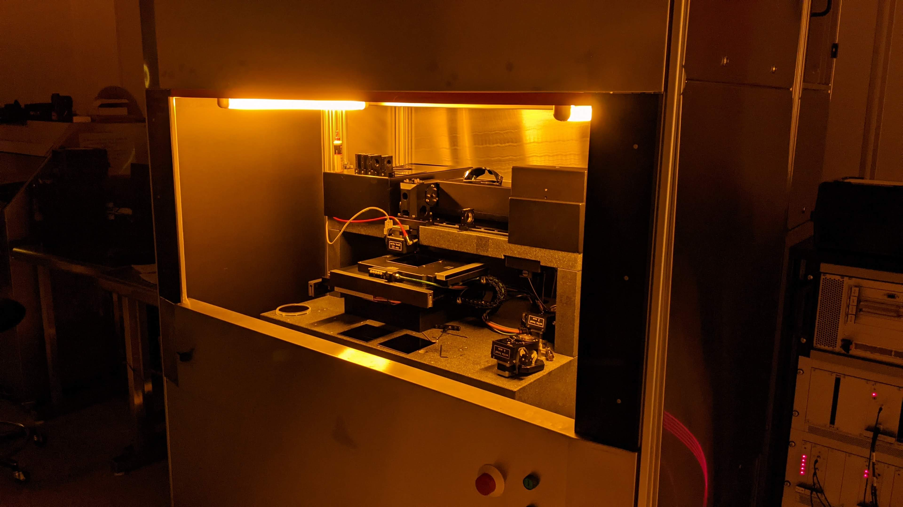
Micro/Nano Technology Center – Laser Pattern Generator

Slide 5
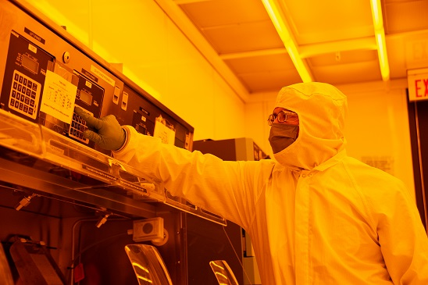
Micro/Nano Technology Center $30 M 10,000 ft² Cleanroom

Slide 6
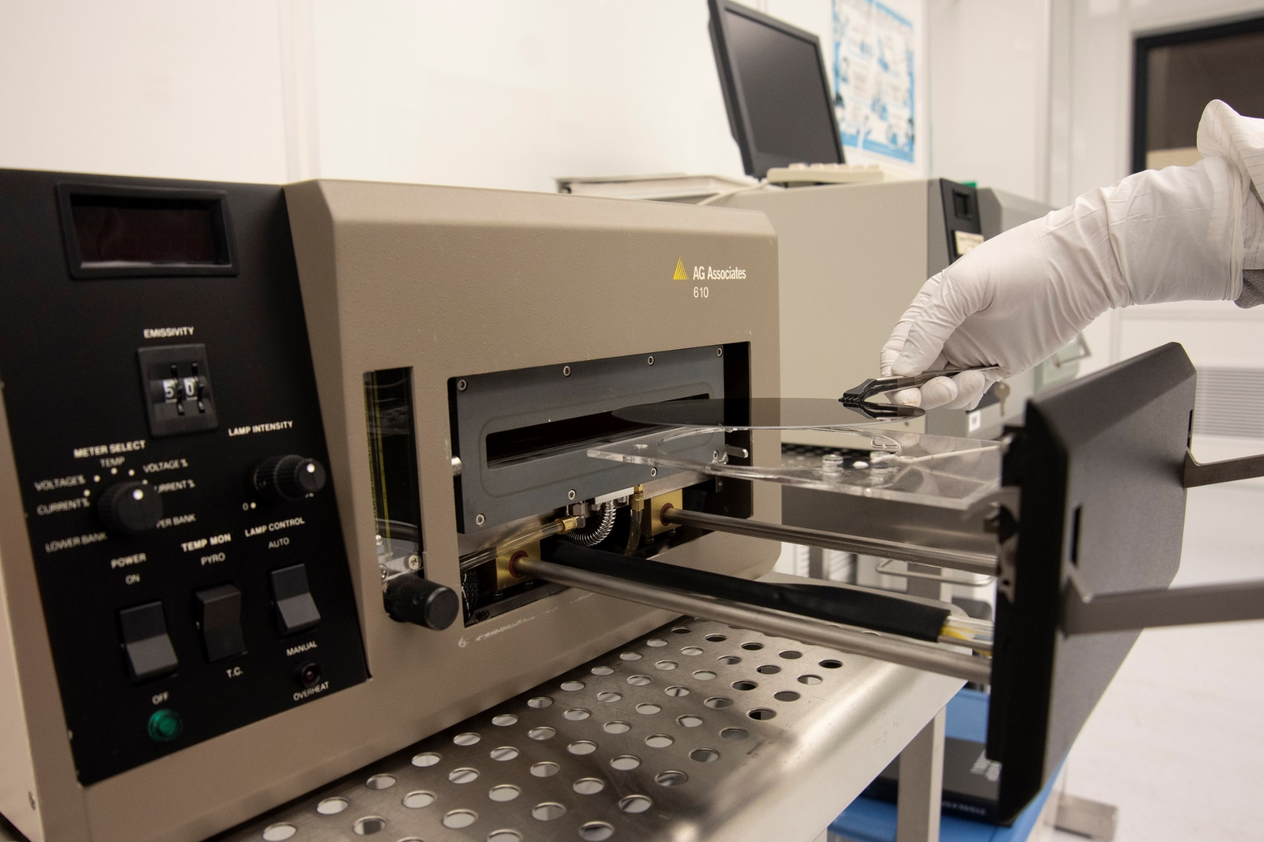
Micro/Nano Technology Center - Rapid Thermal Annealing

Slide 7
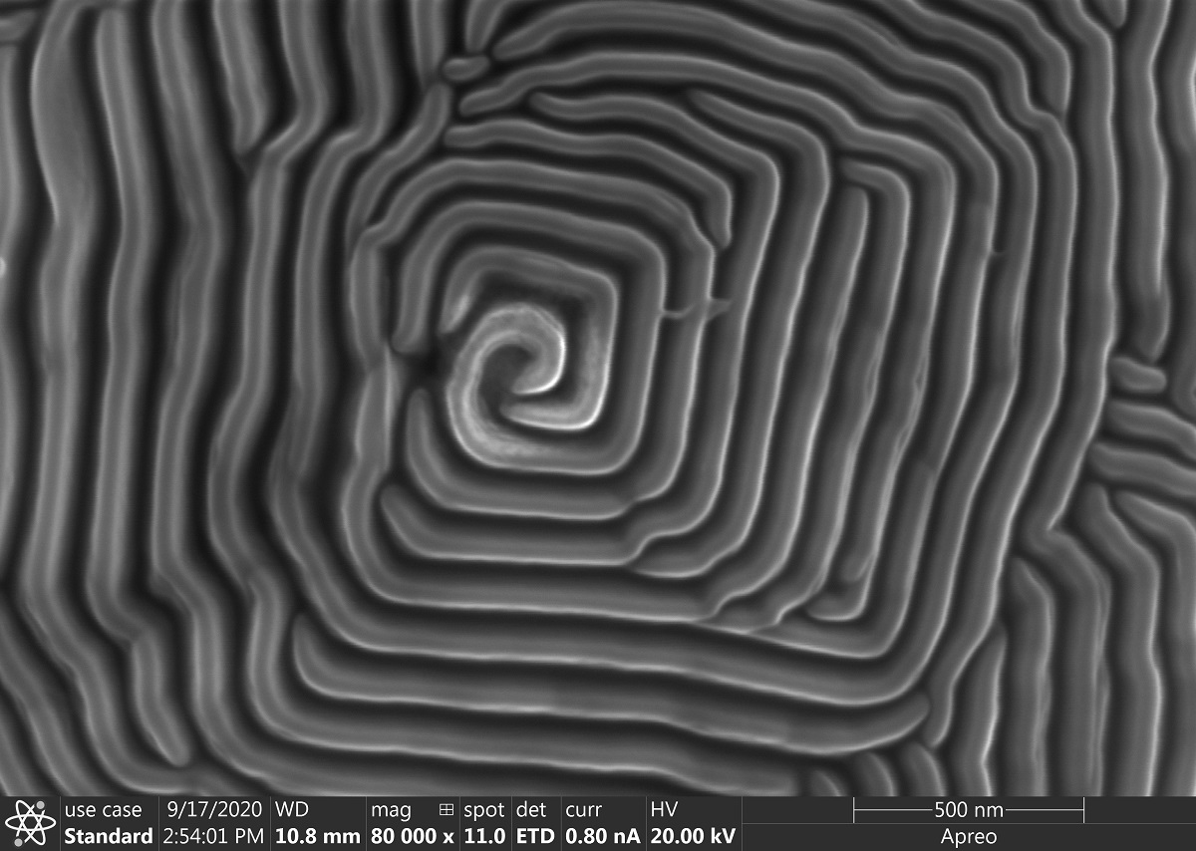
Micro/Nano Technology Center – Aluminum Sputter Target

Slide 8
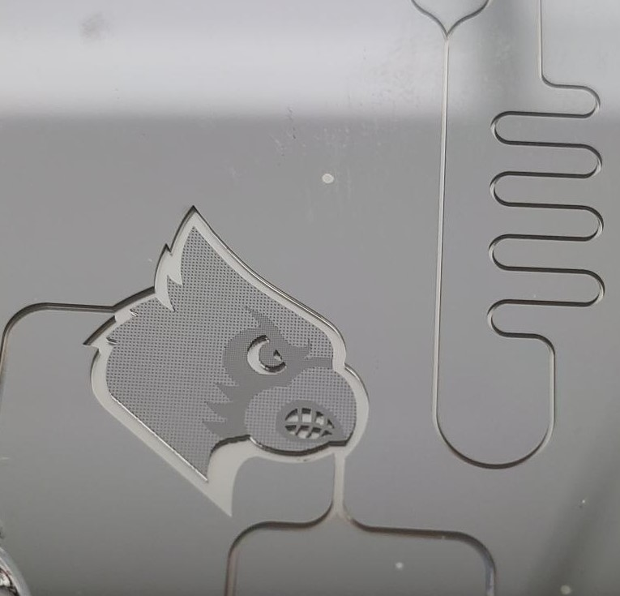
Microfluidics

Slide 9
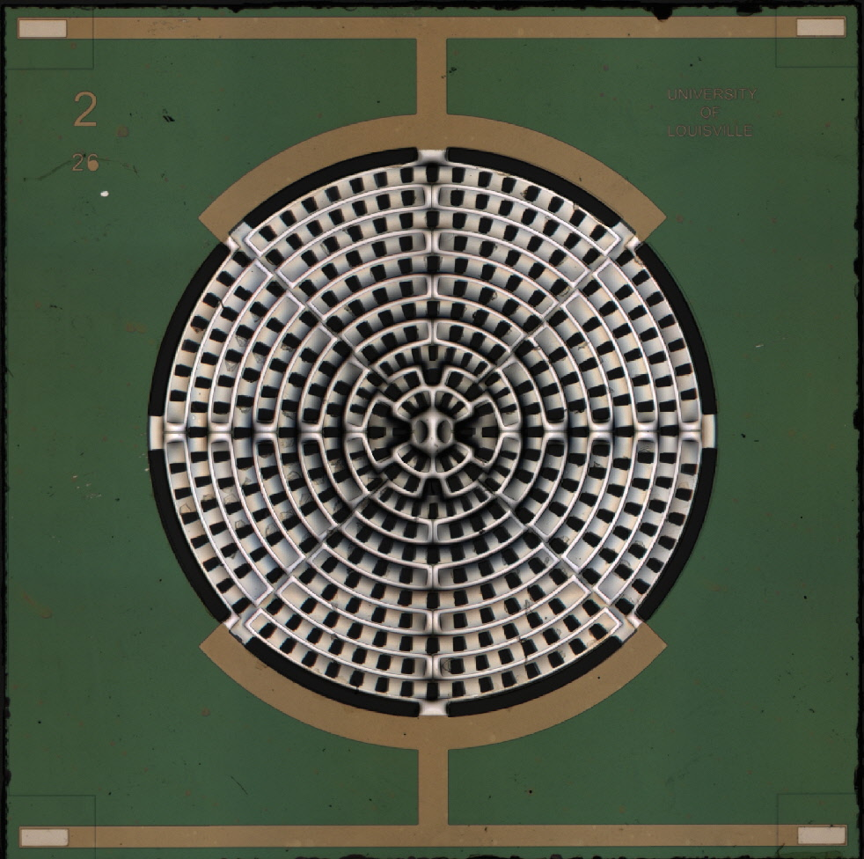
Micro heaters for:
Gas Detectors
Explosive Detection
Differential Scanning Calorimetry

Slide 10
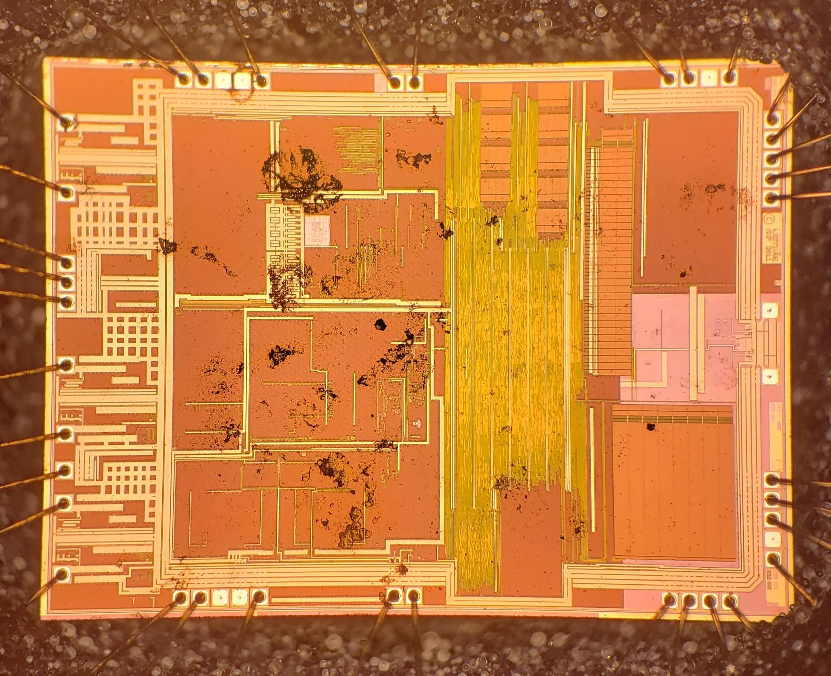
Micro/Nano Technology Center – Reverse Engineering

Slide 11
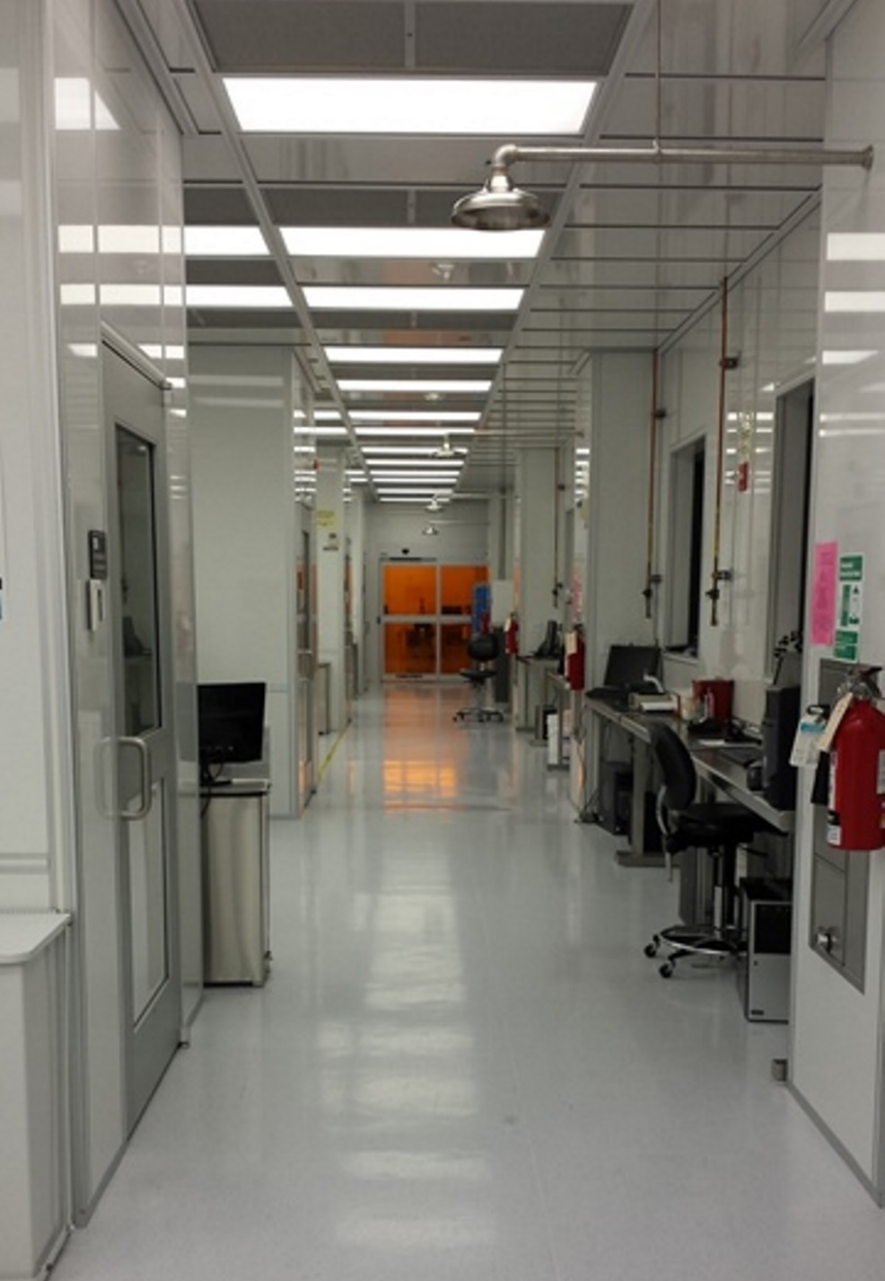
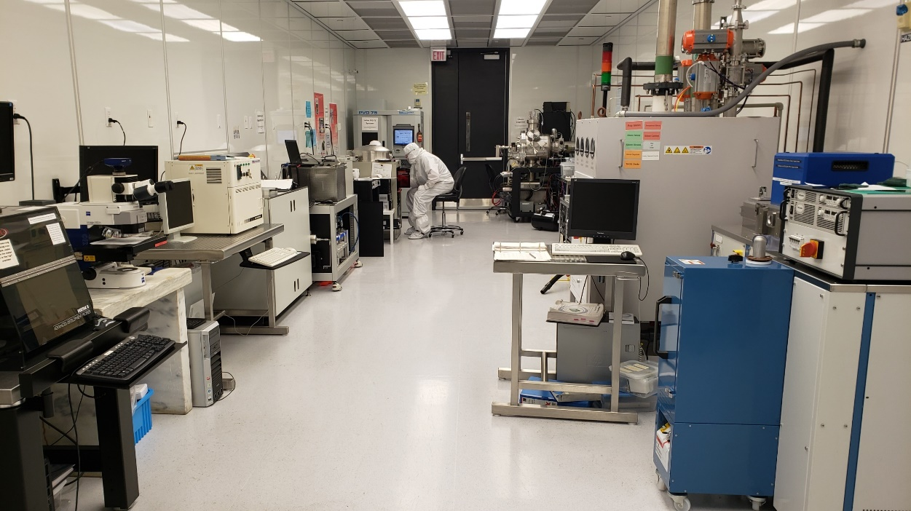
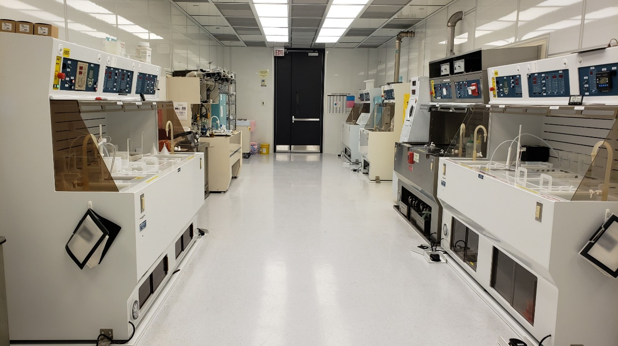
Micro/Nano Technology Center – Cleanroom

Slide 12
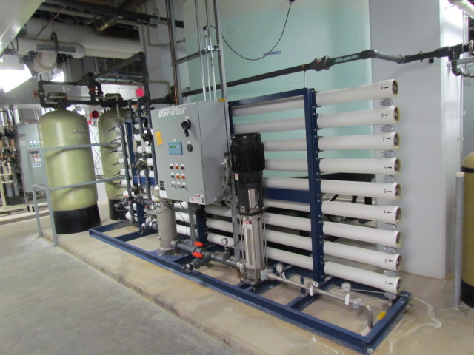
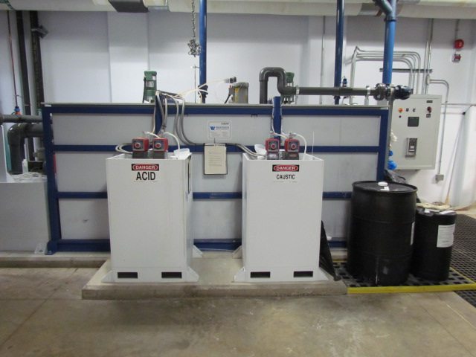
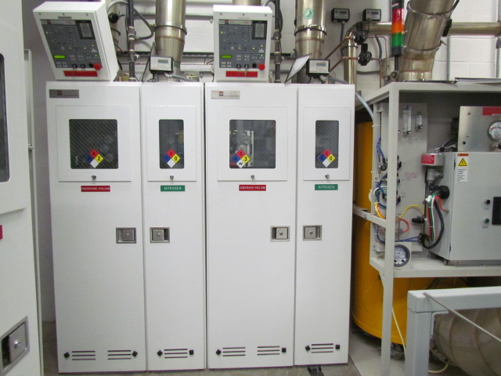
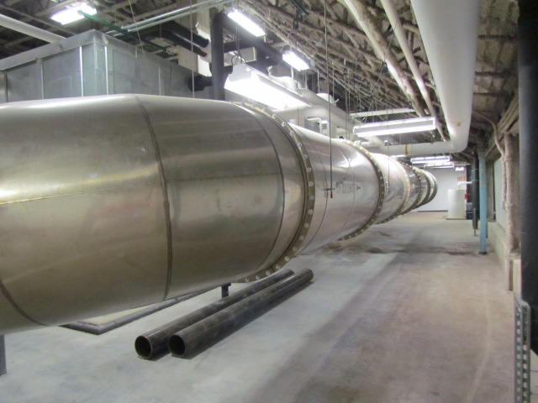
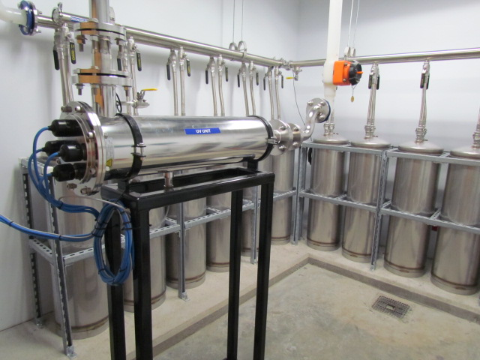
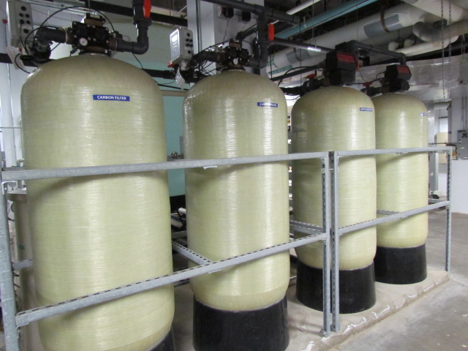
Micro/Nano Technology Center – Cleanroom Infrastructure

Slide 13
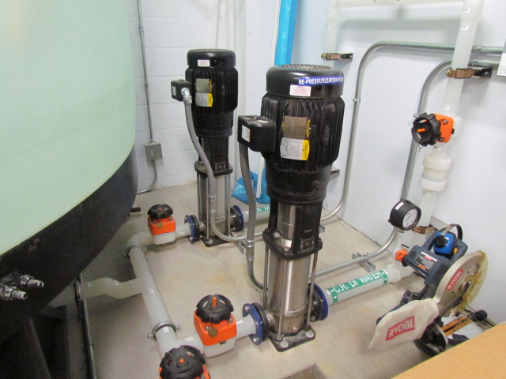
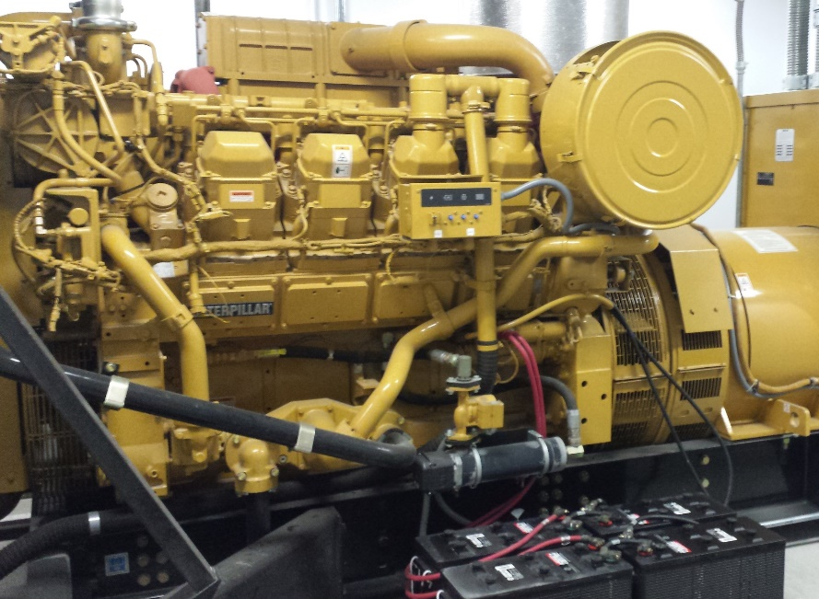
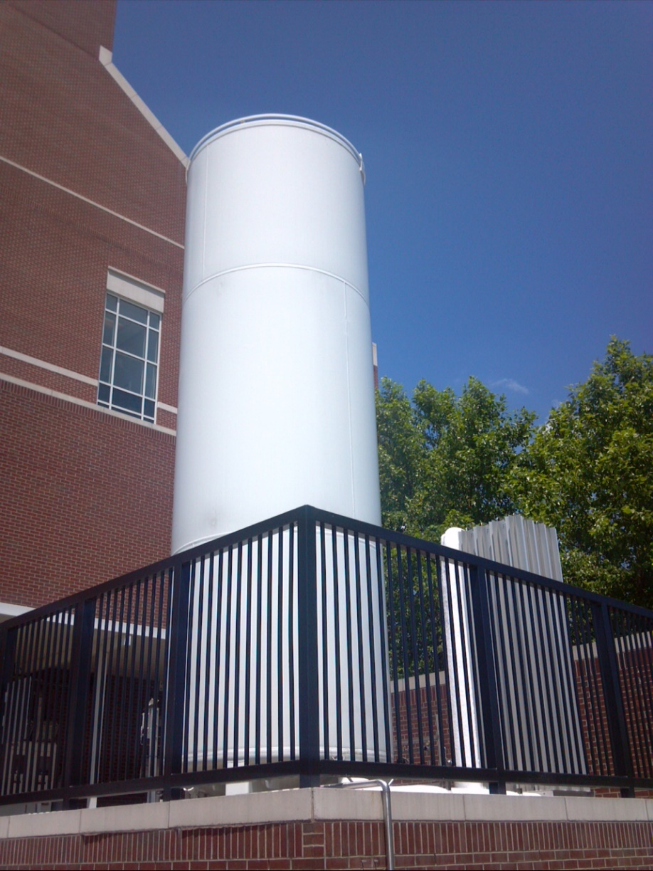
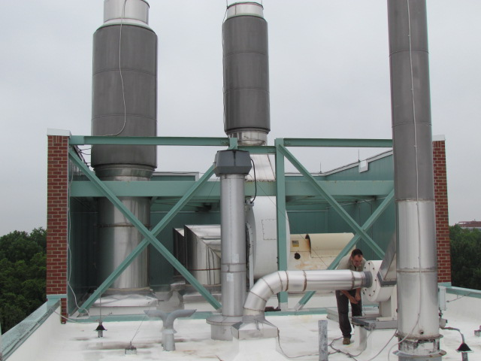
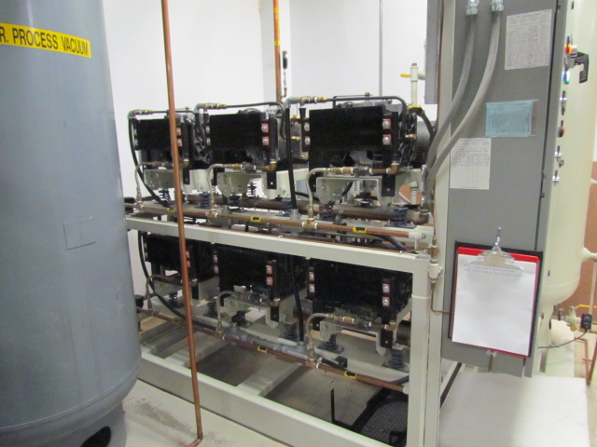
Micro/Nano Technology Center – Cleanroom Infrastructure

Slide 14
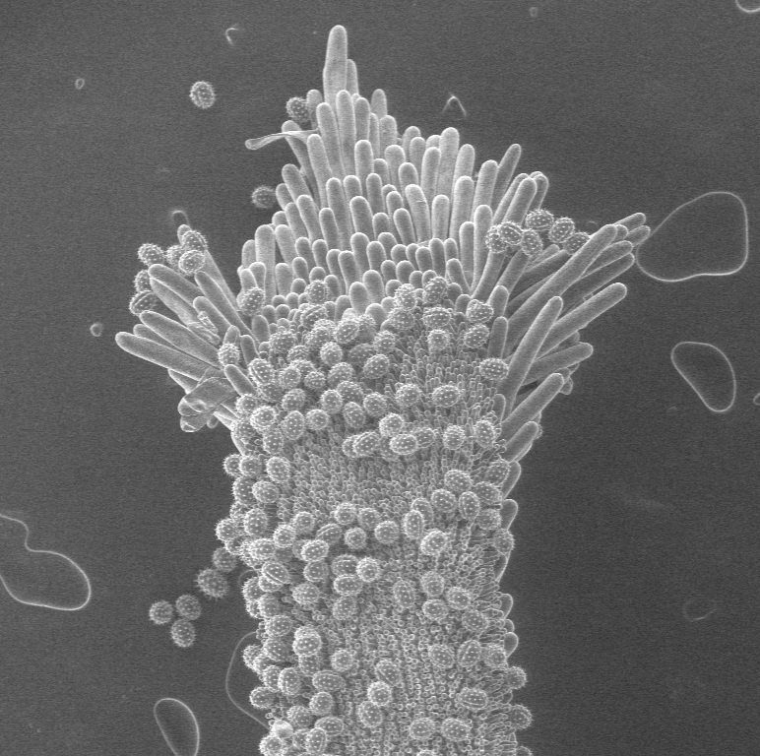
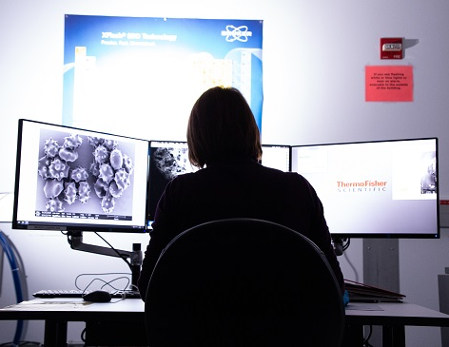
Micro/Nano Technology Center - Scanning Electron Microscopy

Slide 15
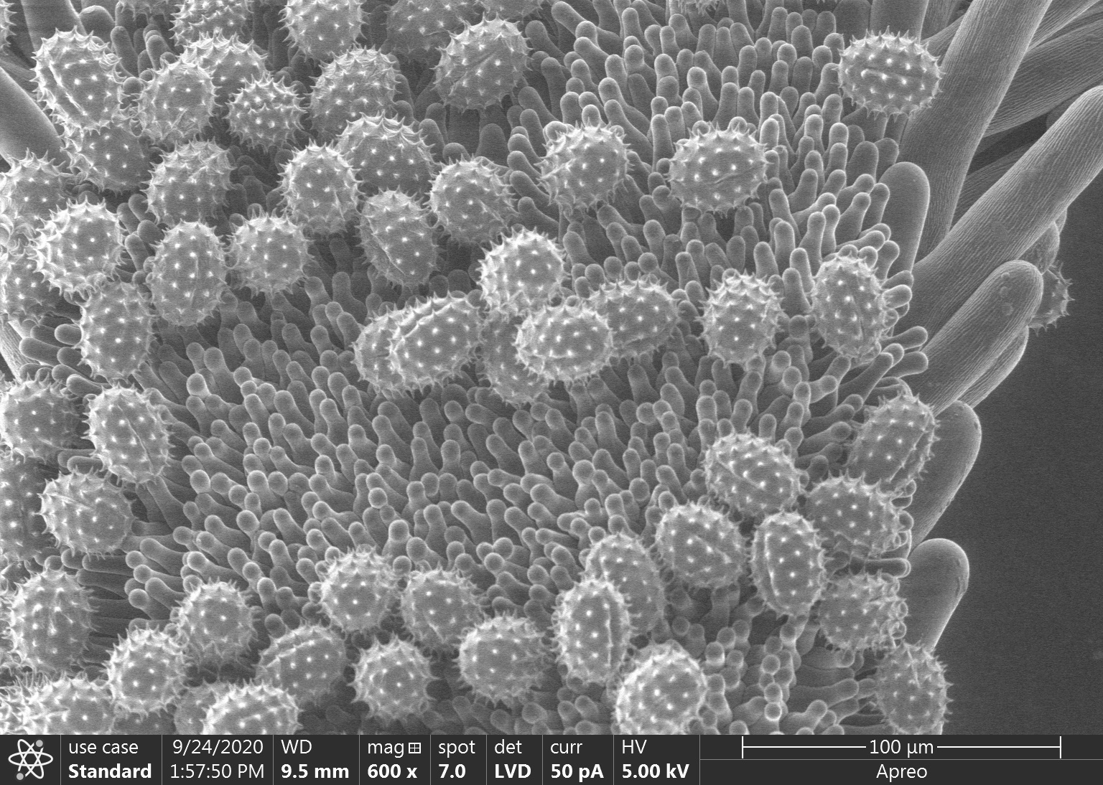
Micro/Nano Technology Center – Pollen

Slide 16
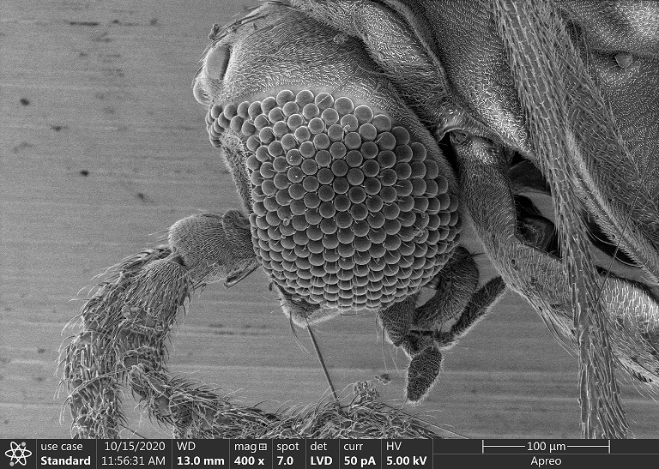
Micro/Nano Technology Center – Spider

Slide 17
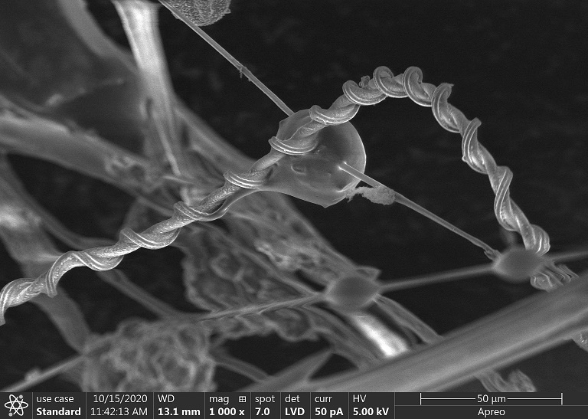
Micro/Nano Technology Center – Spider Web

Slide 18
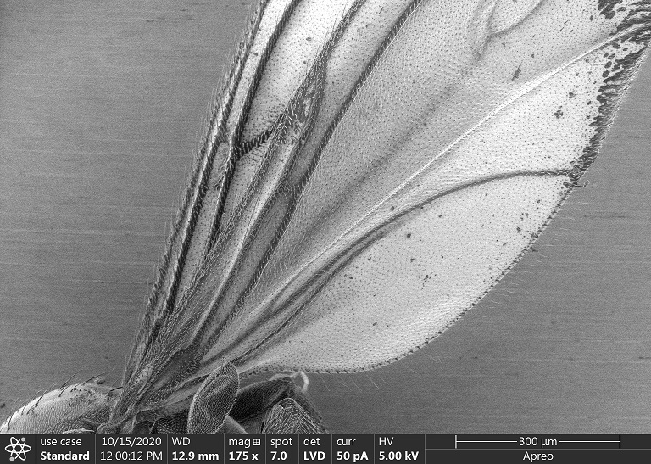
Micro/Nano Technology Center – Insect Wing

Slide 19
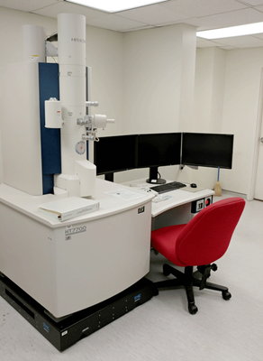
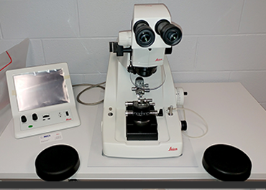
Micro/Nano Technology Center – Transmission Electron Microscopy

Slide 20
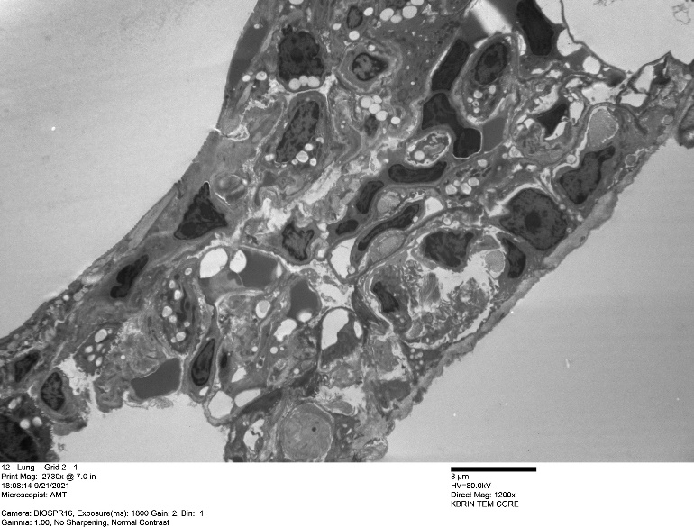
Micro/Nano Technology Center – Mouse Lung

Slide 21
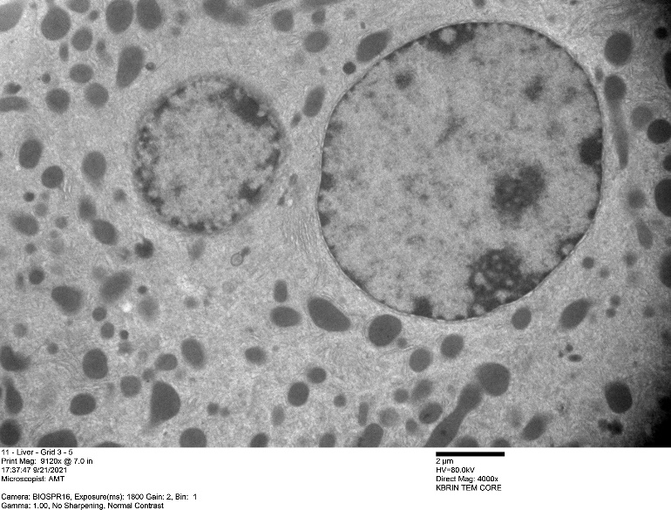
Micro/Nano Technology Center – Mouse Liver

