Slide 1
COVID-19 Vaccines
Sanjay Mishra, MS, PhD
Data Curious, Science writer,
Project Manager,
a vaccine developer once

Slide 2
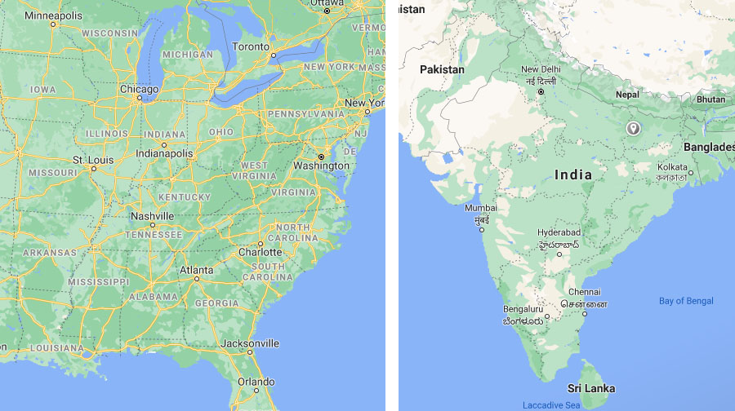
About me..

Slide 3
The COVID-19 and Cancer Consortium (CCC19)

Slide 4
COVID-19 Recap
First cases reported in Wuhan, China in December 2019
Common symptoms:
Fever
Cough
Shortness of Breath
New loss of taste or smell
Caused by viral infection: SARS-CoV-2
>500,000 deaths in the USA due to COVID-19 by Feb 2021; many more contracted and sickened
Potential for asymptomatic (without symptoms) spread
CDC: Symptoms of Coronavirus
3
World Health Organization: Q&A on coronaviruses (COVID-19)

Slide 5
HOW DO
VACCINES WORK?
Introduce "infectious" particles into the body
Stimulate immune response to vaccine
Recognize prior exposure through “Memory” immune cells
Prevent future infections, or reduce the severity disease
Mayo Clinic Health System: Vaccine safety: 6 common questions answered

Slide 6
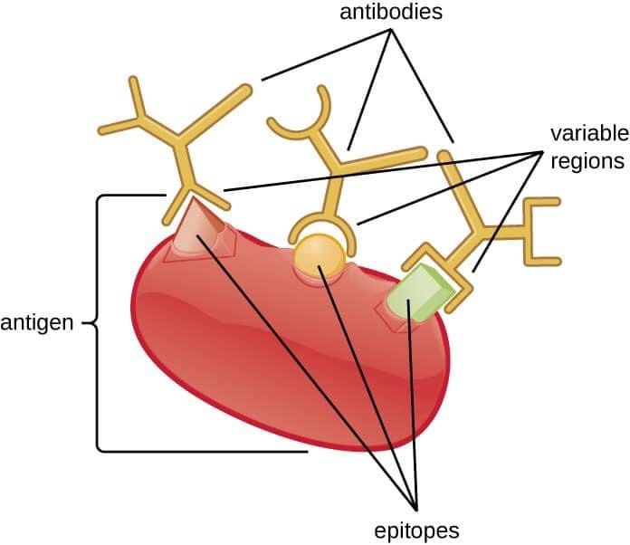
HOW DO
VACCINES WORK?
Introduce "infectious" particles into the body
Stimulate immune response to vaccine
Recognize prior exposure through “Memory” immune cells
Prevent future infections, or reduce the severity disease

Slide 7
Common Childhood Recommended Vaccines
Chickenpox (Varicella)
Diphtheria, tetanus, and whooping cough (pertussis) (DTaP)
Haemophilus influenzae type b (Hib)
Measles, mumps, rubella (MMR)
Polio (IPV) (between 6 through 18 months)
Pneumococcal (PCV)
Hepatitis A (HepA)
Hepatitis B (HepB)

Slide 8
1.
5.
2.
6.
3.
7.
4.
8.
van Riel et al. Nature Materials 19:810–812(2020).
5

Slide 9
 | Candidate vaccines (no. and %)
Protein subunit | 19
Viral Vector (non-replicating) | 10
DNA | 8
Inactivated Virus | 9
RNA | 7
Viral Vector (replicating) | 4
Virus Like Particle | 2
VVr + Antigen Presenting Cell | 2
Live Attenuated Virus | 1
VVnr + Antigen Presenting Cell | 1
whole virus vaccines
Protein subunit
viral vector
nucleic acid

Slide 10
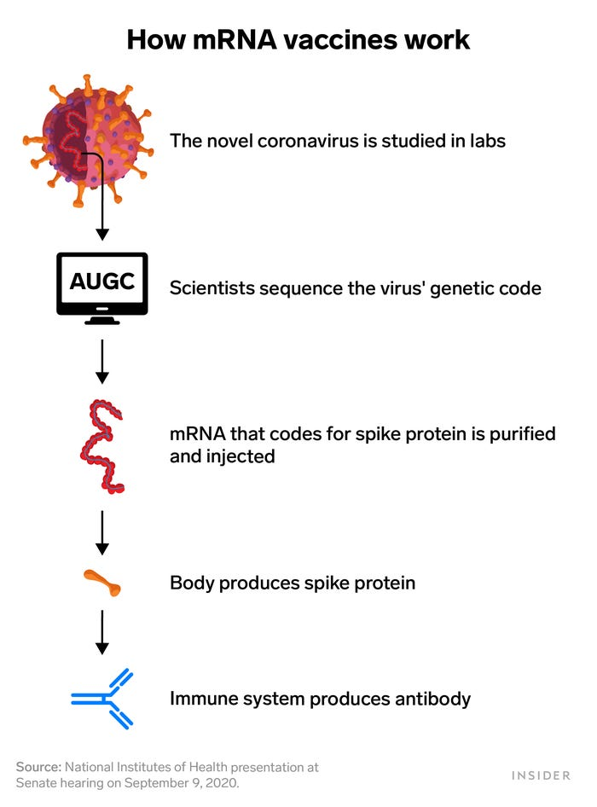
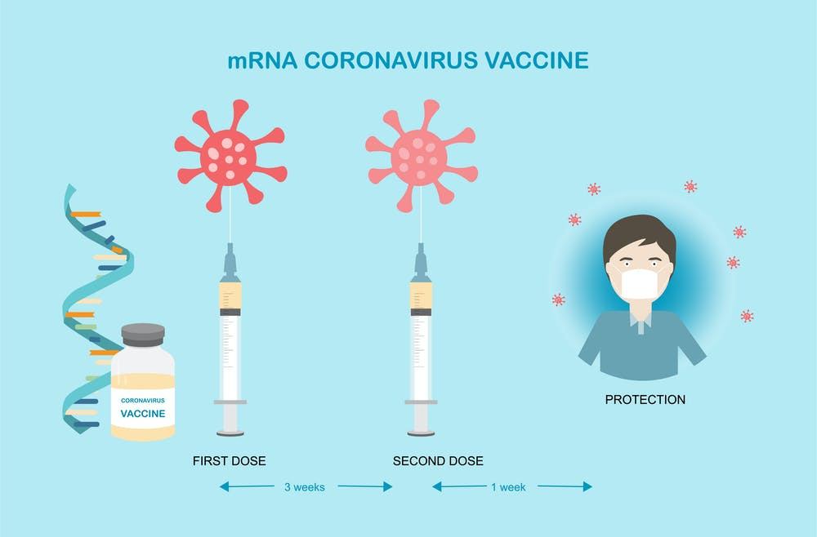

Slide 12
HOW DO WE KNOW VACCINES ARE SAFE AND EFFECTIVE?
7

Slide 13
CORONAVIRUS VACCINES
Human trials in US started March 16, 2020.
In US, two vaccines received Emergency Use Authorization in December 2020.
Pfizer-bioNTech
Moderna
Additional clinical trials ongoing.
World Health Organization: Landscape of COVID-19 candidate vaccines
NYTimes: Coronavirus Vaccine Tracker
8

