Slide 1

Kentucky Academy of Science (KAS) and
Kentucky Junior Academy of Science (KJAS)
Guidelines for Oral and Poster Presentations

Slide 2
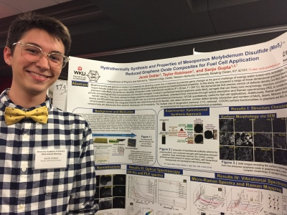
Abstract Guidelines
Ky Junior Academy of Science
High School students who wish to compete to represent KJAS at the American Junior Academy of Science (AJAS) meeting must present their research as an oral presentation. (High School students who wish to present their research without competing, are welcome to participate in the Poster session)
Middle School students who wish to present their research are welcome to participate in the Poster session.
Submissions
Each presenter is required to submit their own registration and abstract
The text of the abstract must be 200 words or fewer
The presenter of each paper must be registered to attend the meeting and be listed as the first author
All co-presenters are required to register; only one presenter will submit the abstract
Only presentations with a student as the first author are eligible for student competition
Include three components: what was done and why, what was found out (i.e., result), and what it means

Slide 3
Abstract Guidelines
Abstract Formatting
Do not use bold
Italics should be used only for scientific names and other expressions that conventionally appear in italic type – not underlined
Spell out generic names the first time they are used and include the name of the describer, afterwards names should be abbreviated to first letter of the genus (plus a period) followed by a specific epithet, e.g., Daphnia pulex (De Geer) then D. pulex thereafter.
When using abbreviations for chemical compounds, spell out the name in full at the first mention and follow with the abbreviation in parentheses, then use the abbreviation thereafter

Slide 4
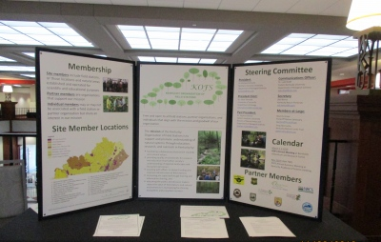
Abstract Example
The following is an example of a portion of a proper abstract as it will appear in the program:
BOTANY
Taxonomic status of the varieties of Seneca snakeroot, Polygala senega L. (Polygalaceae). AMY E. TRAUTH* and ROBERT F.C. NACZI, Department of Biological Sciences, Northern Kentucky University, Highland Heights, KY 41099.
Seneca snakeroot, Polygala senega L. (Polygalaceae), is an uncommon plant ranging throughout most of eastern North America. Two varieties have been described for the species: variety senega and variety latifolia Torrey and Gray . The taxonomic ........

Slide 5
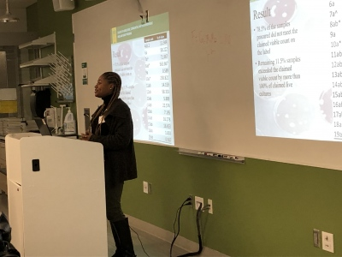
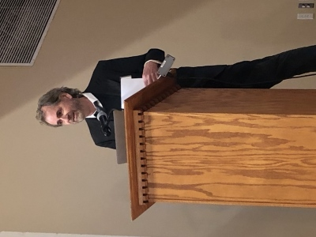
Oral Presentations
All presentations should be compatible with the current version of PowerPoint for Windows and brought on a USB drive
Be prepared to load your presentation 15 minutes before your session on the computer in your presentation room.
Presentations should be 10-12 minutes long with 3-5 minutes for questions
Video Tips for a Good Presentation
More Tips for Giving a Good Scientific Talk

Slide 6
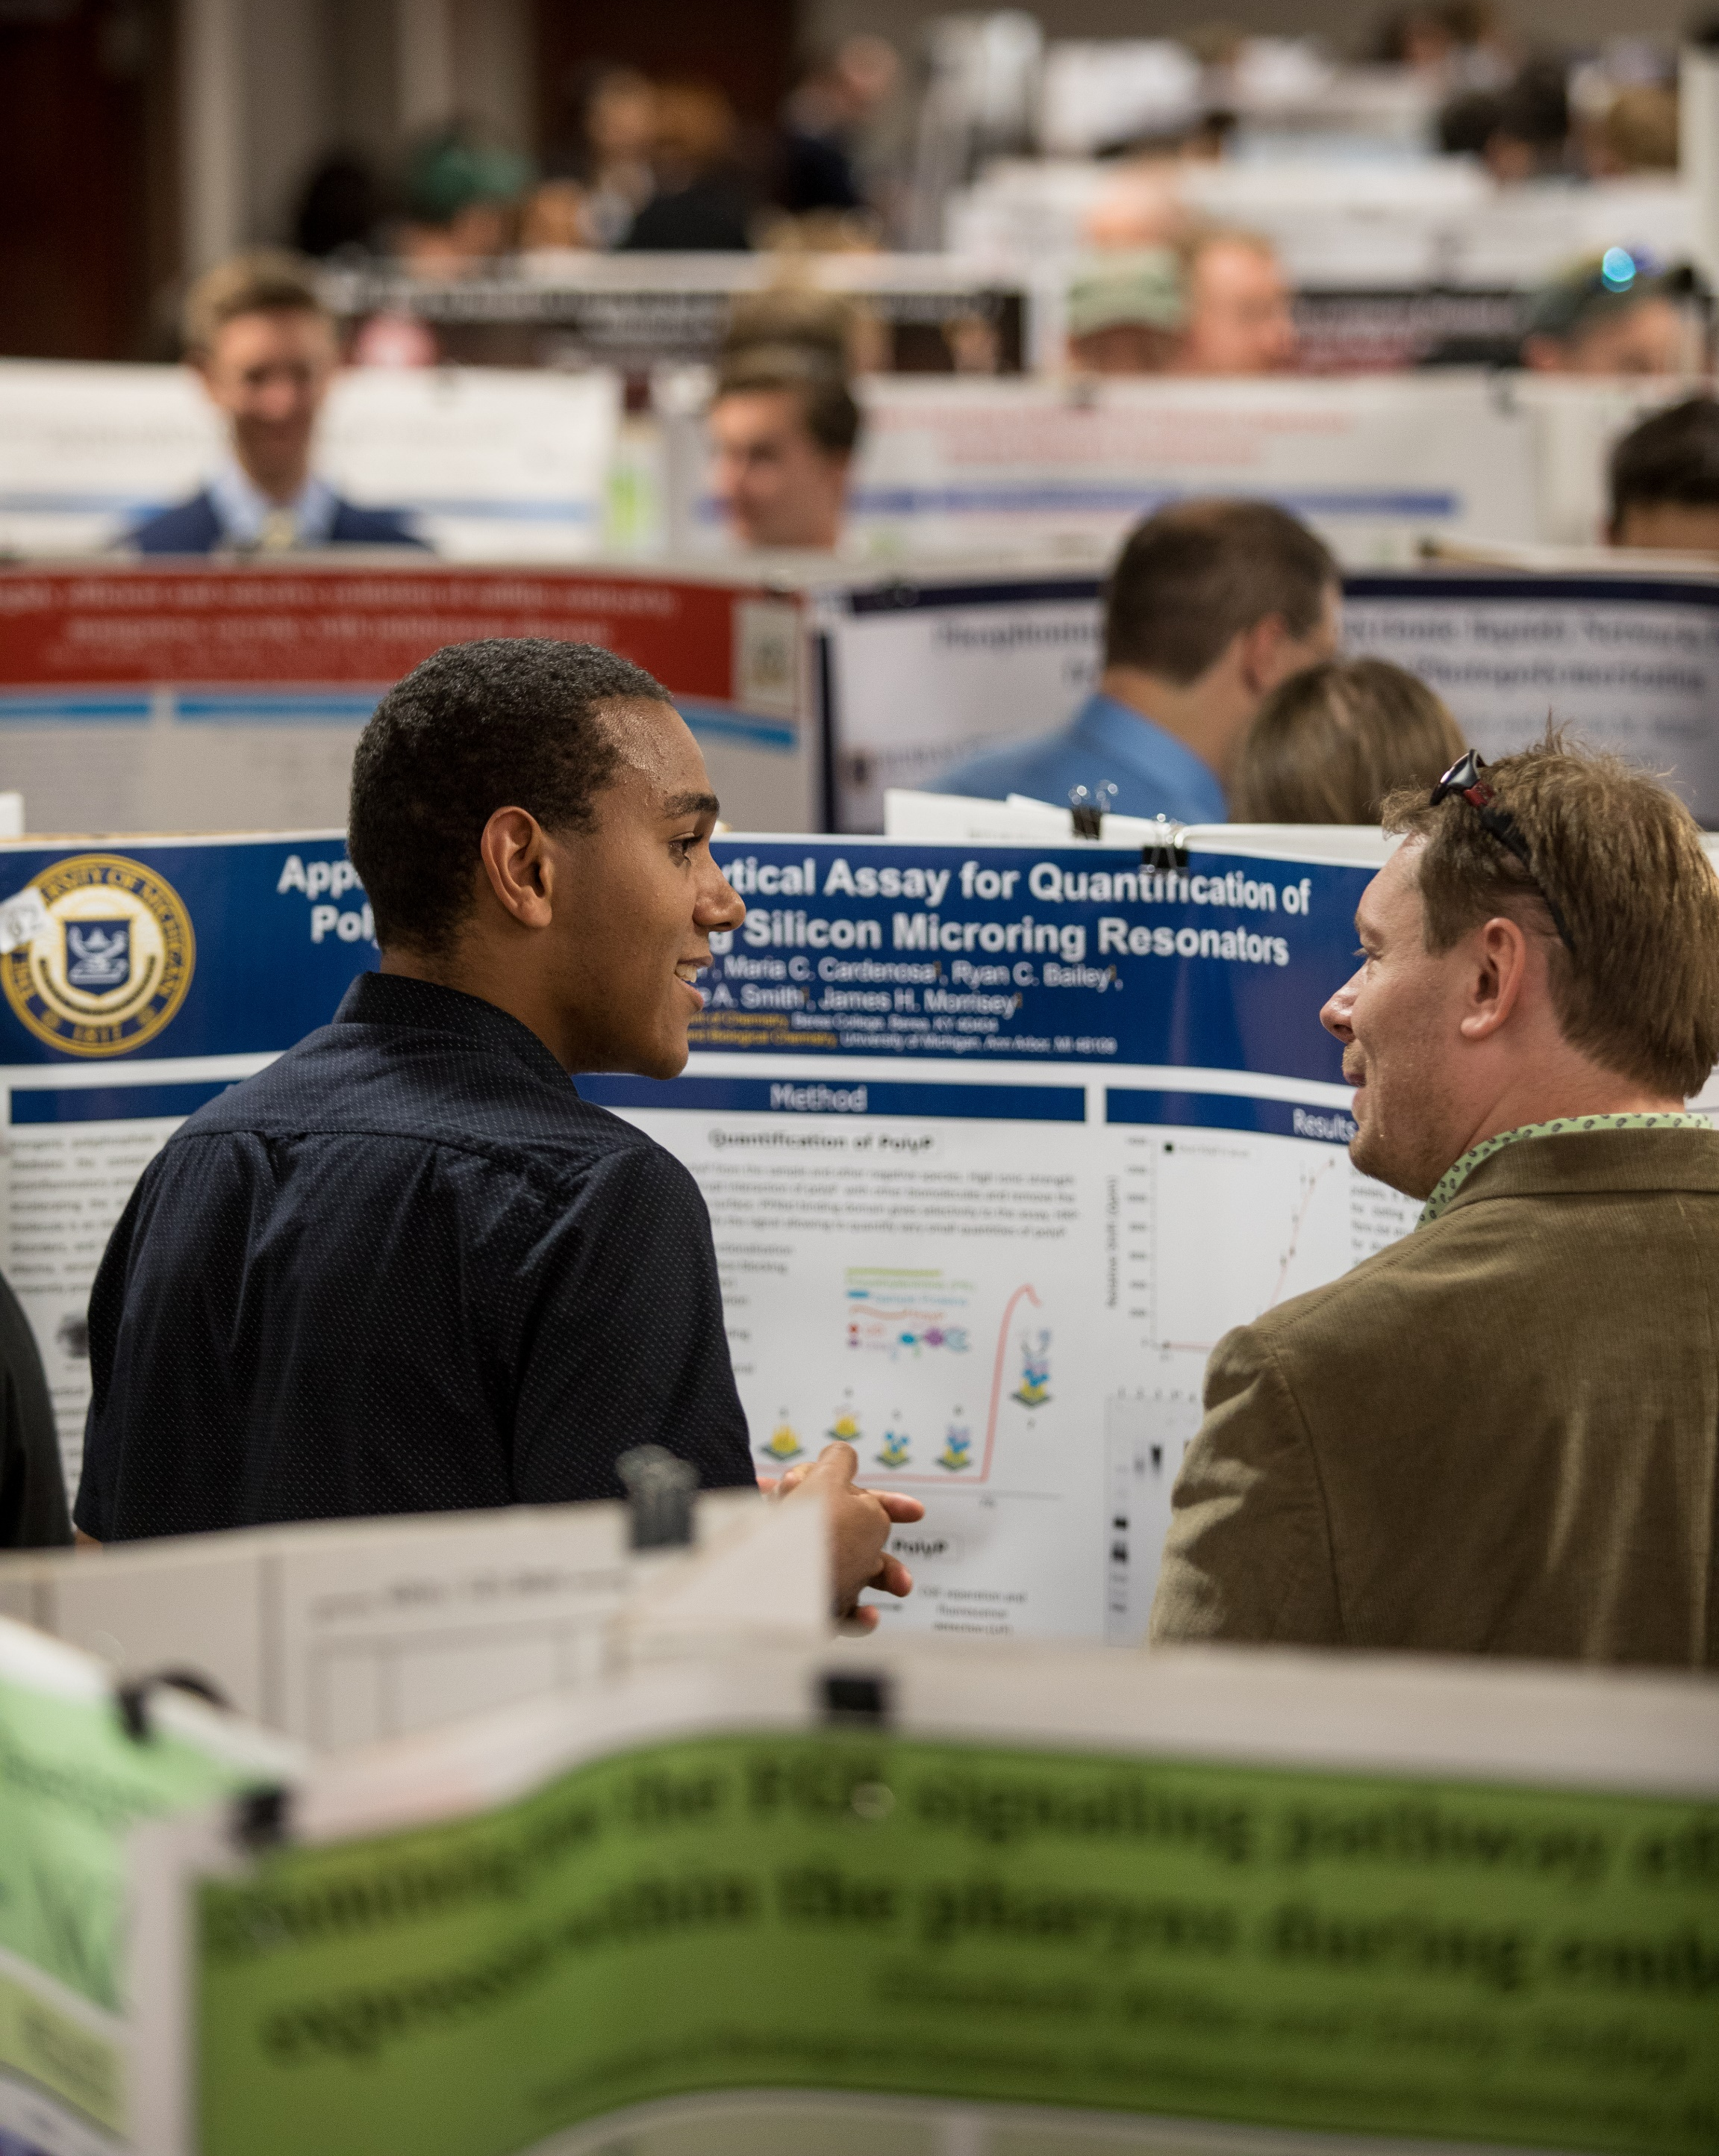
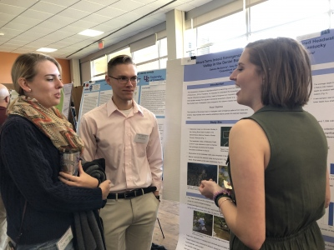
Poster Presentations
Suggestions for a Great Poster
Do not include an Abstract on a poster as they are available in the program.
Studies show that you have only 11 seconds to grab and retain your audience’s attention so make the punch line prominent and brief.
Thank anyone you collaborated with or provided funding for your research
Include your contact information
Those who are directly involved in related research will seek you out for more information.

Slide 7
Poster Presentations
More Suggestions
EDIT RUTHLESSLY!
Most posters contain way too much text.
Posters are primarily visual presentations with the text serving to support the graphic materials.
Poster Specifications
KAS poster size is 48” x 36”.
If you use PowerPoint, you can set the poster size to this size.
You may use “Drawing Tools” to insert a text box for each section you will use

Slide 8
Plagiarism Policy
Plagiarism is unacceptable at KAS and other scientific societies. Participating authors are expected to recognize the basic principles of plagiarism as they apply to scientific writing.
Plagiarism in science includes, but is not limited to:
Failing to paraphrase (not using your own words)
Changing the order of the words or only a few words in a copied sentence
Quoting extensively, even when quotation marks are used
Failing to cite the source of information that is not common knowledge to your peers
Using ideas first proposed by others without acknowledging the source of the idea
Using images, figures, graphs, maps, or other visual elements without citing the source
Reusing past assignments from classes without the instructor’s permission
Using information, ideas, or wording provided by another student
Failing to provide an accurate list of references
Presenting the work of others as your own.

