Slide 1
Kentucky Academy of Science
Presentation Guidelines

Slide 2
Kentucky Academy of Science
Poster Format
Some Suggestions for a Great Poster
Do not include an Abstract on a poster as they are available on the website.
Studies show that you have only 11 seconds to grab and retain your audience’s attention so make the punch line prominent and brief.
Those who are directly involved in related research will seek you out for more information.
More Suggestions
EDIT RUTHLESSLY!
Most posters contain too much text.
Posters are primarily visual presentations with the text serving to support the graphic materials.
Your poster will be viewed prior to your 5 minutes in the Q&A session, so summarize your research in about 1 minute before questions.
Poster Specifications
KAS poster size is 48” 36”.
For a virtual poster session, use PowerPoint and set the poster size to this size.
You may use “Drawing Tools” to insert a text box for each section you will use
Record audio up to 10 minutes to accompany your poster. Instructions follow on slide 4.

Slide 3
Kentucky Academy of Science
Oral Format
Some Suggestions for a Great Presentation
Do not include an Abstract on the PowerPoint as they are available in the program.
Studies show that you have only 11 seconds to grab and retain your audience’s attention so make the punch line prominent and brief.
Those who are directly involved in related research will seek you out for more information.
More Suggestions
EDIT RUTHLESSLY!
Most presentations contain way too much text.
Your presentation will be viewed prior to your Q&A session, so take about 1 minute to summarize your research in the Q&A before questions
PowerPoint Slides
Remember that you have up to 10 minutes total for your recording.
There is no limit to the number of slides as long as your presentation fits within the 10-minute time limit.
See audio recording instructions following this slide.

Slide 4
How to record audio for a powerpoint presentation
A step by step guide

Slide 5
All presentations need Accompanying audio
Regardless of your presentation format

Slide 6
On the main home page, select Slideshow

Slide 7
Make sure these three have been selected

Slide 8
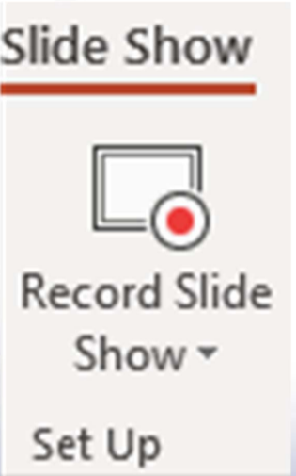
Select “Record Slide show” Holding down the arrow will allow you to either record audio from the beginning of your presentation or from the current slide or from the current slide.

Slide 9
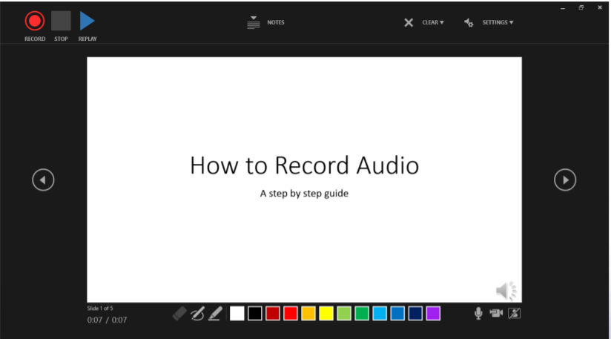
Press here to record, stop, or replay audio

Slide 10
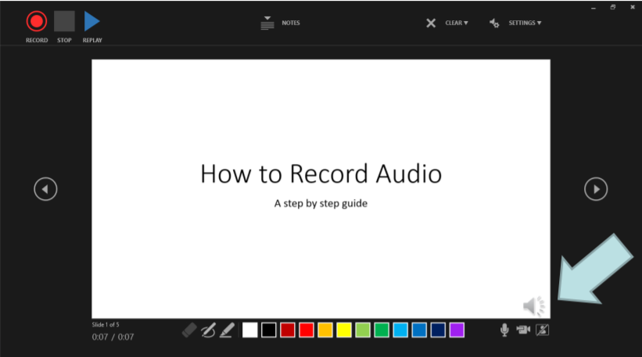
This symbol lets you know audio has been recorded and is ready to play

Slide 11
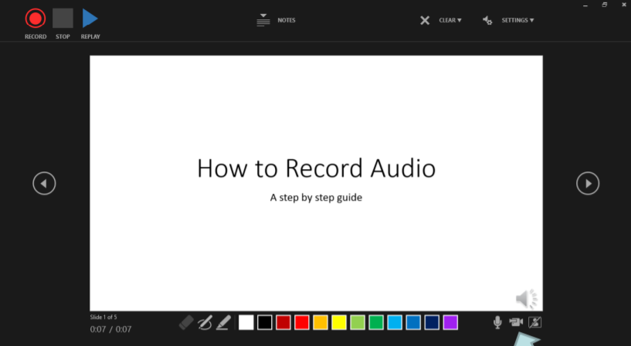
This symbol lets you record a video to add to your slide. You must press this button to turn camera on/off when you initially go to record audio.

Slide 12
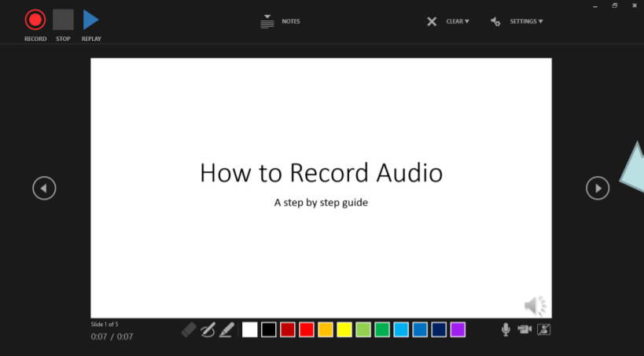
Click through each slide to add audio to any additional slides

Slide 13
Helpful tips for inserting audio into presentations:
The best time to add audio to your slides is once your presentation has been completed
Time your PowerPoint!
Remember that you have up to 10 minutes total for your recording.
There is no limit to the number of slides as long as your presentation fits within the 10-minute time limit.

