Slide 1
Cargill Building Classrooms and Labs

Slide 2
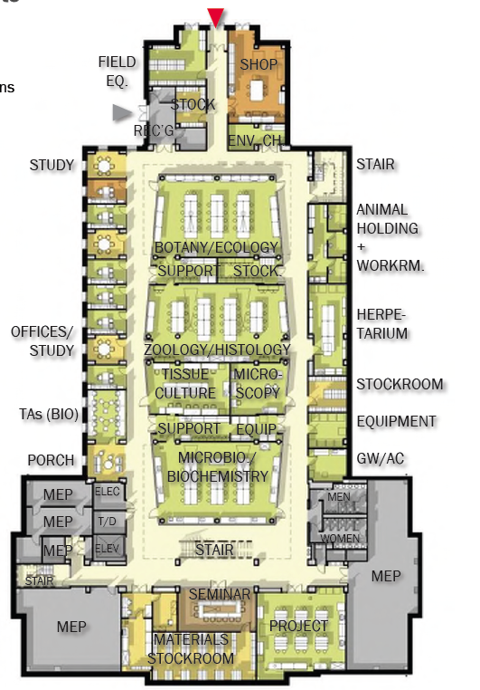
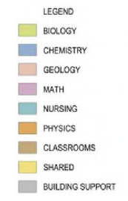
First Floor Classrooms:
102: Seminar Room seating 16
Possible Class-Labs that could be used with EHS & Departmental Permission:
157: Genetics Lab seating 32
167: Zoology seating 32
170: Botany seating 28

Slide 3
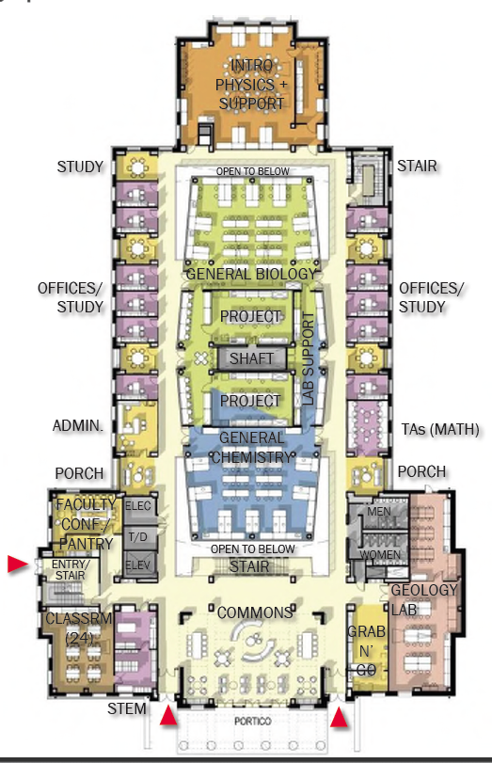
Second Floor Classrooms:
206: Math Education seating 24
251: Geo-Archeology seating 24
230: General Physics seating 36
Possible Class-Labs that could be used with EHS Permission:
257: General Chemistry seating 32
270: General Biology seating 32

Slide 4
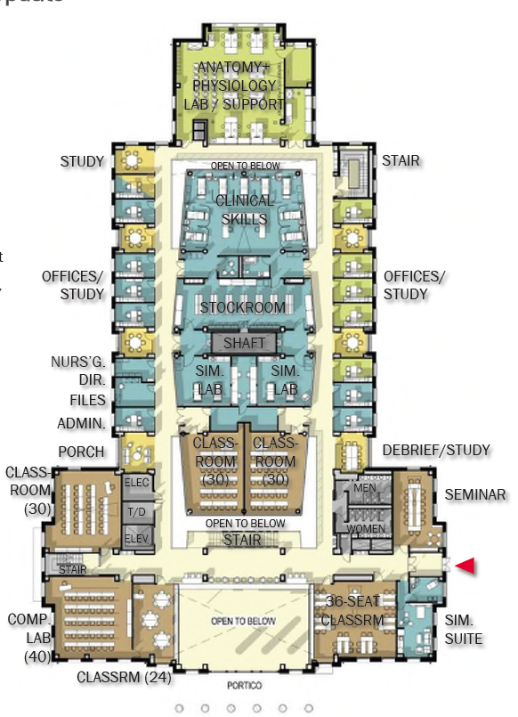
Third Floor Classrooms:
304: Math Education seating 18
306: Testing Lab seating 40
308: General Classroom seating 30
350: Seminar room seating 16
355: Nursing classroom seating 36
357: General Classroom seating 30
358: General Classroom seating 30
Possible Class-Labs that could be used with EHS Permission:
257: General Chemistry seating 32
270: General Biology seating 32

Slide 5
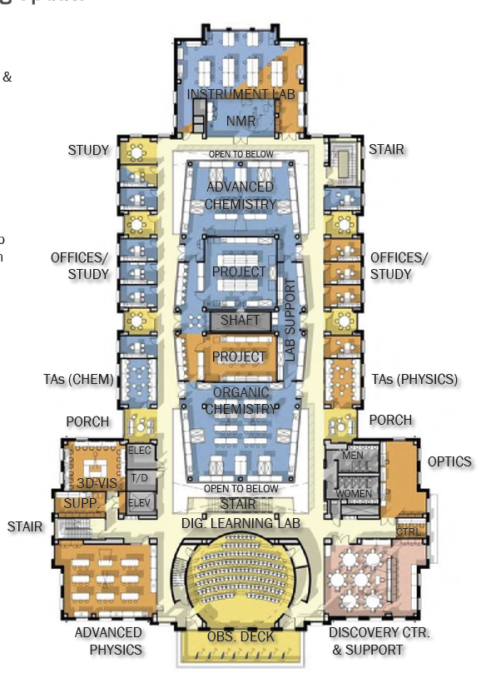
Fourth Floor Classrooms:
402: Planetarium seating 122
406: Advanced Physics seating 24
455: Yahng Discovery Center seating 56
Possible Class-Labs that could be used with EHS Permission:
457: Organic Chemistry seating 32
470: Advanced Chemistry seating 24

Slide 6
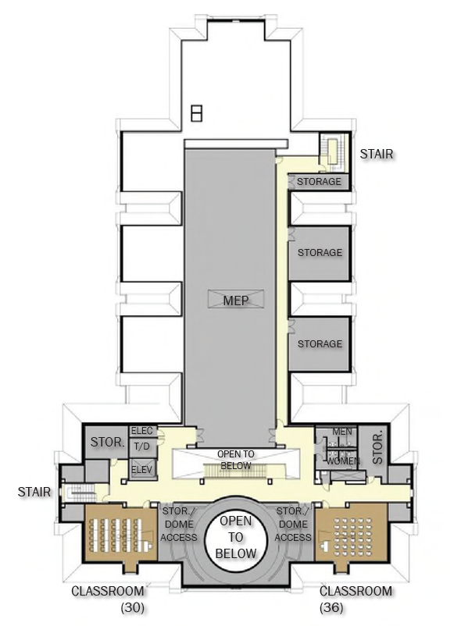
Fifth Floor Classrooms:
506: General Classroom seating 28
551: General Classroom seating 36

Slide 7
Room # | Description | Occupancy | Seating Description
102 | Seminar Room 102 | 16 | long seminar table
157 | Microbiology & Genetics Class/Lab | 32 | fixed tables & chairs in center, lab benches along walls
167 | Zoology Class/Lab | 32 | fixed lab benches & chairs
170 | Botany & Ecology Class/Lab | 28 | fixed tables & chairs in center, lab benches along walls
206 | Math Classroom 206 | 24 | fixed tables & chairs organized for group work
230 | General Physics Class/Lab | 36 | 4 round tables for 9 (SCALE UP)
251 | Geology & Archeology Class/Lab | 24 | fixed lab benches & chairs
257 | General Chemistry Class/Lab | 32 | fixed tables & chairs in center, lab benches along walls
270 | General Biology Class/Lab | 32 | fixed tables & chairs in center, lab benches along walls
304 | Developmental Math Classroom 304 | 18 | 3 round tables for 6
306 | Computer Testing Classroom | 40 | 40 fixed desks with popup computers for secure test taking
307 | Classroom 307 | 30 | chairs and movable tables
330 | Anatomy & Physiology Class/Lab | 24 | chairs and movable tables
350 | Seminar Room | 16 | long seminar table
355 | Nursing Classroom | 36 | fixed tables & chairs organized for group work
356 | Classroom 356 | 30 | chairs and movable tables
357 | Classroom 357 | 30 | chairs and movable tables
402 | Planetarium/Digital Theater | 121 | auditorium style seating
406 | Advanced Physics Class/Lab | 24 | fixed tables & chairs
457 | Organic Chemistry Class/Lab | 32 | fixed tables & chairs in center, lab benches along walls
470 | Advanced Chemistry Class/Lab | 16 | fixed tables & chairs in center, lab benches along walls
506 | Classroom 506 | 28 | chairs and movable tables
551 | Classroom 551 | 36 | Tablet arm chairs
Yellow indicates labs with food/drink restrictions

