Slide 1
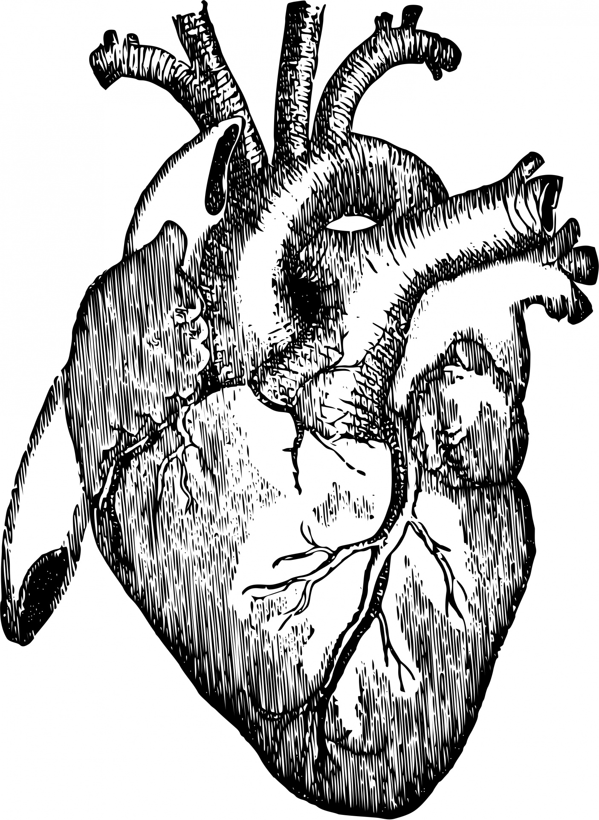


Exploring the metabolic mechanisms of cardiac remodeling
Bradford G. Hill, Ph.D.
Associate Professor of Medicine
University of Louisville

Slide 2
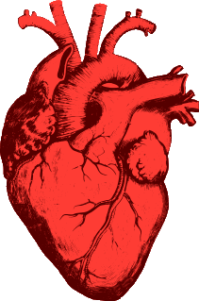
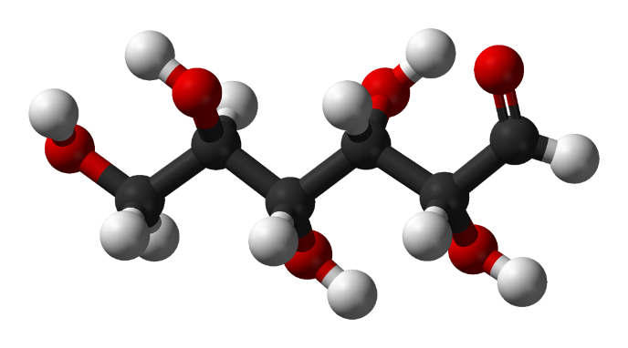
Areas of research
Metabolic regulation of heart failure
Metabolic mechanisms of myocardial repair and regeneration
Metabolic regulation of exercise-induced benefits to cardiovascular health

Slide 3
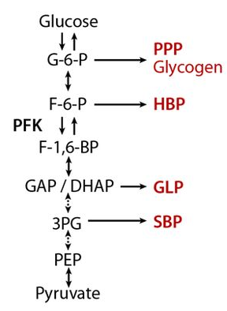
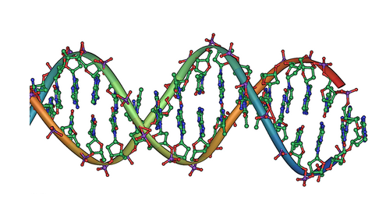
Why study metabolism?
Metabolism
ATP production
Signals &
Transcription
Control of redox state
Glycolysis
AMPK
mTOR
Akt
Biosynthesis
Epigenetic modifications
NAD(P)⁺/NAD(P)H
GSH/GSSG
Gibb AA and Hill BG. Circ Res 123: 107, 2018

Slide 4

How does a cell know when and where to shuttle nutrients?
Glucose
Glycogen
G-6-P
PPP
Nucleotides
F-6-P
HBP
UDP-GlcNAc
F-1,6-BP
N-, O-linked glycosylation
GAP / DHAP
GLP
Glycero(phospho)lipids
Serine/Glycine
Methyl donors
3PG
SBP
PEP
Nucleotides
Amphibolic metabolites
G6P, F6P, DHAP, 3PG, R5P
Lactate
Pyruvate
PC
OAA
Asp
Nucleotides
FAs
AAs
KBs
Acetyl
CoA
Krebs cycle

Slide 5
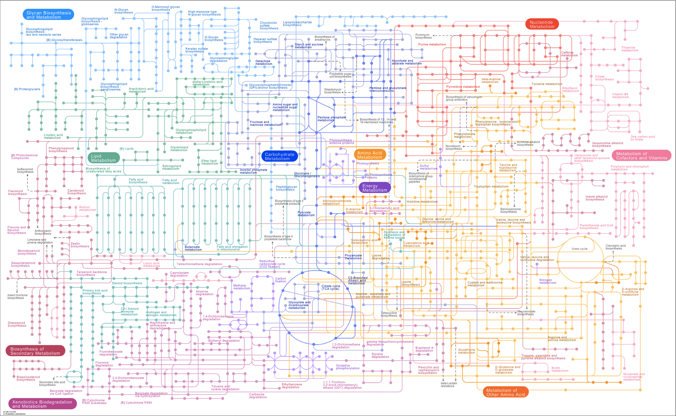

Slide 6
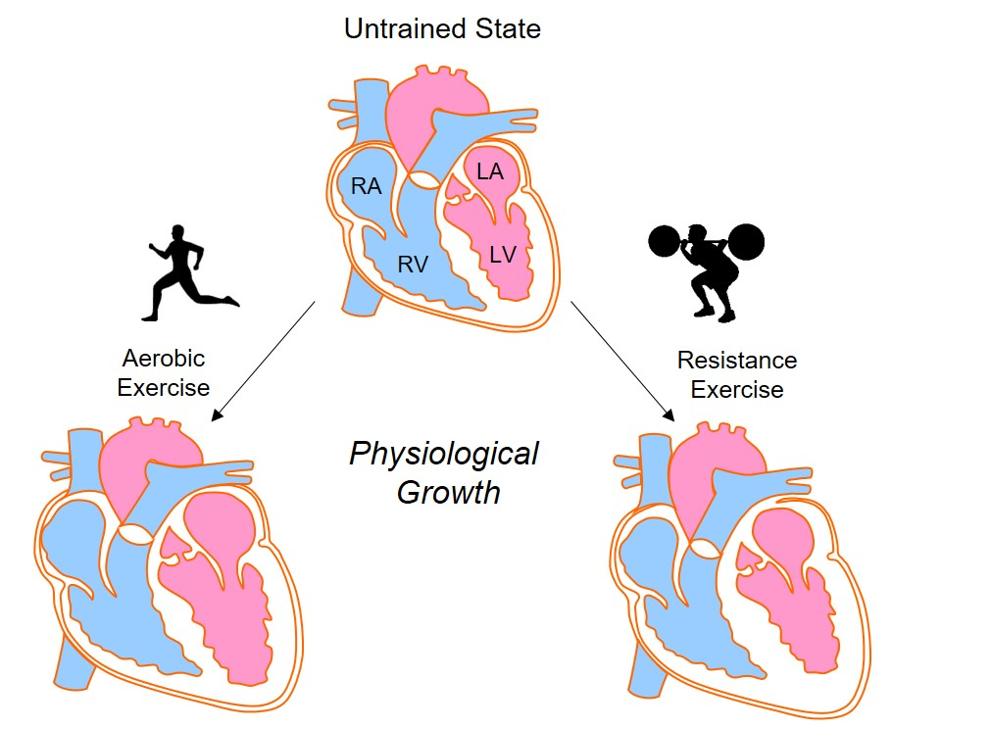
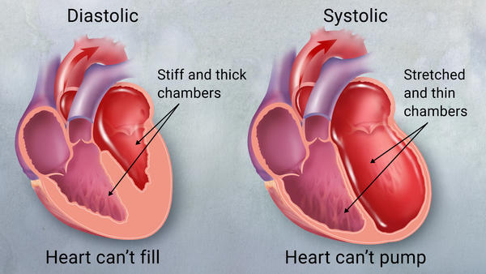
Cardiac metabolism in health and disease
Glucose
Heart failure
Glycogen
G-6-P
PPP
Nucleotides
F-6-P
HBP
UDP-GlcNAc
F-1,6-BP
N-, O-linked glycosylation
GAP / DHAP
GLP
Glycero(phospho)lipids
Serine/Glycine
Methyl donors
3PG
SBP
PEP
Nucleotides
Lactate
Pyruvate
OAA
Asp
Nucleotides
FAs
AAs
KBs
Acetyl
CoA
Krebs cycle
Fulghum K and Hill BG. Front Cardiovasc Med. 5: 127, 2018

Slide 7

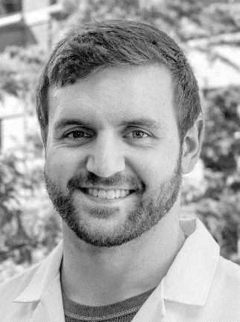
Andrew Gibb Kyle Fulghum
Temple University, Post-Doctoral Fellow
University of Louisville, Graduate Student

Slide 8
Two questions
How does cardiac metabolism change with exercise and heart failure?
Do cardiac metabolic changes cause cardiac remodeling?

Slide 9
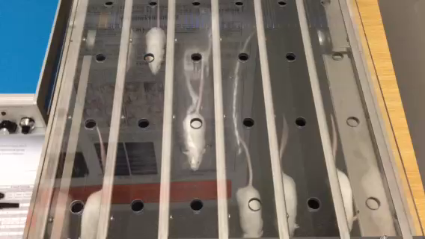
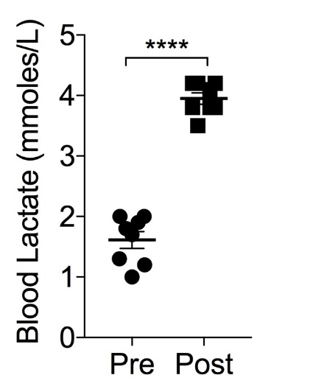
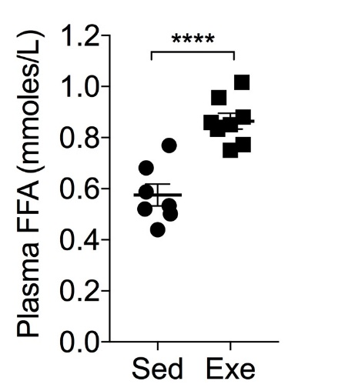
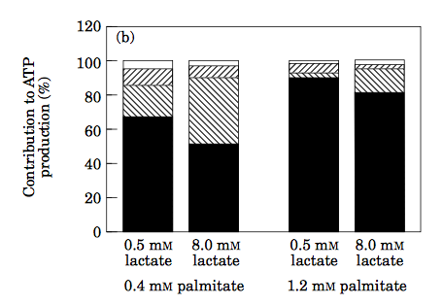
What systemic metabolic changes occur during exercise that could influence the heart?
Circulating substrates
Glycolysis
Glucose Oxidation
Lactate Oxidation
Fatty Acid Oxidation
Blood analyses
40 min Exe at 75% max
< 5 min
Gibb AA et al. Circulation 136(22): 2144-57, 2017
Schonekess BO. J Mol Cell Cardiol 29(10):2725-33, 1997

Slide 10
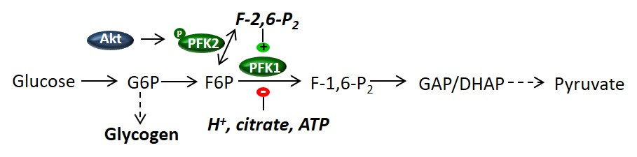
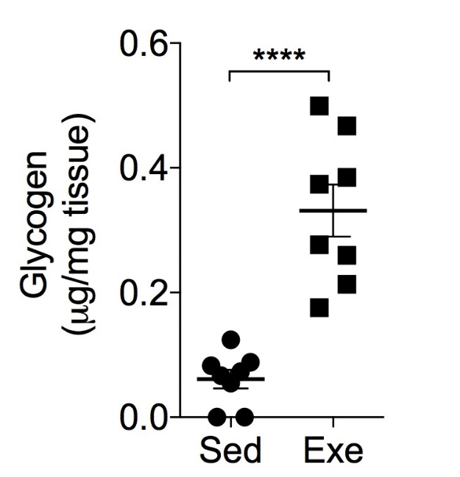
How does cardiac glucose metabolism change during exercise?
Biochemical analyses in heart
40 min Exe at 75% max
< 5 min
Lactate
Fatty acids
PFK activity
Cardiac glucose catabolism is diminished during intense aerobic exercise
Gibb AA et al. Circulation 136(22): 2144-57, 2017

Slide 11
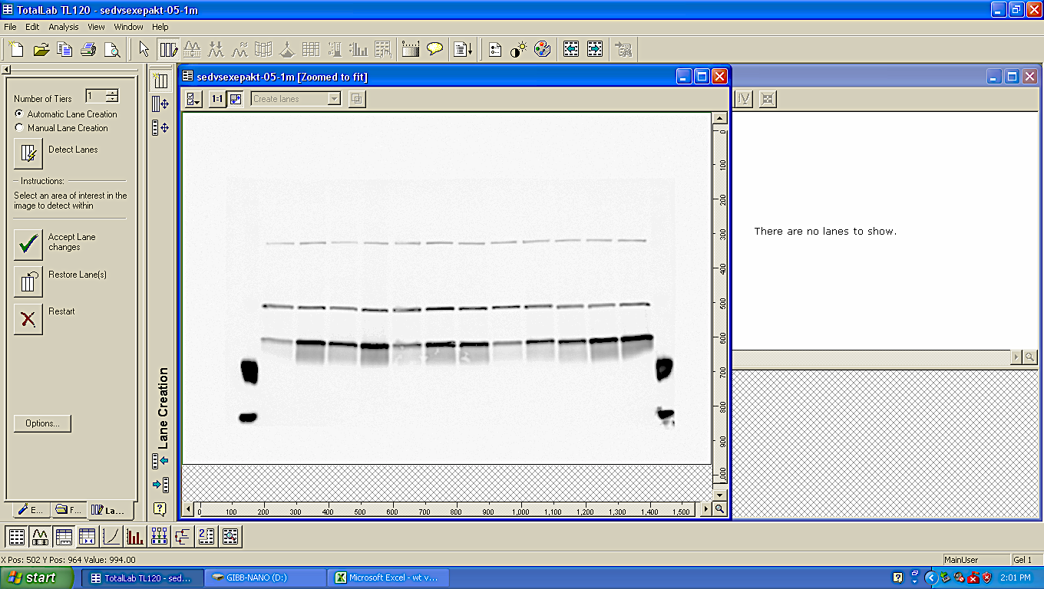
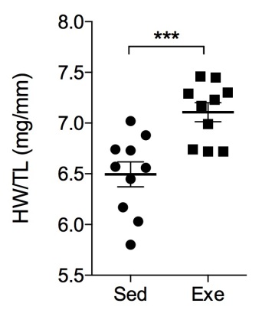
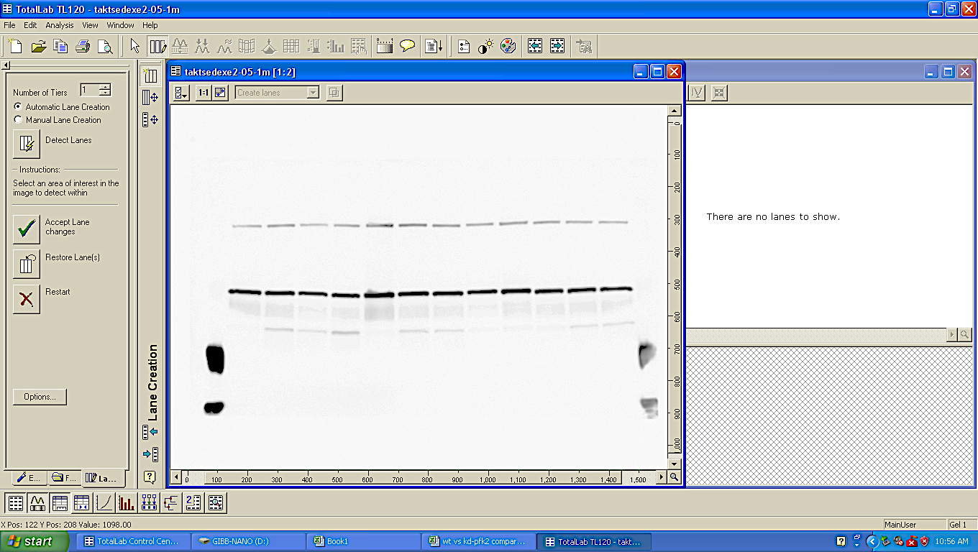
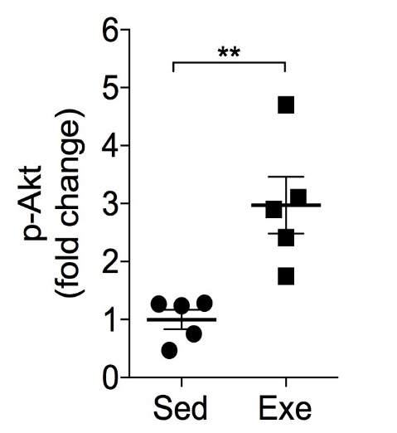
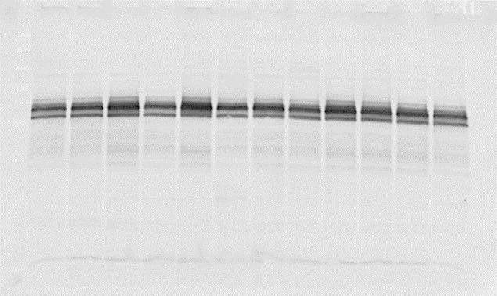
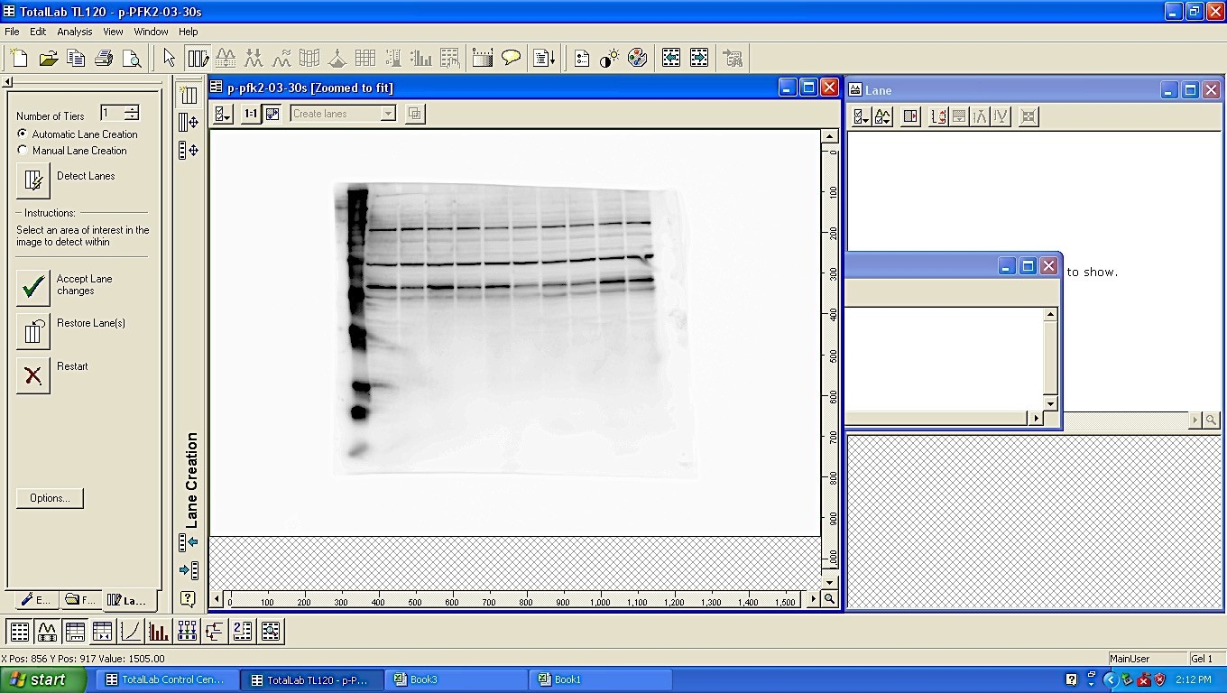
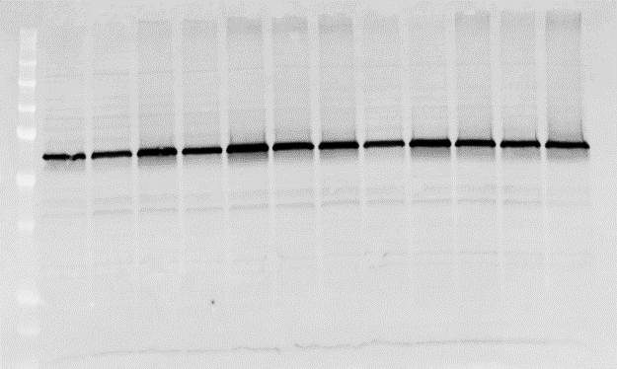
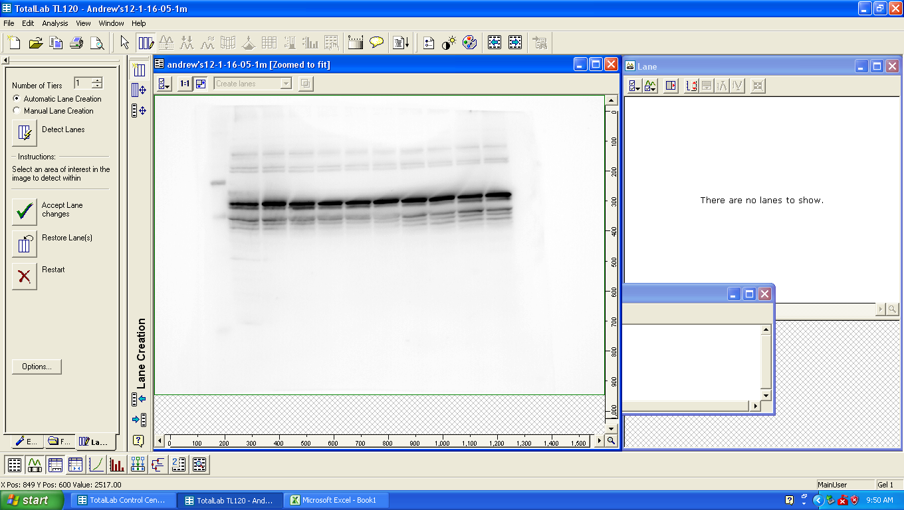
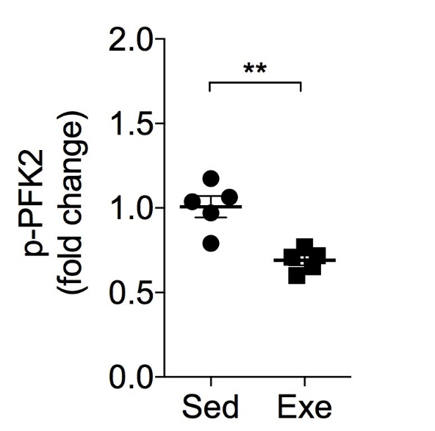
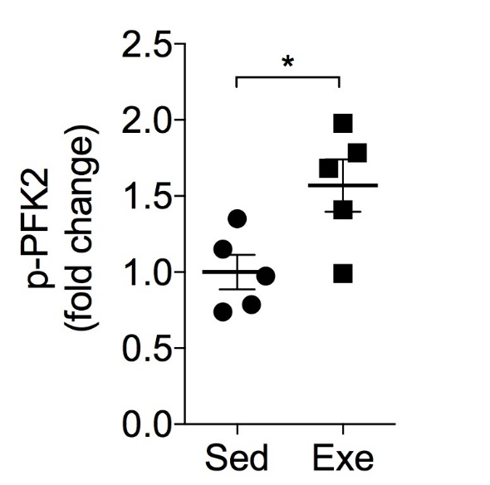
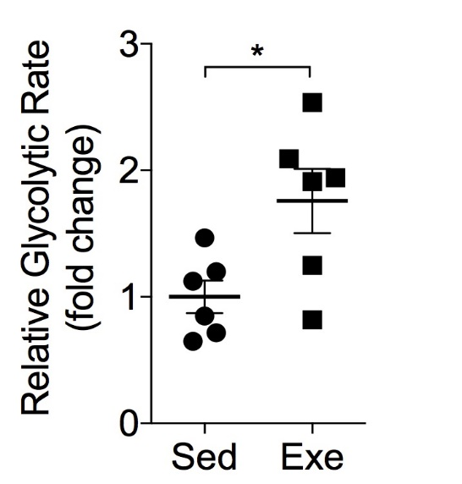
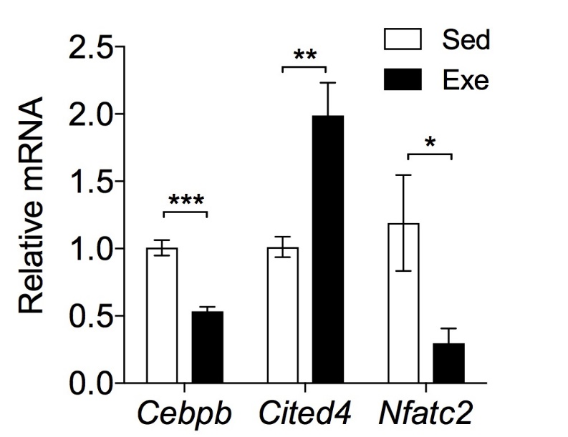
Glucose metabolism in the exercise-adapted heart
Recovery
p-Akt
4 weeks of exercise training
1 h
End
t-Akt
ECT
24 h
1 h post-exercise
24 h post-exercise
S E S E S E
S E S E S E
p-PFK2
p-PFK2
t-PFK2
t-PFK2
Gibb AA et al. Circulation 136(22): 2144-57, 2017
Gibb AA et al. Front Physiol 21;7:636, 2016

Slide 12
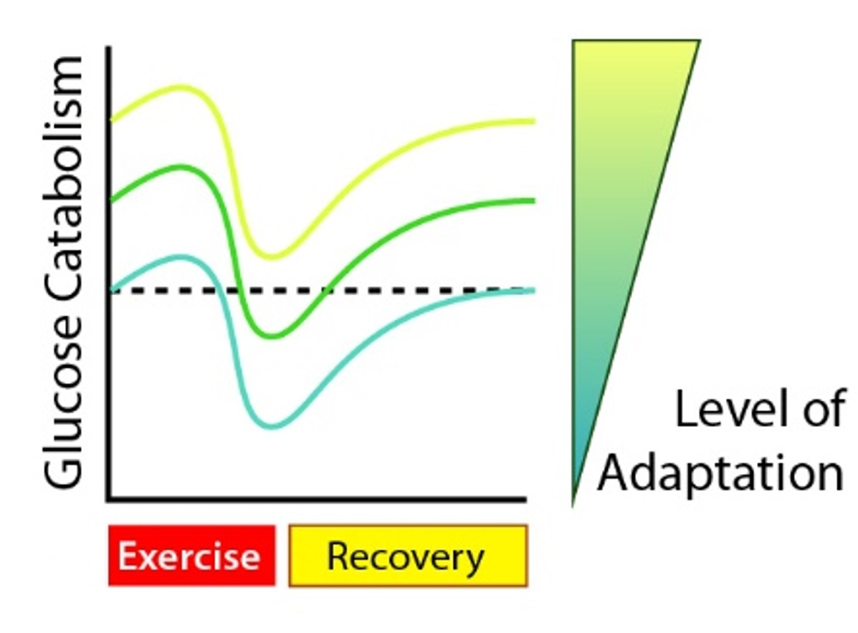
Might exercise-induced decreases in cardiac glucose catabolism regulate adaptation?
Glucose
Glycogen
G-6-P
PPP
Nucleotides
F-6-P
HBP
UDP-GlcNAc
PFK
F-1,6-BP
N-, O-linked glycosylation
GAP / DHAP
GLP
Glycero(phospho)lipids
Serine/Glycine
Methyl donors
3PG
SBP
PEP
Nucleotides
Lactate
Pyruvate
PC
OAA
Asp
Nucleotides
FAs
AAs
KBs
Acetyl
CoA
Krebs cycle

Slide 13
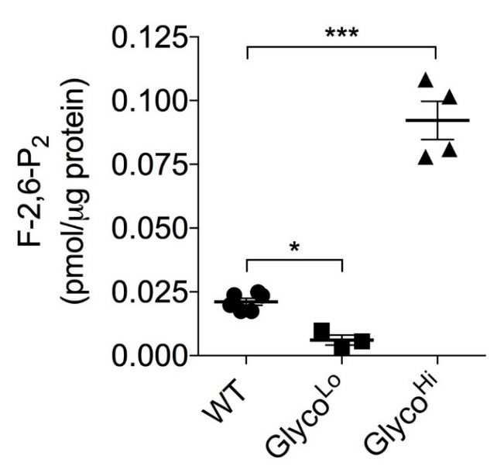
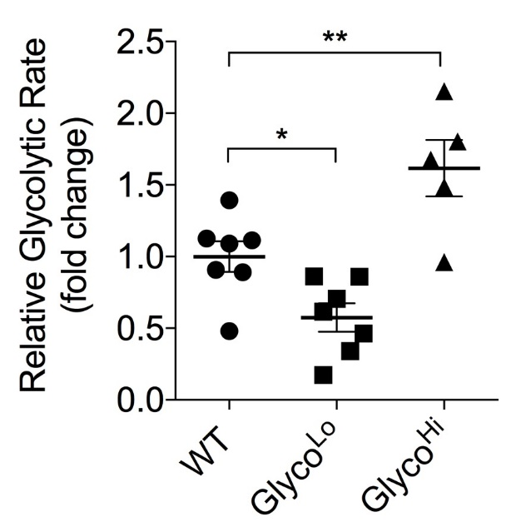
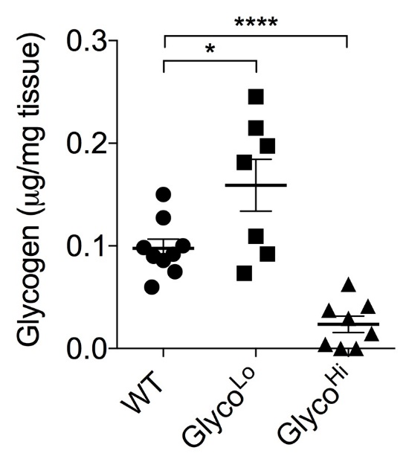
PFK2 mutant mice: tools to examine the role of PFK
F-2,6-P₂
Glyco^{Hi}
phosphatase-deficient PFK2 construct
Glyco^{Hi}
+
Glyco^{Lo}
αMHC
Kinase Phosphatase
PFK2
S32A
H258A
Glucose
PFK1
G6P
F6P
F-1,6-P₂
GAP/DHAP
Pyruvate
Glyco^{Lo}
_-
Glycogen
kinase-deficient PFK2 construct
H⁺, citrate, ATP
αMHC
Kinase Phosphatase
S32D
T55V
Gibb AA et al. Circulation 136(22): 2144-57, 2017

Slide 14
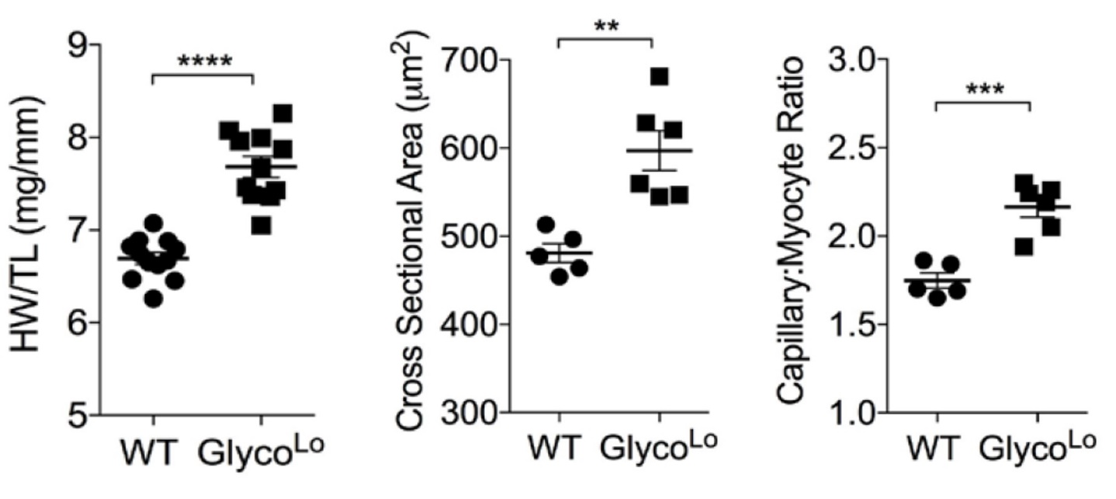
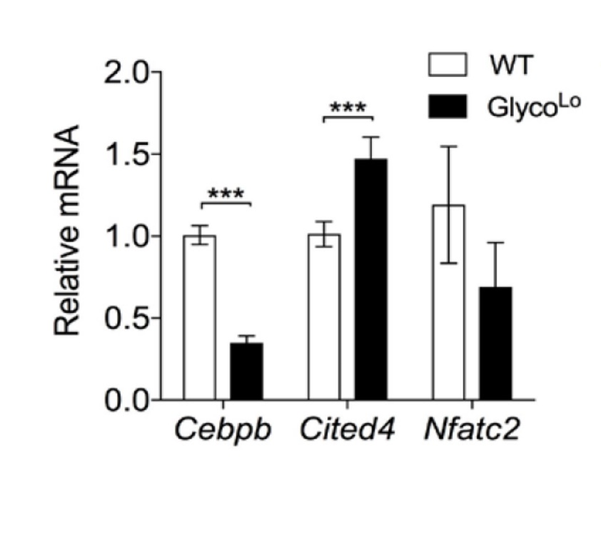
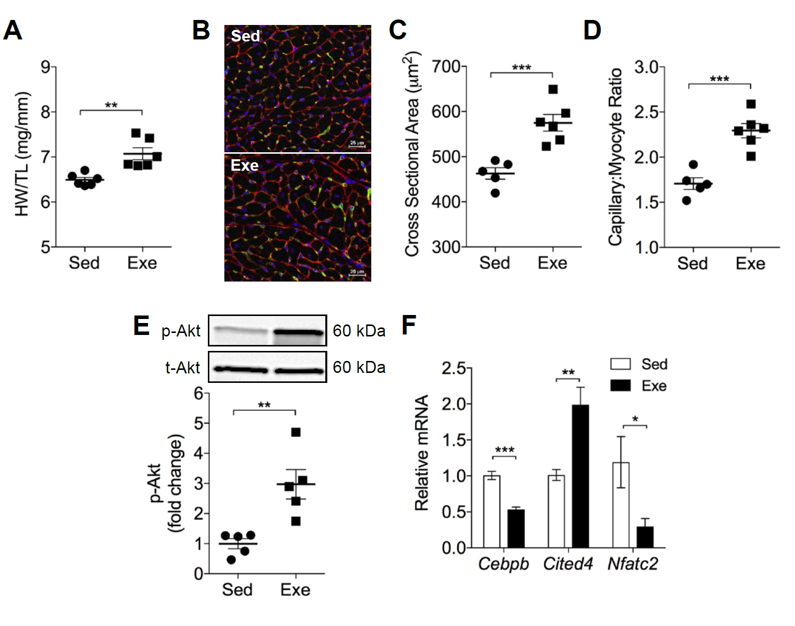
Low rates of glucose catabolism are sufficient to drive cardiac growth and the exercise gene program
Gibb AA et al. Circulation 136(22): 2144-57, 2017

Slide 15
How does PFK cause cardiac growth?
Glucose
Glycogen
G-6-P
PPP
Nucleotides
F-6-P
HBP
UDP-GlcNAc
PFK
F-1,6-BP
N-, O-linked glycosylation
GAP / DHAP
GLP
Glycero(phospho)lipids
Serine/Glycine
Methyl donors
3PG
SBP
PEP
Nucleotides
Lactate
Pyruvate
PC
OAA
Asp
Nucleotides
FAs
AAs
KBs
Acetyl
CoA
Krebs cycle

Slide 16
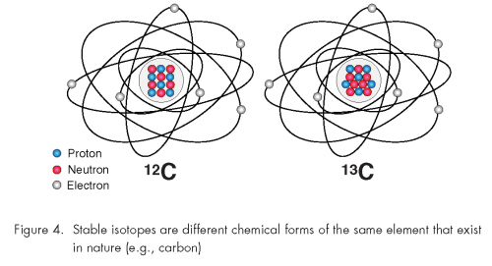
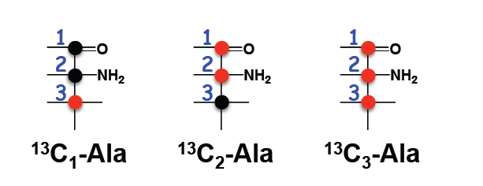
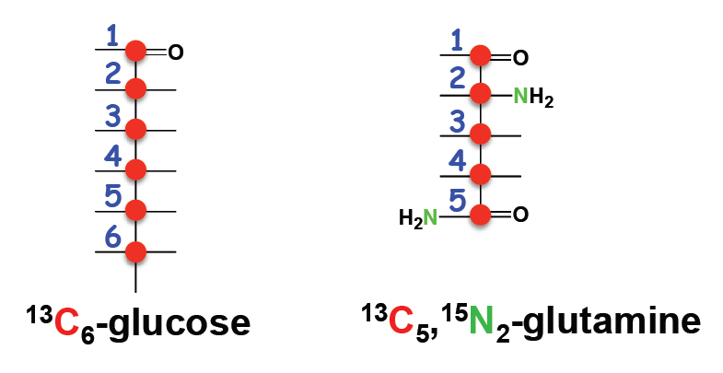
Stable isotope resolved metabolomics (SIRM): A key methodology for addressing this question
Isotopic Mass
¹²C Mass = 12.0 (12.011) ¹³C Mass = 13.003355
Cells
m + 0
m + 1
Tissues
Organisms
m + 2
m + 3

Slide 17
Deep network tracing
Sun RC et al. Nat Commun 8(1):1646, 2017

Slide 18
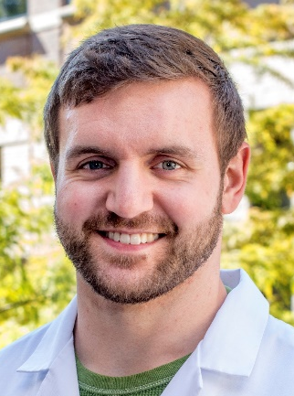
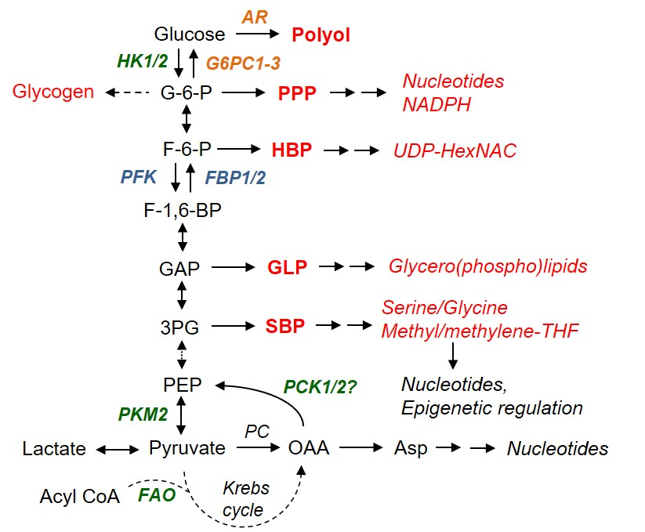
Experimental Design
2 d acclimatization
18 h feeding
PFK
WT
Glyco^{Hi}
Glyco^{Lo}
Freeze-clamped
Metabolite extraction
NMR
IC-MS

Slide 19
PFK influences amphibolic metabolite abundance
G6P
F6P
*
*
Glucose
Glucose
Glucose
F16BP
1,3-BPG
G6P
F6P
F16BP
GAP/DHAP
1,3-BPG
3PG/2PG
PEP
3-PG/2-PG
PEP
Pyr
Lac
Pyr
Lac
WT
Glyco^{Lo}
Glyco^{Hi}

Slide 20
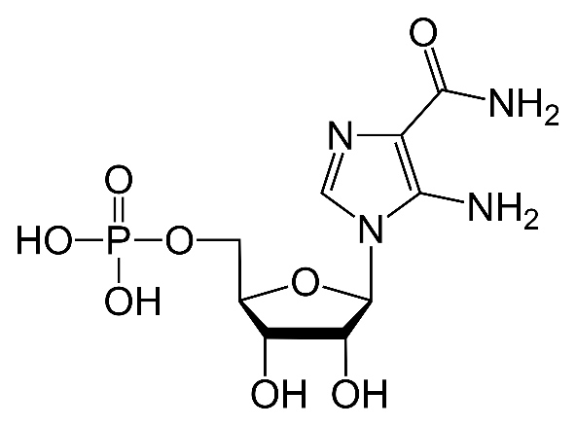
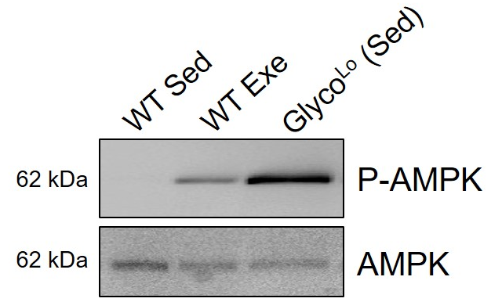
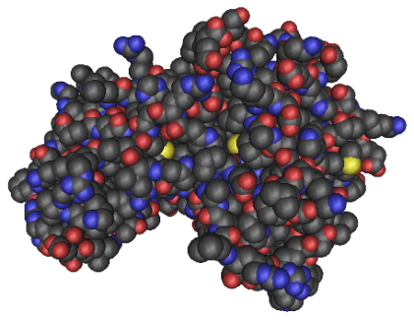
SIRM reveals PFK-dependent metabolic channeling
Pentose phosphate pathway
Glucose
G6P
F6P
*
WT
Glyco^{Lo}
Glyco^{Hi}
F-1,6-BP
AICAR
GAP / DHAP
Purine synthesis pathway
3PG
PEP
Pyruvate
AMPK

Slide 21
Conclusions
Cebpb/Cited4
Nucleotides
?
Low PFK activity, such as occurs during exercise, promotes G6P and F6P accumulation
Glucose
AICAR
AMPK
G6P
R5P
PRPP
Histidine
F6P
F16BP
Low PFK promotes metabolic channeling to synthesize AICAR
GAP/DHAP
1,3-BPG
3-PG/2-PG
PEP
Pyr
PFK-modulated AICAR synthesis likely plays a role in metabolite signaling.
Lac
Glyco^{Lo}
Exercise

Slide 22


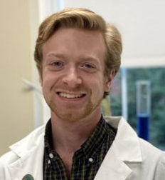

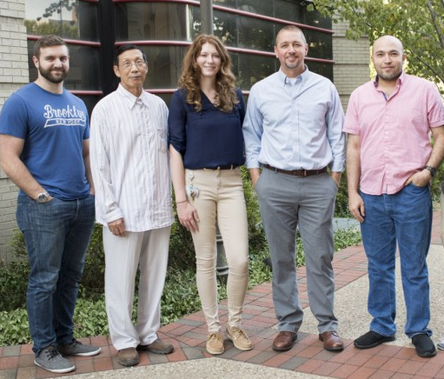
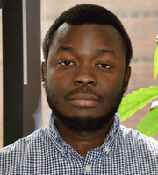


Acknowledgments
University of Louisville
Steve Jones, Ph.D.
Sujith Dassanayaka, Ph.D.
Helen Collins, Ph.D.
Pawel Lorkiewicz, Ph.D.
Matt Nystoriak, Ph.D.
Jason Hellmann, Ph.D.
Petra Haberzettl, Ph.D.
Marcin Wysoczynski, Ph.D.
Sanjay Srivastava, Ph.D.
Aruni Bhatnagar, Ph.D.
Temple University
Andrew Gibb, Ph.D.
University of Kentucky
Teresa Fan, Ph.D.
Rick Higashi, Ph.D.
Andrew Lane, Ph.D.
R01 HL130174
R01 HL147844
P01 HL078825
R01 ES028268
P30 GM127607
F31 HL154663

