Slide 1
Discovery, Design, Synthesis and Testing of High Performance Structural Alloys
T. John Balk
Chemical & Materials Engineering, University of Kentucky
Daryl Chrzan, Andrew Minor, Mark Asta
Lawrence Berkeley National Laboratory
Acknowledgement
DOE BES Materials Sciences and Engineering (MSE) Division
U.S. Department of Energy, Office of Science, Award # DE-SC0019402

Slide 2
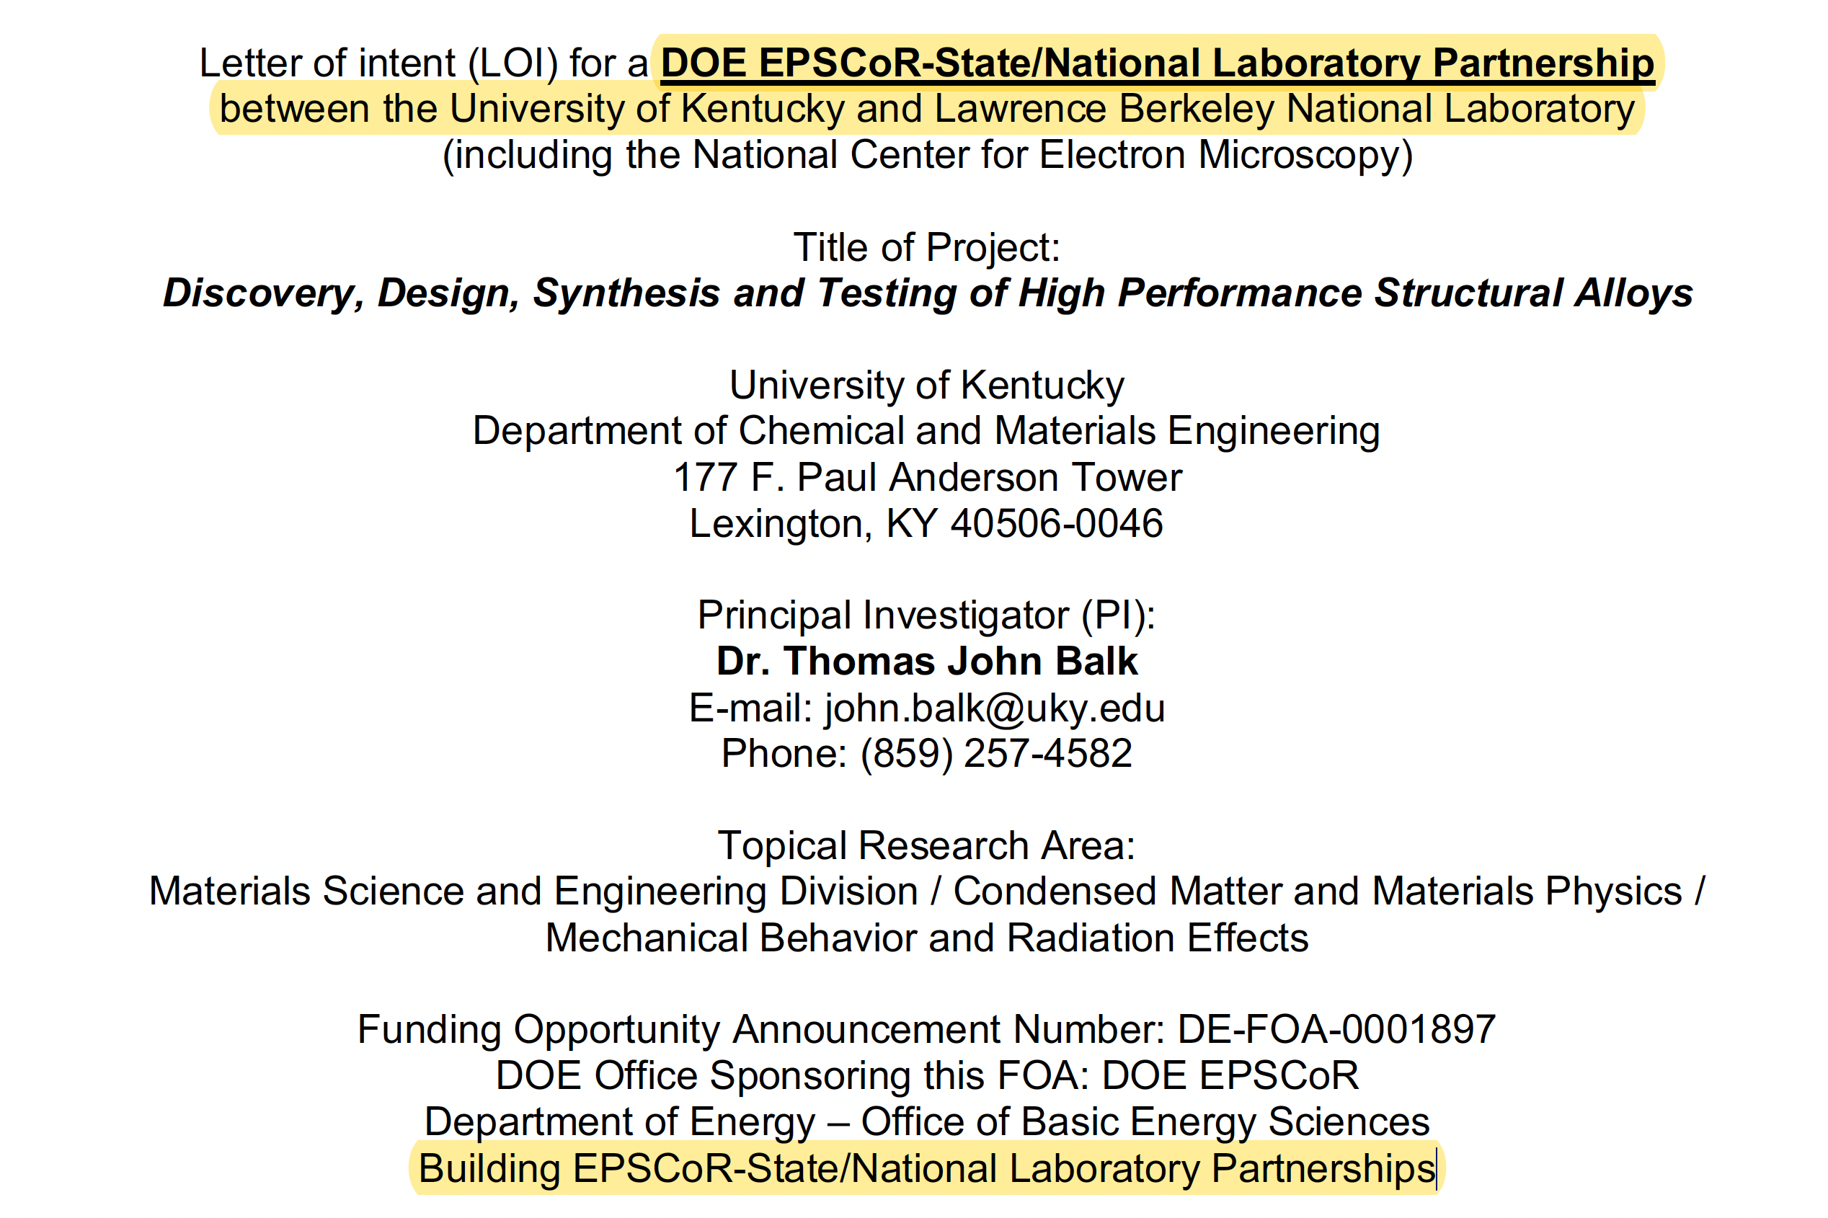
FOA and Identification of Research Area

Slide 3
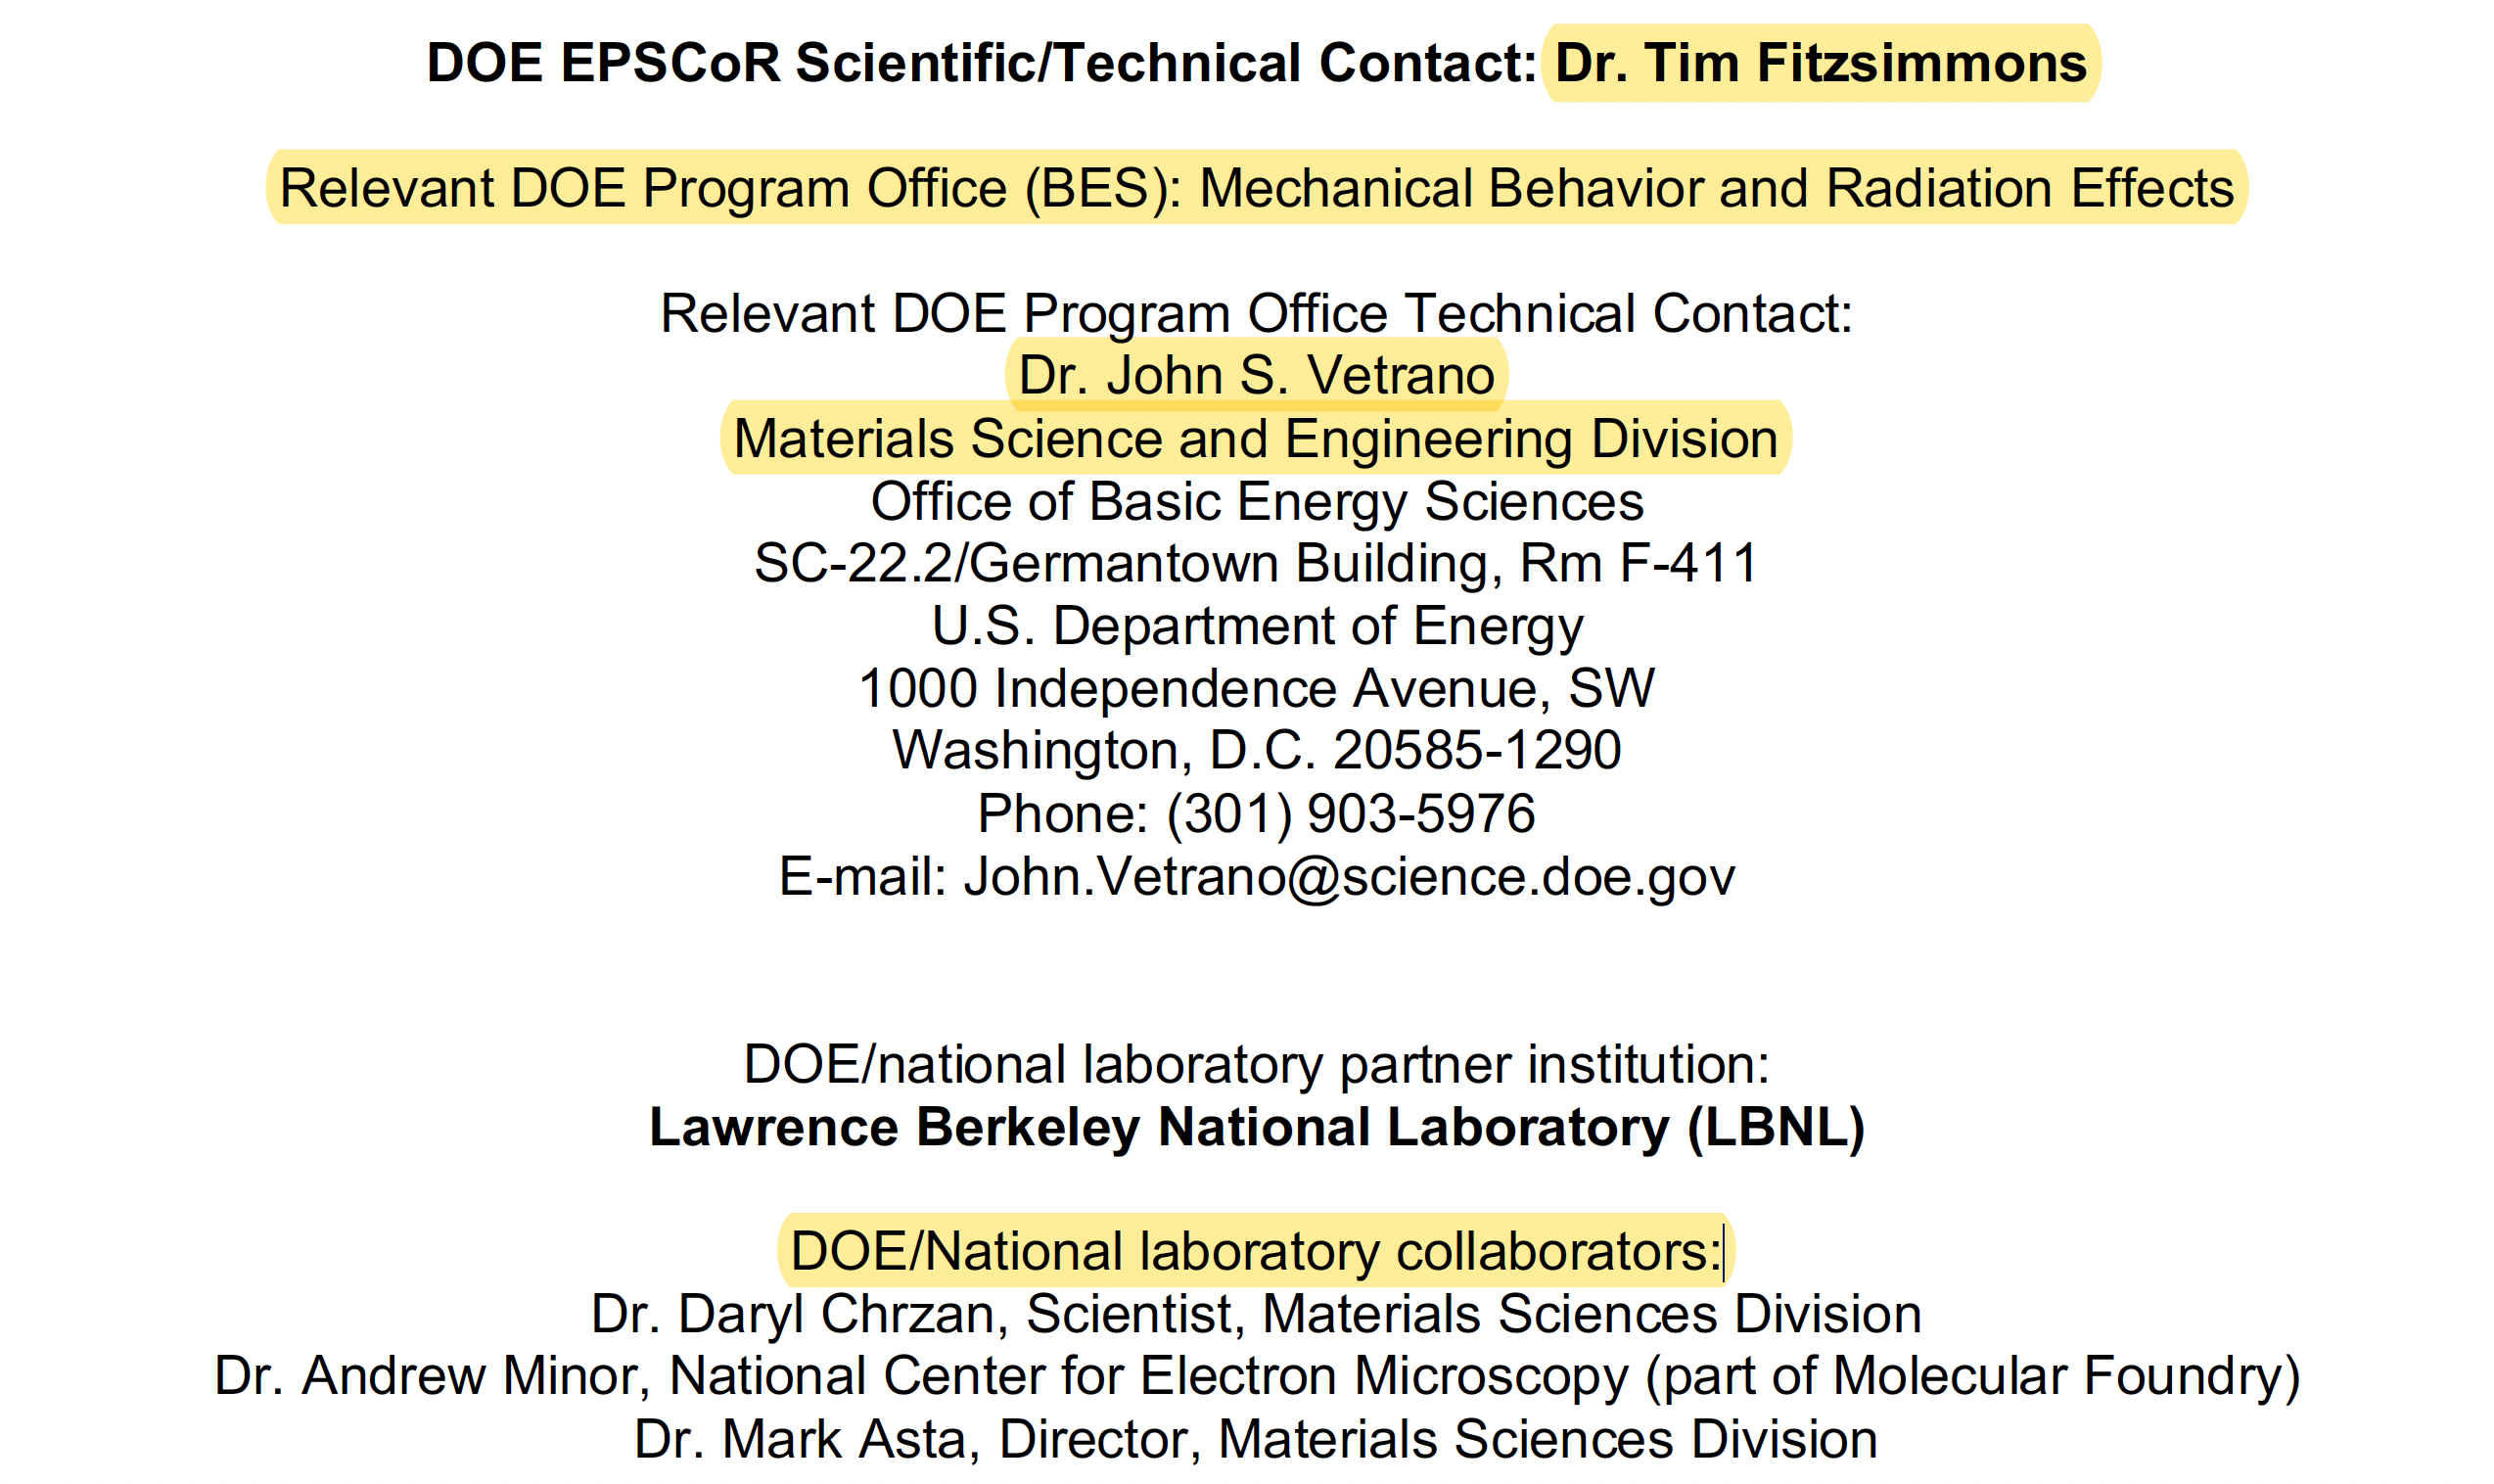
DOE Partnership and Collaborators

Slide 4
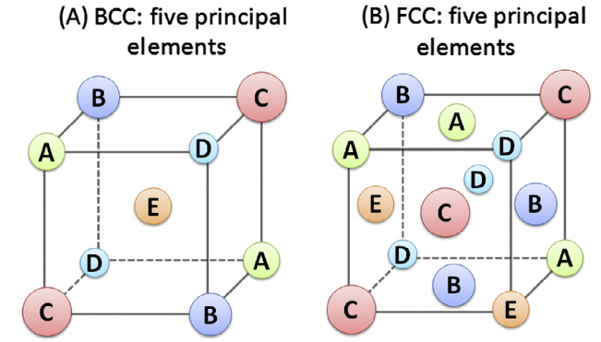
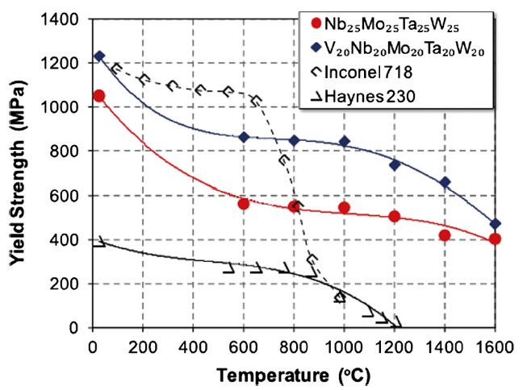
Multi-Principal Element Alloys (High Entropy Alloys)
Schematic depiction of substitutional solid solutions for high entropy alloys with BCC or FCC crystal structures
Elevated temperature strength of refractory HEAs, vs. traditional high-temperature superalloys
Yeh, et al., Formation of simple crystal structures in Cu-Co-Ni-Cr-Al-Fe-Ti-V alloys with multiprincipal metallic elements, Met Trans A 35A, p. 2533 (2004)
Senkov, et al., Mechanical properties of Nb₂₅Mo₂₅Ta₂₅W₂₅ and V₂₀Nb₂₀Mo₂₀Ta₂₀W₂₀ refractory high entropy alloys, Intermetallics 19, p. 698 (2011)

Slide 5
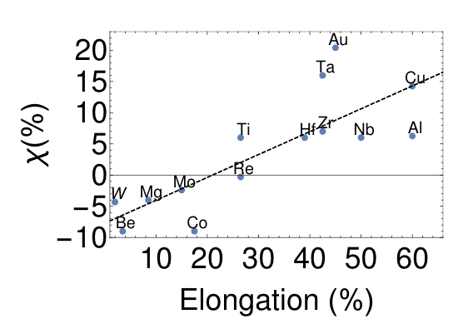
Collaboration with Chrzan, Asta, Minor (LBNL)
Ideal strength computations lend insight into bulk alloy properties.
For BCC metals, difference in strain between the tensile cleavage and shear elastic instabilities, χ≝ε_{c}-ε_{s}, correlates with the experimentally observed ductility of metals.
Extended the calculation to MPEAs, specifically TaNbVWMo, which is known to have a high melting point but is brittle under tension.
Refractory MPEA: TaNbVWMo
Computation indicates $χ=−8 \%$, i.e. alloy should be brittle. Replacing Mo with Nb raises $χ$ to 18%, suggesting that alloy can become more ductile by shifting its composition away from stoichiometry.
L. Qi, D. C. Chrzan, “Tuning Ideal Tensile Strengths and Intrinsic Ductility of bcc Refractory Alloys,” Physical Review Letters, 112, 115503 (2014)
Notes:
Chi (hard)

Slide 6
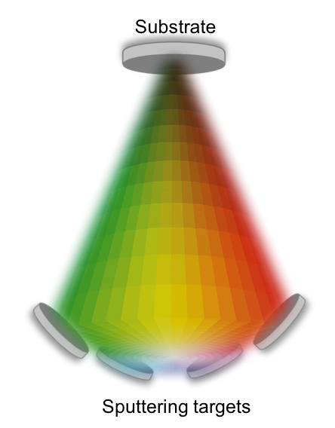
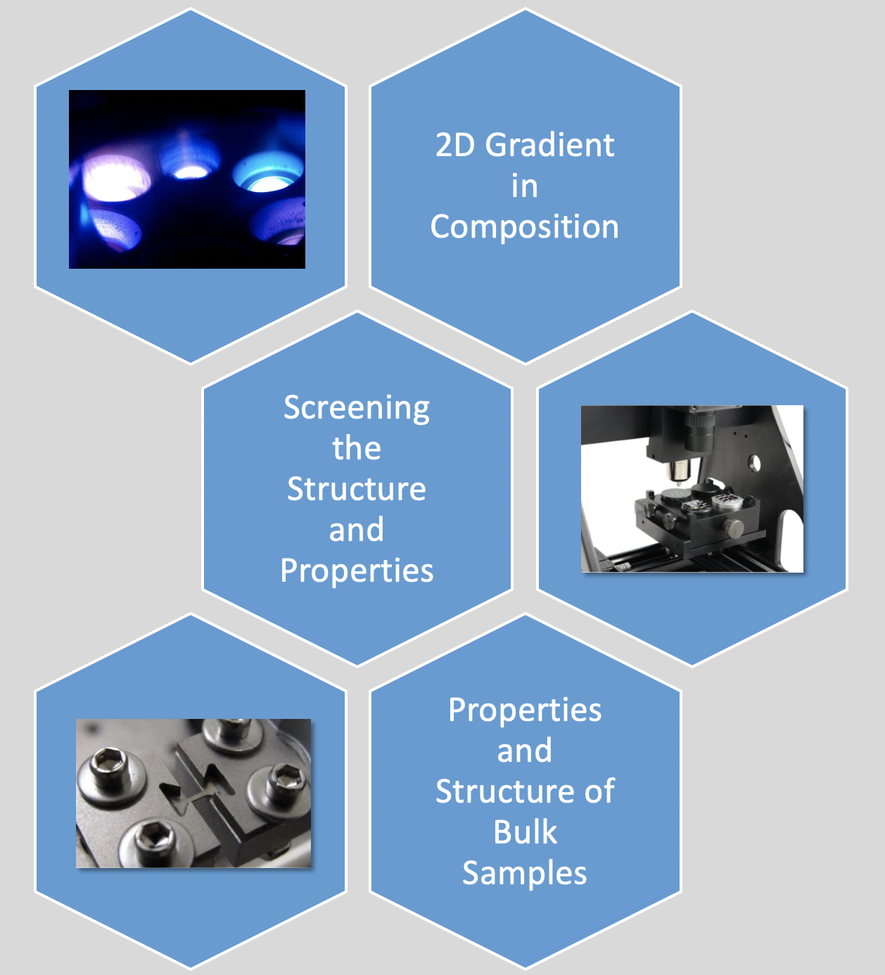
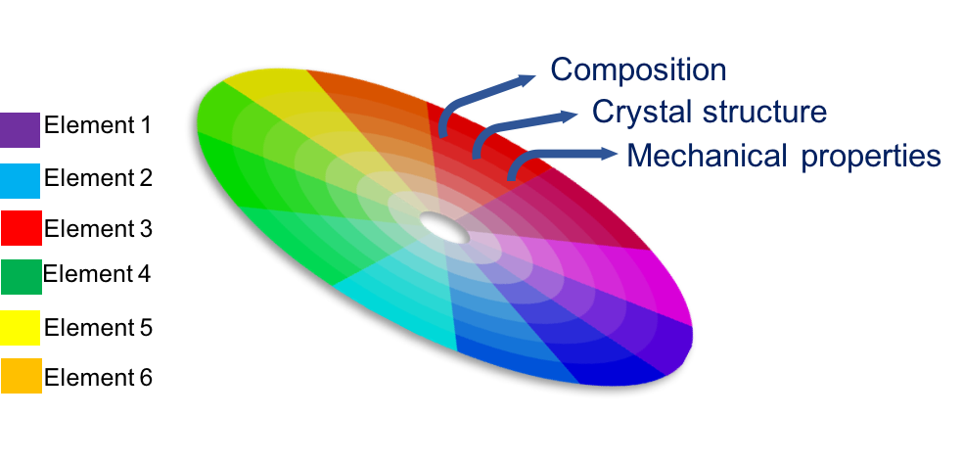
Combinatorial Screening with Thin Films
Color palette illustrates expected gradient in composition, phase and MPEA properties

Slide 7
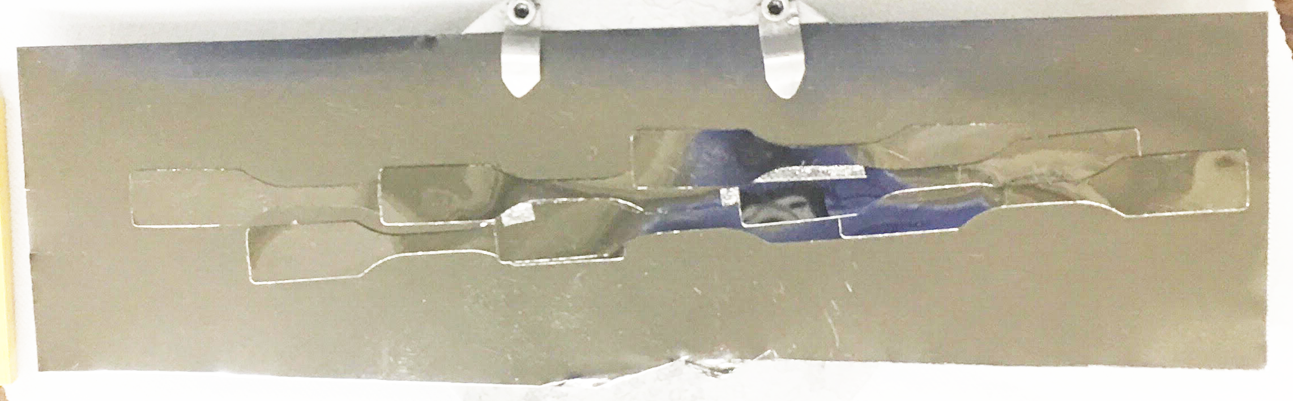
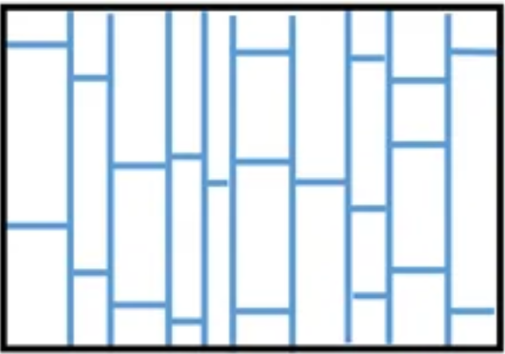
Tensile Deformation of Gradient Films – Fragmentation Test
Straining direction
22 cm
Gradient film on Kapton dogbone sample
Mo and Nb targets placed opposite each other
Uniaxial loading to achieve saturation crack spacing
Crack morphology can vary with changes in thickness, residual stress and film composition
Test Parameters:
Extension : 0.25 inch
Crosshead speed : 0.1 inch/min
Thickness of Kapton substrate : 125 μm
Thickness of film : ~370 nm
Similar thickness expected for all samples
Deposited at a pressure that minimizes film stress
T. Jörg et al., “Deformation behavior of Re alloyed Mo thin films on flexible substrates: In situ fragmentation analysis supported by first-principles calculations,” Scientific Reports, 7, 7374 (2017)

Slide 8
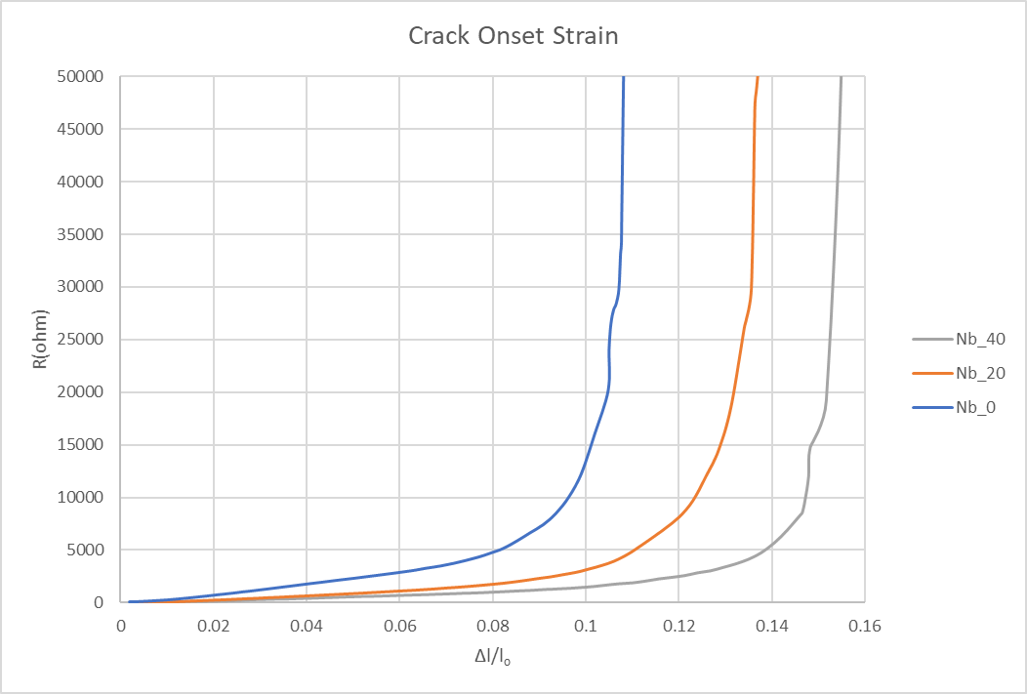
Niobium Enhancement of MPEA Ductility
Ω

Slide 9

Acknowledgment
The work was supported by the grant DE-SC0019402 funded by the U.S. Department of Energy, Office of Science.

Slide 10
Impact on Research Group
Support of three graduate students, including one who will complete his PhD this year
Established new research capabilities, including infrastructure for alloy fabrication
Built expertise in alloy development that has led to additional funding (Army Research Office)

Slide 11
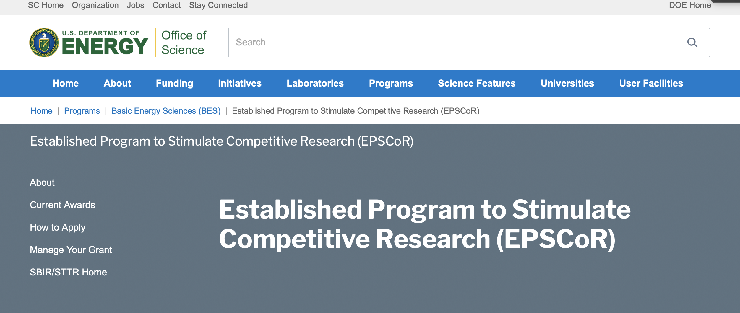
DOE EPSCoR: https://science.osti.gov/bes/epscor

Slide 12
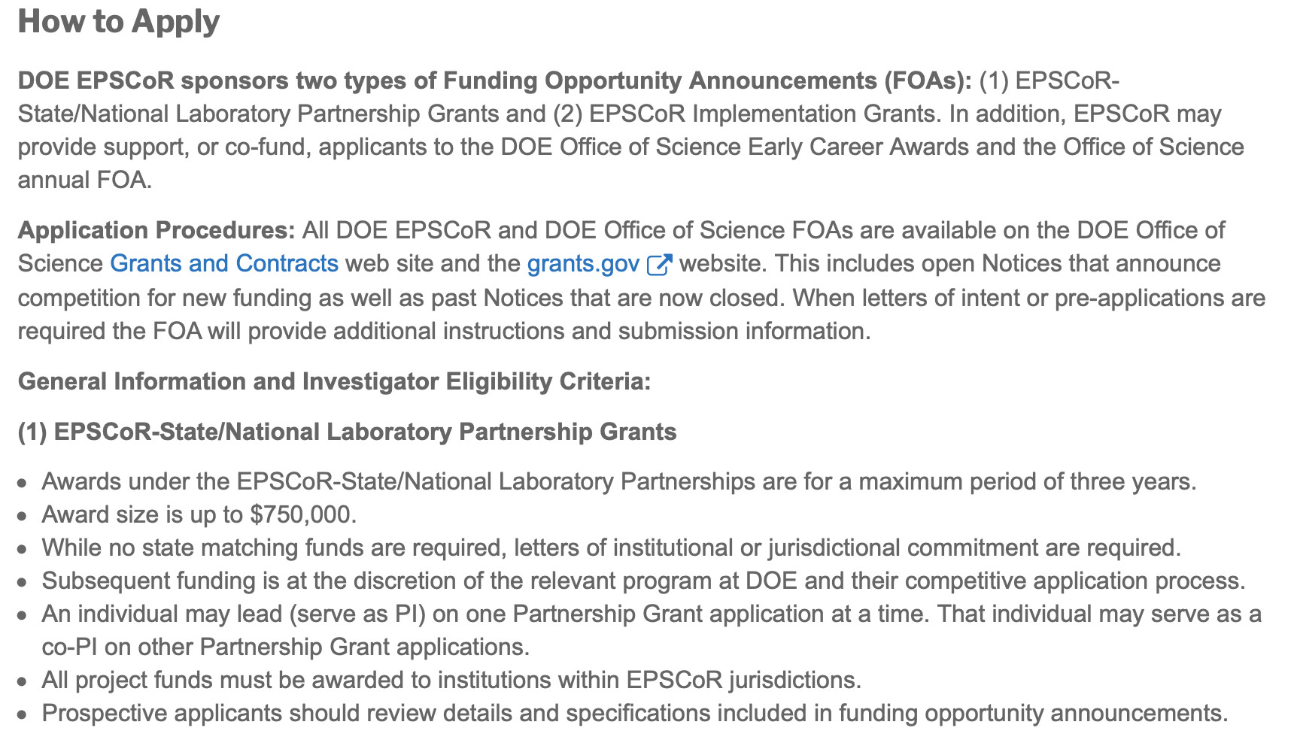
Applying for DOE EPSCoR Funding

Slide 13
DOE EPSCoR Funding Oppportunities
1. Implementation Grants
Up to $2,500,000 for three years with the possibility for a three-year extension
Build capacity in areas of interest to DOE
2. EPSCoR-State/National Laboratory Partnership Grants
Up to $250,000 per year for up to three years
Allows EPSCoR researchers to work closely with the DOE national laboratories
3. DOE Office of Science Early Career Awards
Consideration is limited to applications received from academic institutions in EPSCoR jurisdictions to the DOE Office of Science Early Career Award FOAs.
4. Office of Science Annual FOA
DOE Program Area/Office many nominate meritorious applications for joint funding consideration with DOE EPSCoR on a funds available basis
Dr. Timothy Fitzsimmons
Program Manager
U.S. Department of Energy
tim.fitzsimmons@science.doe.gov
https://www.epscorideafoundation.org/about/agencies/doe-epscor

